Slide 1
Proof-number search based solver for combinatorial games
Tomáš Čížek, Martin Balko, and Martin Schmid

Slide 2
Combinatorial game
A two-player game satisfying the following conditions:
Players alternate in their moves.
Finite, deterministic, and both players have perfect information.
Winning player based on the last move:
Normal play convention: no move loses.
Misère play convention: no move wins.
Impartial games – players have identical moves.
Partizan games – otherwise.

Slide 3
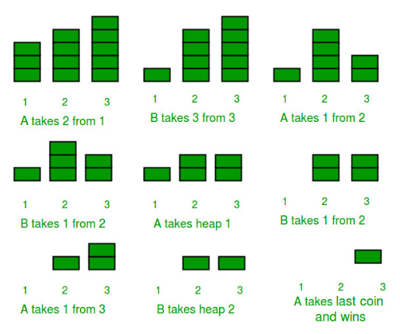
Impartial games + normal play convention
Nim game:
Starts with k heaps of sizes n₁, …, n_{k} ∈ ℕ₀.
Players alternate in removing objects from heaps.
The first player with no moves loses.
Nim is winning ⟺ n₁ ⊕ … ⊕ n_{k} ≠ 0.
https://www.geeksforgeeks.org/

Slide 4
Grundy numbers
Grundy number gn(G) ∈ ℕ₀, also called nimber, of a game G:
For terminal positions, gn(G) = 0.
For non-terminal positions, gn(G) = min ℕ₀ \ N, where N is a set of Grundy numbers of children of G.
Sprague—Grundy Theorem:
Every impartial game G under the normal play convention is equivalent to a single Nim heap with gn(G) objects.

Slide 5
Sprouts game
An impartial game with simple rules:
Starts with n initial spots.
Players alternate in connecting spots by curves (cycles are allowed).
Curves cannot cross.
A new spot is added along a newly drawn curve.
Each spot can be incident to at most three curves.
The first player with no move loses.

Slide 6
Sprouts game
An impartial game with simple rules:
Starts with n initial spots.
Players alternate in connecting spots by curves (cycles are allowed).
Curves cannot cross.
A new spot is added along a newly drawn curve.
Each spot can be incident to at most three curves.
The first player with no move loses.

Slide 7
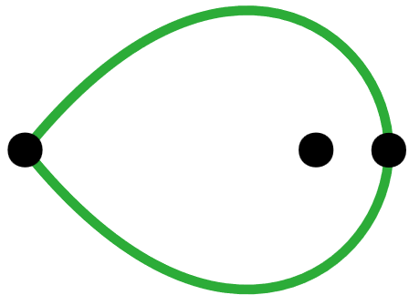
Sprouts game
An impartial game with simple rules:
Starts with n initial spots.
Players alternate in connecting spots by curves (cycles are allowed).
Curves cannot cross.
A new spot is added along a newly drawn curve.
Each spot can be incident to at most three curves.
The first player with no move loses.

Slide 8
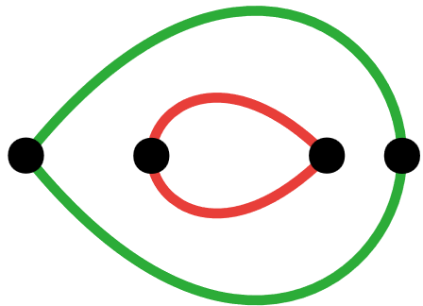
Sprouts game
An impartial game with simple rules:
Starts with n initial spots.
Players alternate in connecting spots by curves (cycles are allowed).
Curves cannot cross.
A new spot is added along a newly drawn curve.
Each spot can be incident to at most three curves.
The first player with no move loses.

Slide 9
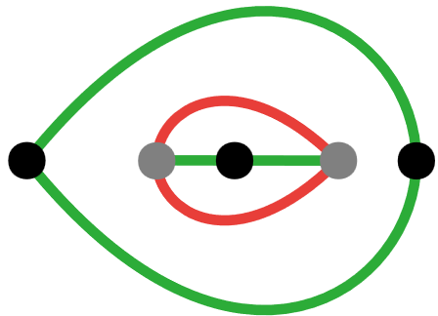
Sprouts game
An impartial game with simple rules:
Starts with n initial spots.
Players alternate in connecting spots by curves (cycles are allowed).
Curves cannot cross.
A new spot is added along a newly drawn curve.
Each spot can be incident to at most three curves.
The first player with no move loses.

Slide 10
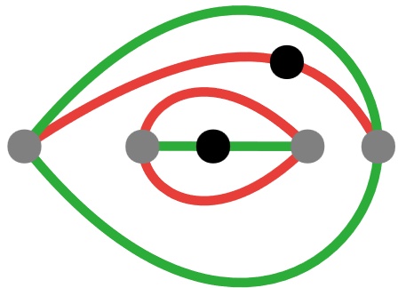
Sprouts game
An impartial game with simple rules:
Starts with n initial spots.
Players alternate in connecting spots by curves (cycles are allowed).
Curves cannot cross.
A new spot is added along a newly drawn curve.
Each spot can be incident to at most three curves.
The first player with no move loses.

Slide 11
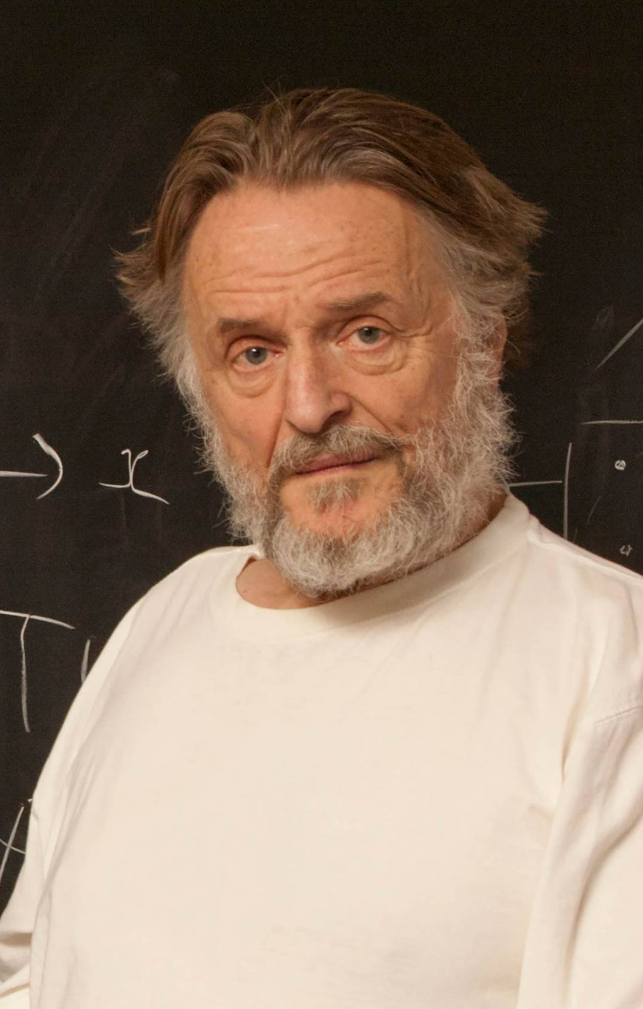
The early beginnings
Designed by British mathematicians J. Conway and M. Paterson in 1967.
Easy to play, difficult to analyze.
Many attempts to determine outcomes of Sprouts positions with n initial spots under the perfect play (weak solutions).
www.princeton.edu
www.alchetron.com/Mike-Paterson

Slide 12
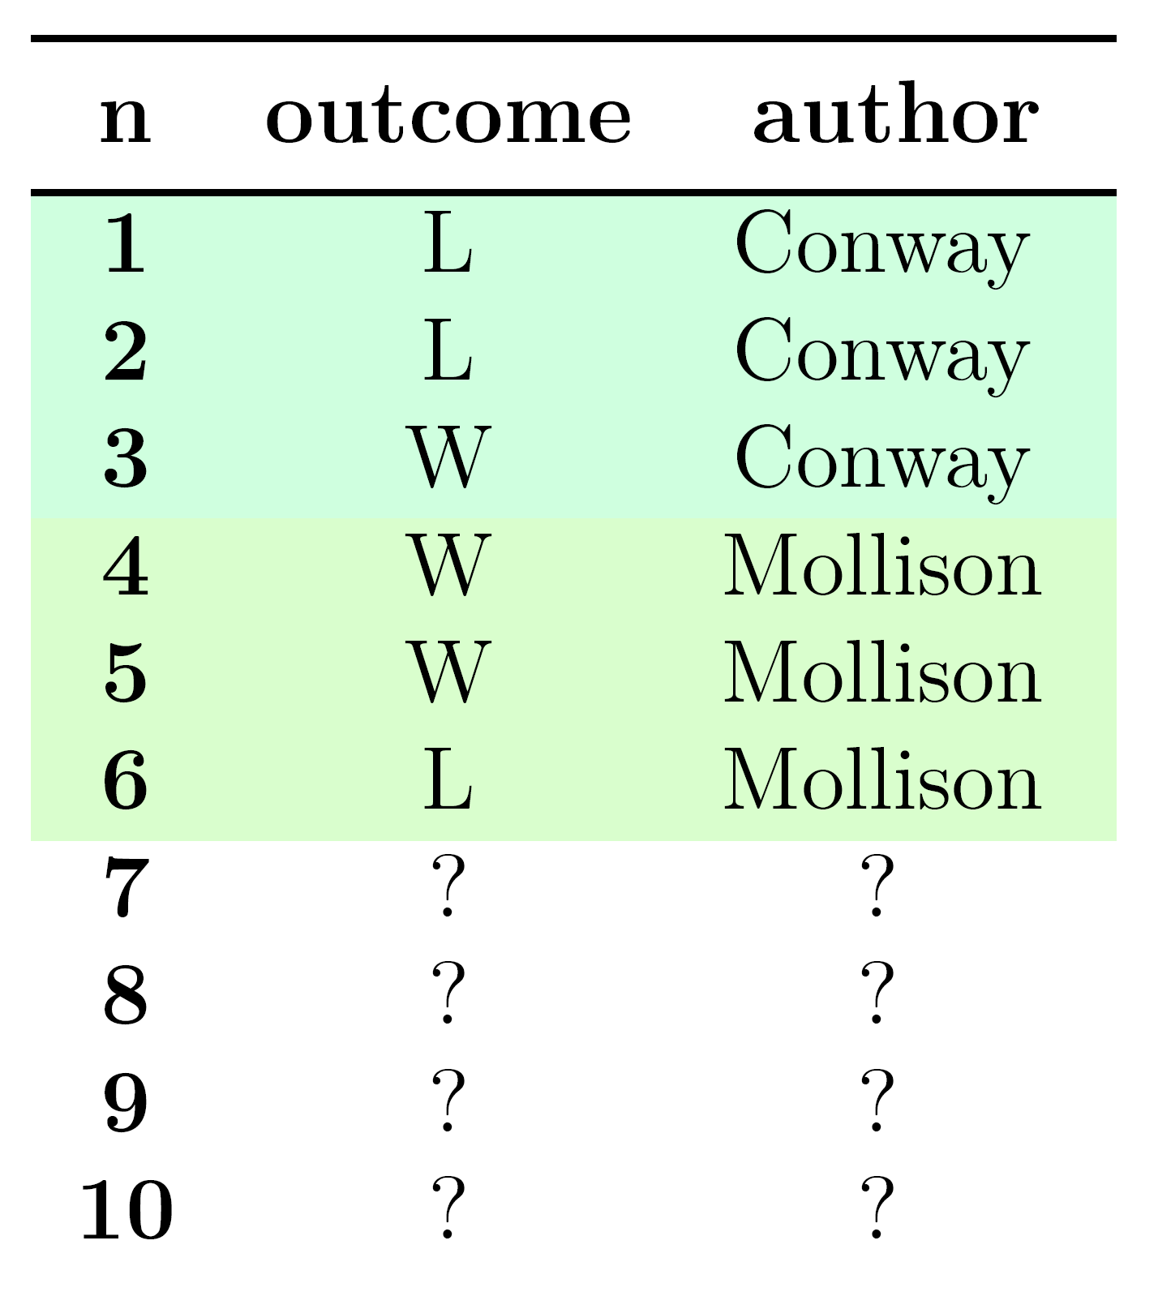
The early beginnings
Designed by British mathematicians J. Conway and M. Paterson in 1967.
Easy to play, difficult to analyze.
Many attempts to determine outcomes of Sprouts positions with n initial spots under the perfect play (weak solutions).

Slide 13
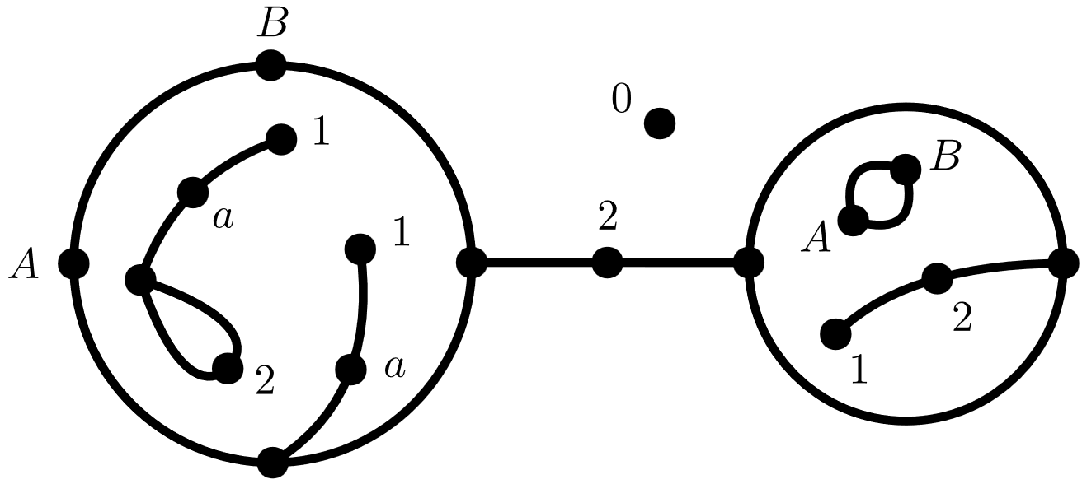
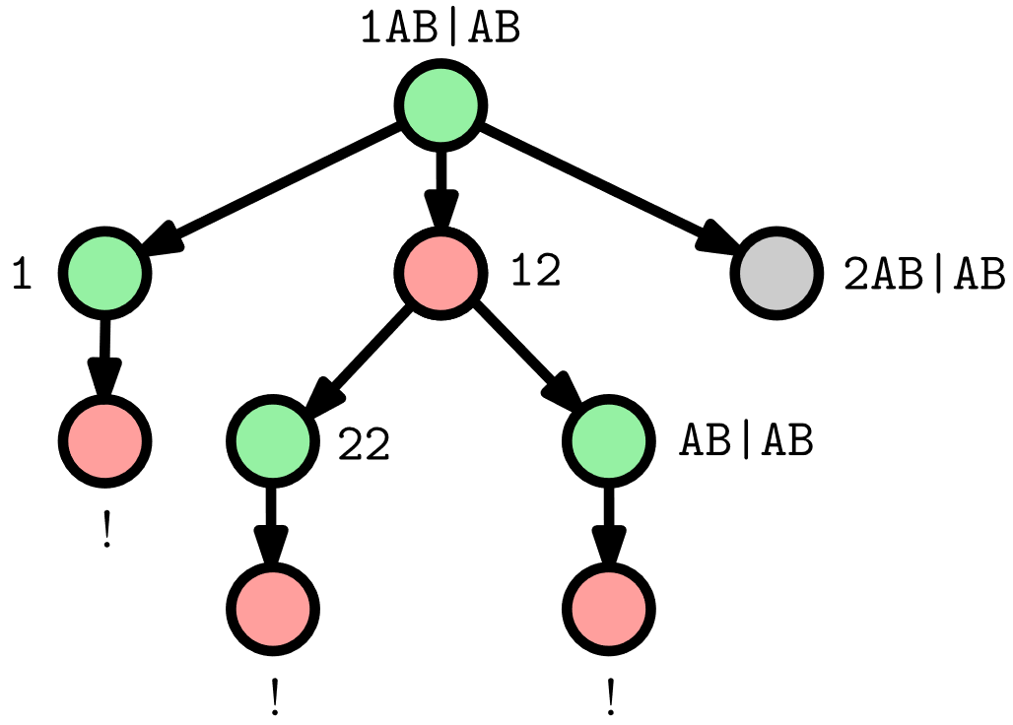
Searching trees computationally
Applegate, Jacobson, and Sleator (1991) [1] created the first computer solver for Sprouts.
A necessity of a state representation (planar embeddings).
Using a simple Alpha-Beta pruning for search.
0.2AB|1a2a.1aABa+12.AB|AB

Slide 14
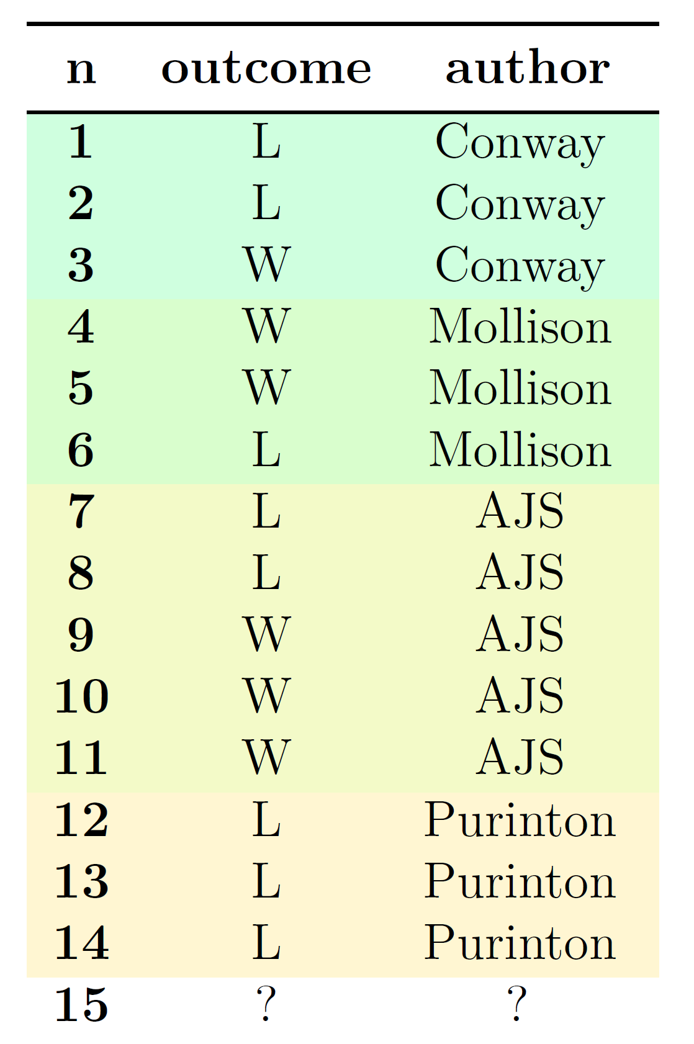
Searching trees computationally
Applegate, Jacobson, and Sleator (1991) [1] created the first computer solver for Sprouts.
A necessity of a state representation (planar embeddings).
Using a simple Alpha-Beta pruning for search.
The famous Sprouts conjecture was formed.
n-spot position is winning ↔ n ≡ 3, 4, 5 (mod 6).

Slide 15
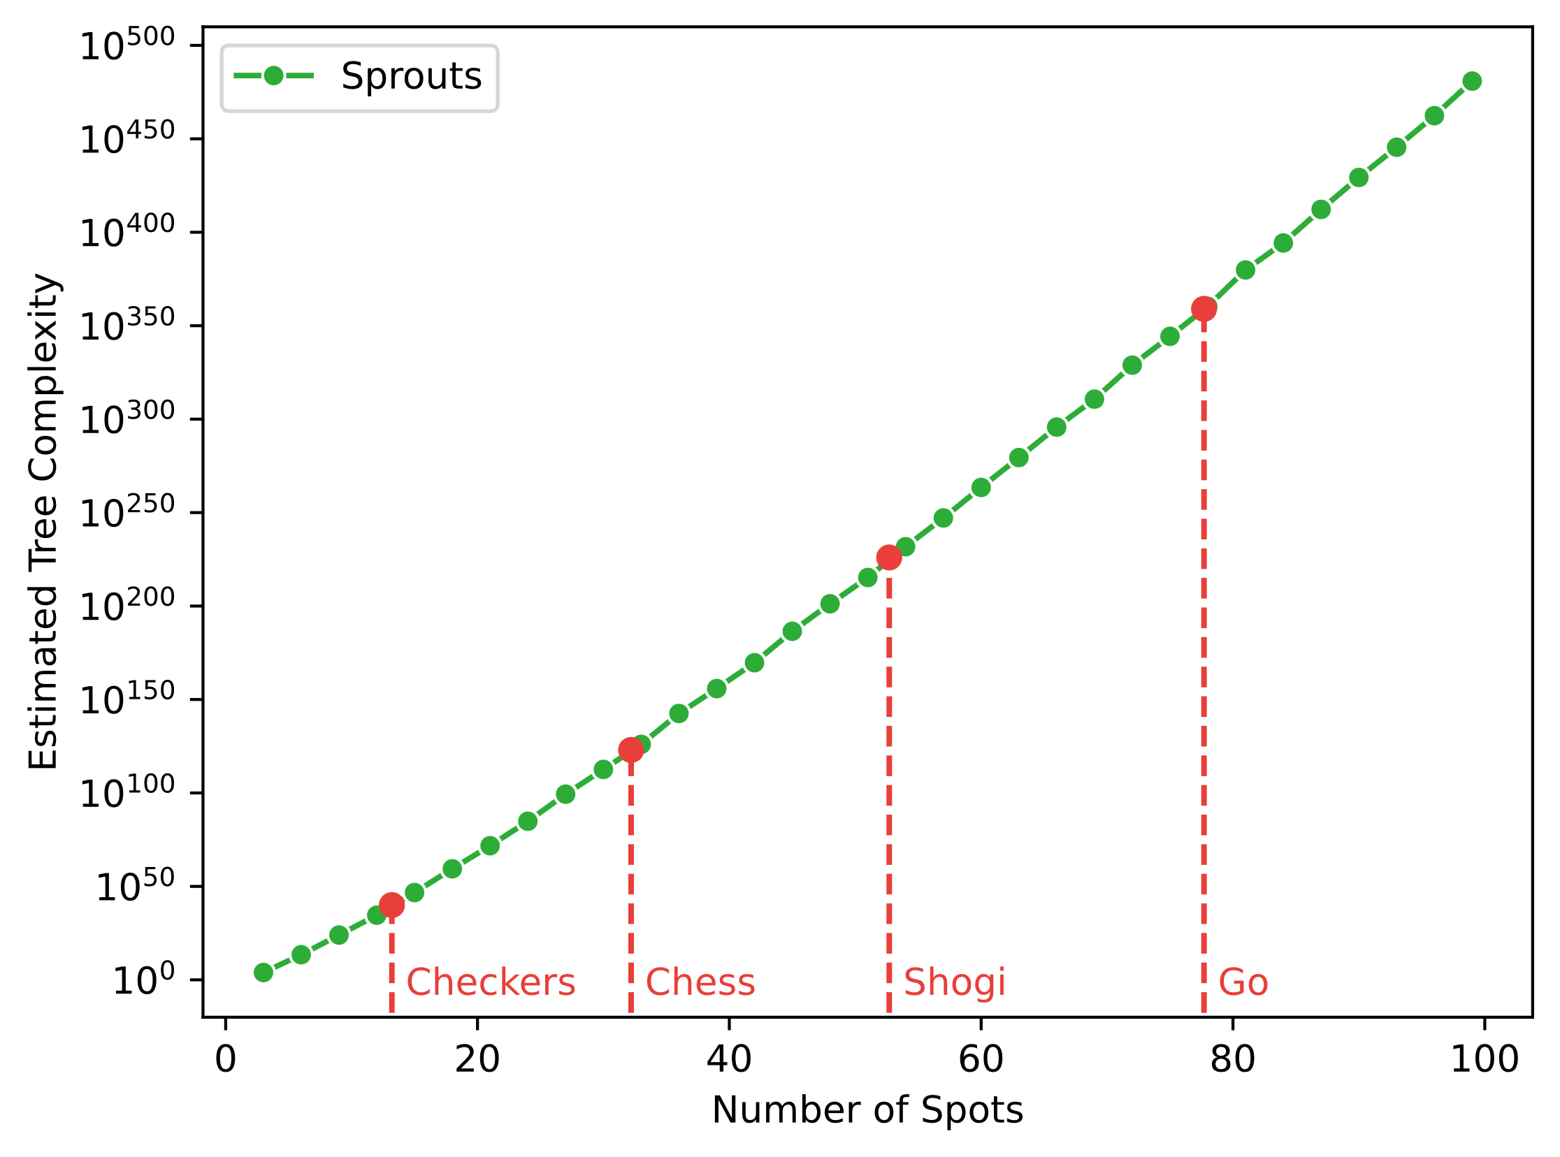
Game trees grow extremely fast

Slide 16
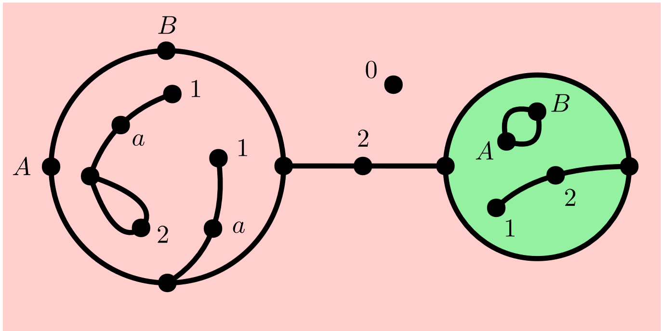
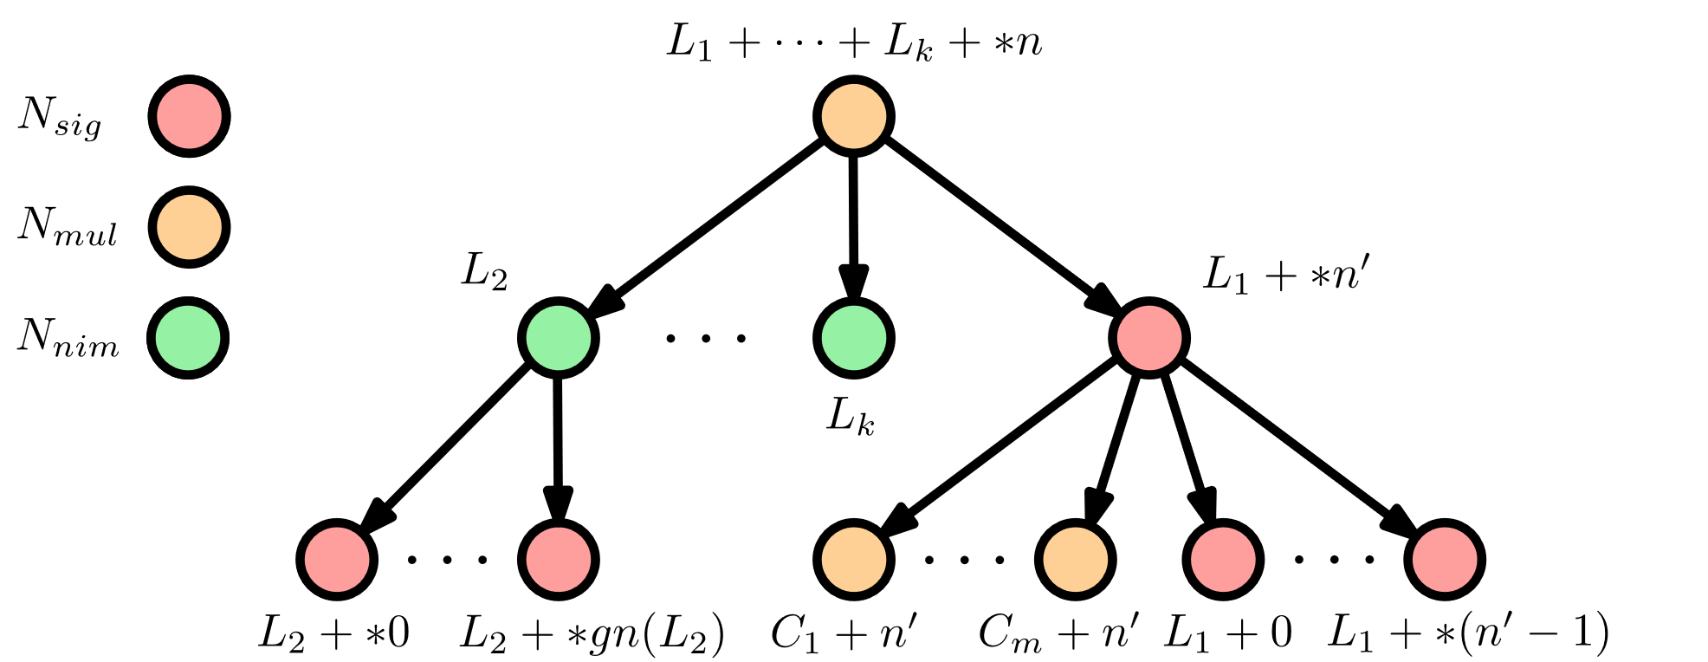
Grundy numbers
Lemoine and Viennot (2007) [2] introduced a solver Glop utilizing the Sprague–Grundy theorem.
Analyze independent parts (lands) separately:
Compute Grundy number gn(L) for each land L.
gn(L₁ + L₂) = gn(L₁) ⊕ gn(L₂).
L₁ + L₂ is loss ⟺ gn(L) = 0.
→ More complicated NAND trees with Grundy numbers.

Slide 17
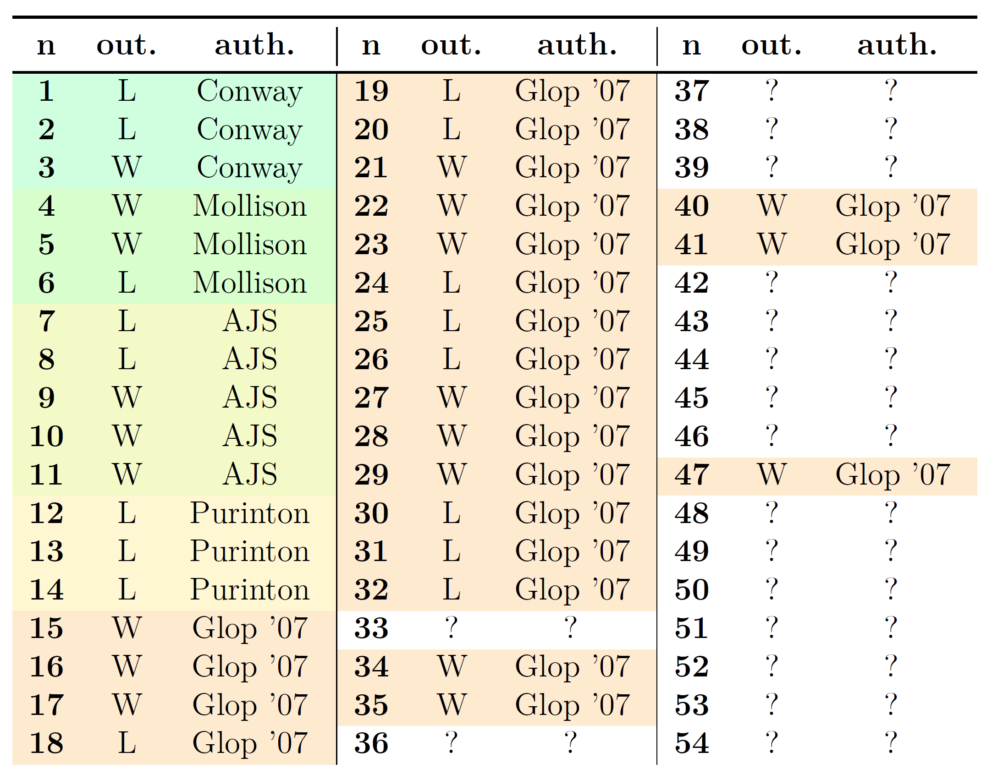
Grundy numbers
Lemoine and Viennot (2007) [2] introduced a solver Glop utilizing the Sprague–Grundy theorem.
Analyze independent parts (lands) separately:
Compute Grundy number gn(L) for each land L.
gn(L₁ + L₂) = gn(L₁) ⊕ gn(L₂).
L₁ + L₂ is loss ⟺ gn(L) = 0.
→ More complicated NAND trees with Grundy numbers.

Slide 18
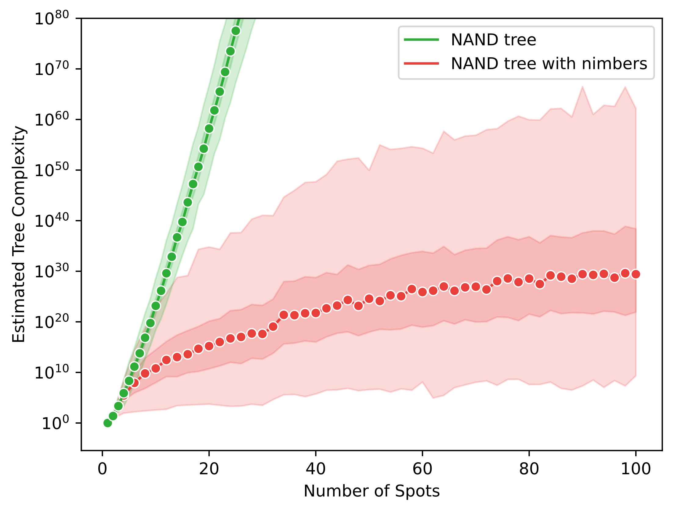
Largely imbalanced game trees

Slide 19
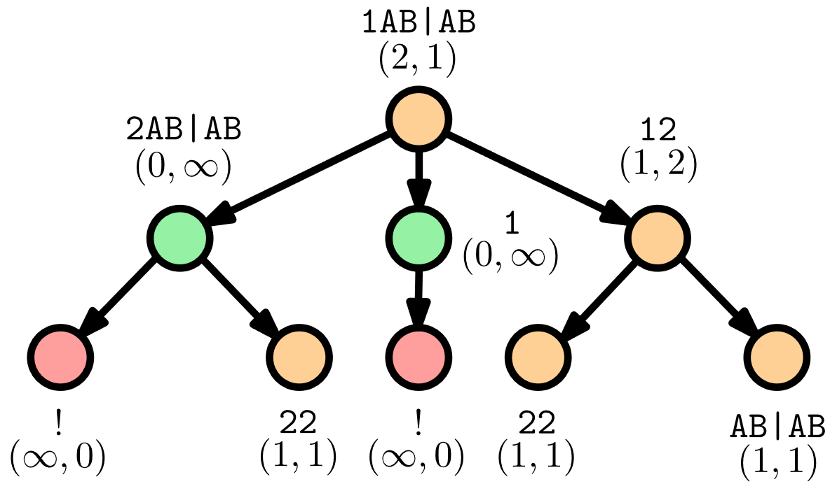
Proof-number search
Alpha-beta pruning can get stuck in difficult subtrees if the heuristic was wrong.
Explore subtrees with potentially shortest proof → Proof-number search (PNS) [4]:
Each node N is associated with a proof number pn(N) and a disproof number dn(N).
Initialized heuristically in leaves.
Aggregated from children in expanded nodes.
Expand the most-proving node (MPN) and update.
Must be adapted for NAND trees with Grundy numbers!

Slide 20
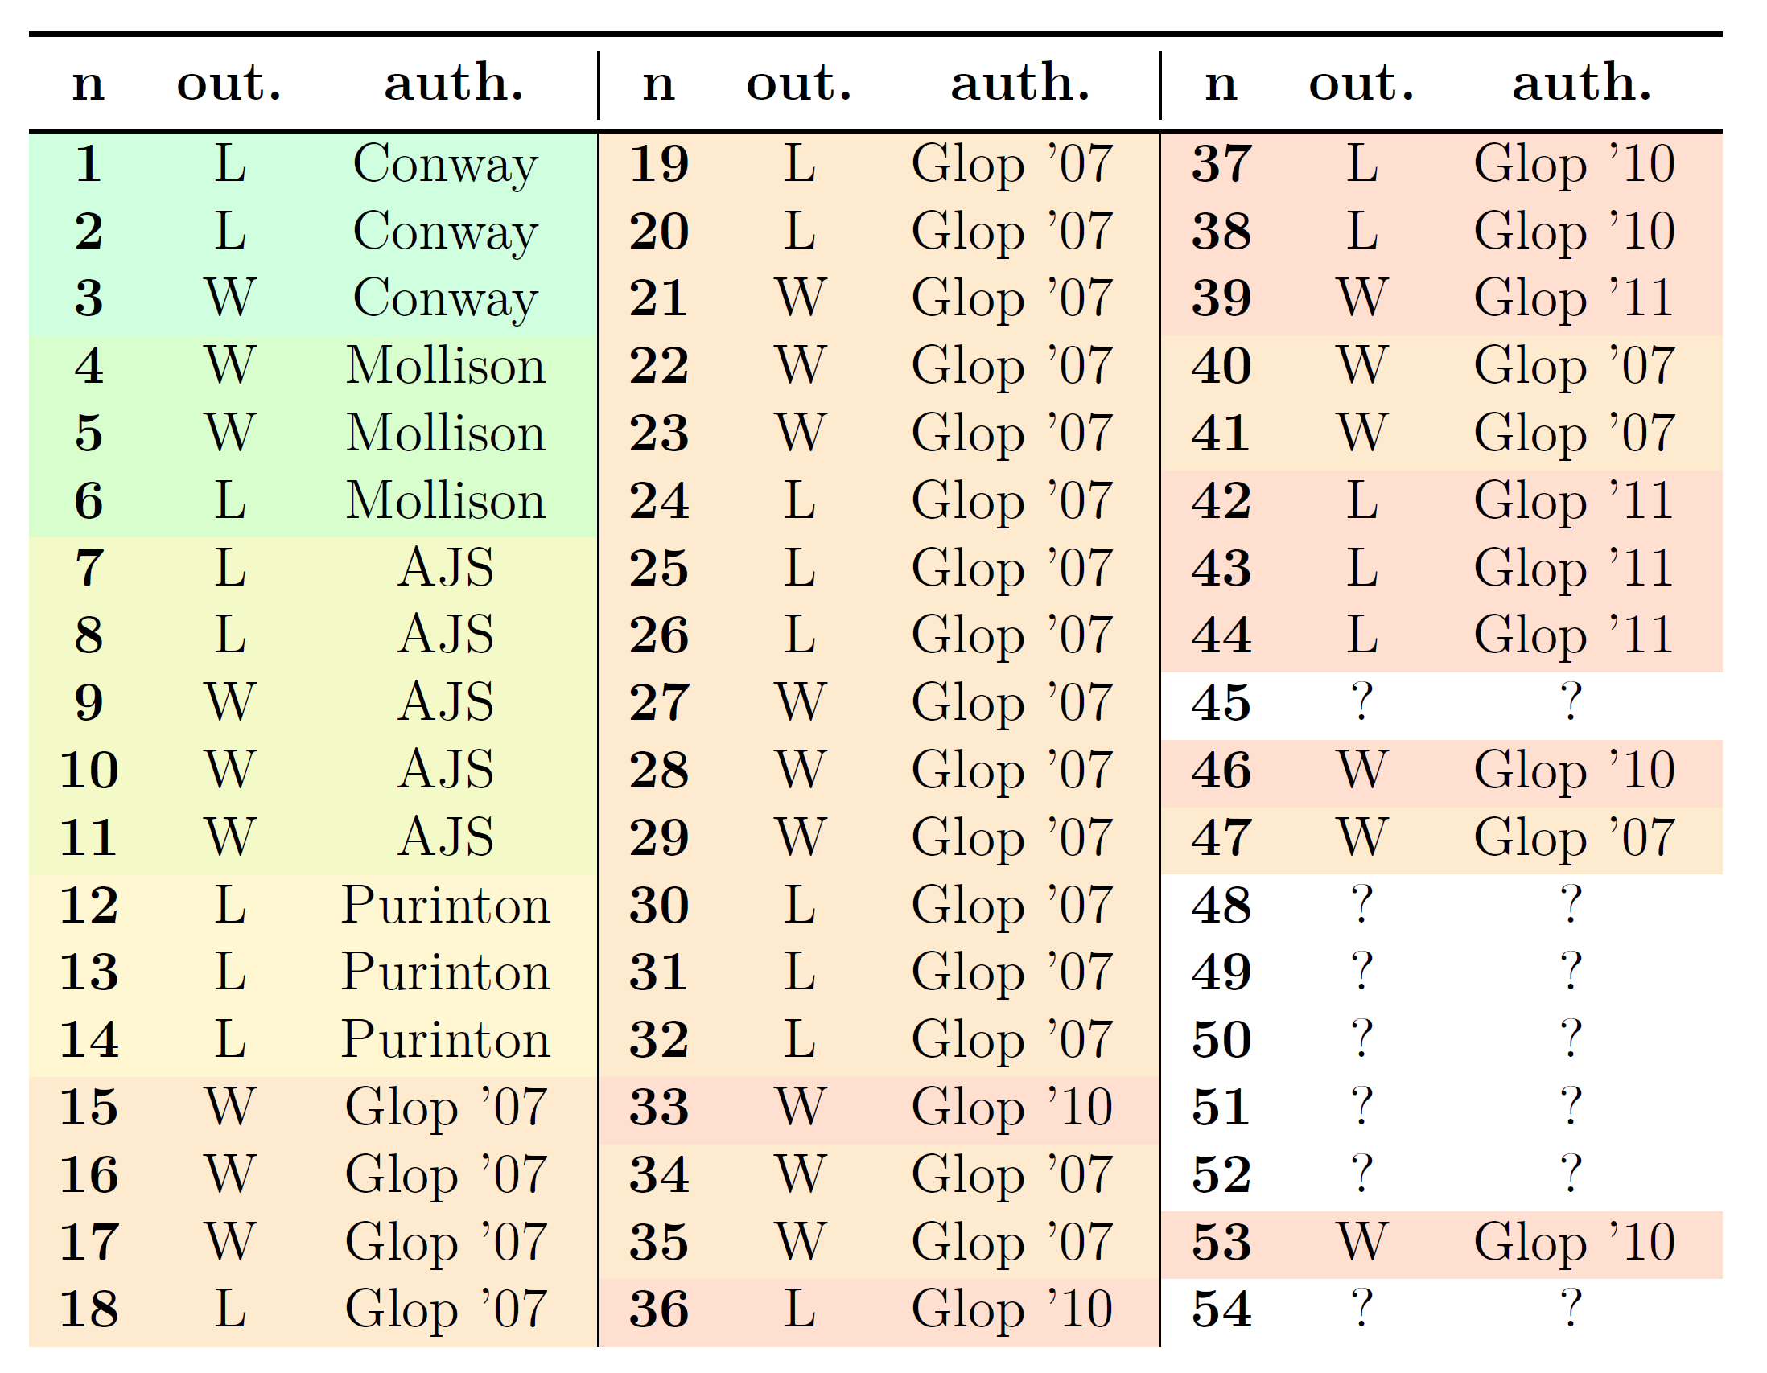
Proof-number search
Alpha-beta pruning can get stuck in difficult subtrees if the heuristic was wrong.
Explore subtrees with potentially shortest proof → Proof-number search (PNS) [4]:
Each node N is associated with a proof number pn(N) and a disproof number dn(N).
Initialized heuristically in leaves.
Aggregated from children in expanded nodes.
Expand the most-proving node (MPN) and update.
Must be adapted for NAND trees with Grundy numbers!

Slide 21
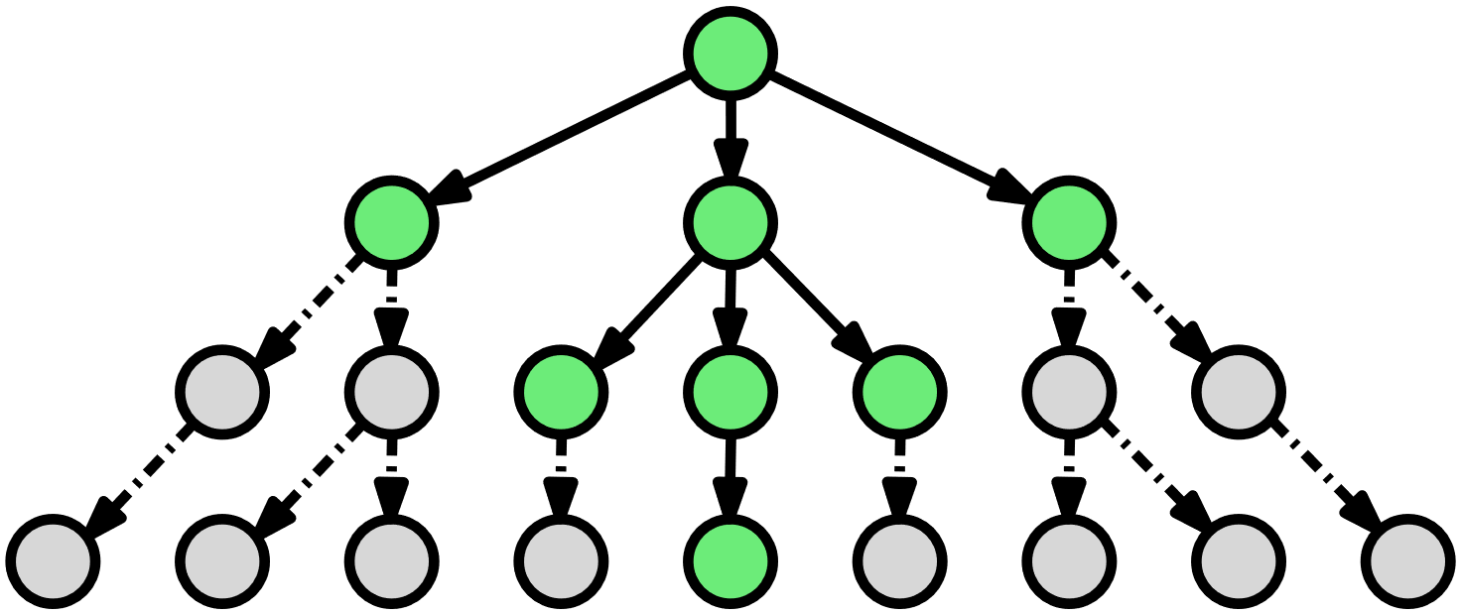
Depth-first Proof-number search
The space complexity of PNS is too large (the whole tree is stored in memory).
Depth-first Proof-number search (df-pn) [5]:
A recursive and memory-efficient variant of PNS (logarithmic space complexity).
Two thresholds pt(N_{curr}) and dt(N_{curr}) to guarantee MPN in the subtree of N_{curr}.
Combined with a transposition table (replacing policy) and a nimber database.

Slide 22
Depth-first Proof-number search
The space complexity of PNS is too large (the whole tree is stored in memory).
Depth-first Proof-number search (df-pn) [5]:
A recursive and memory-efficient variant of PNS (logarithmic space complexity).
Two thresholds pt(N_{curr}) and dt(N_{curr}) to guarantee MPN in the subtree of N_{curr}.
Combined with a transposition table (replacing policy) and a nimber database.
The update rules for N_{next}:

Slide 23
Depth-first Proof-number search
The space complexity of PNS is too large (the whole tree is stored in memory).
Depth-first Proof-number search (df-pn) [5]:
A recursive and memory-efficient variant of PNS (logarithmic space complexity).
Two thresholds pt(N_{curr}) and dt(N_{curr}) to guarantee MPN in the subtree of N_{curr}.
Combined with a transposition table (replacing policy) and a nimber database.
Extended update rules for N_{next} with Grundy numbers:

Slide 24
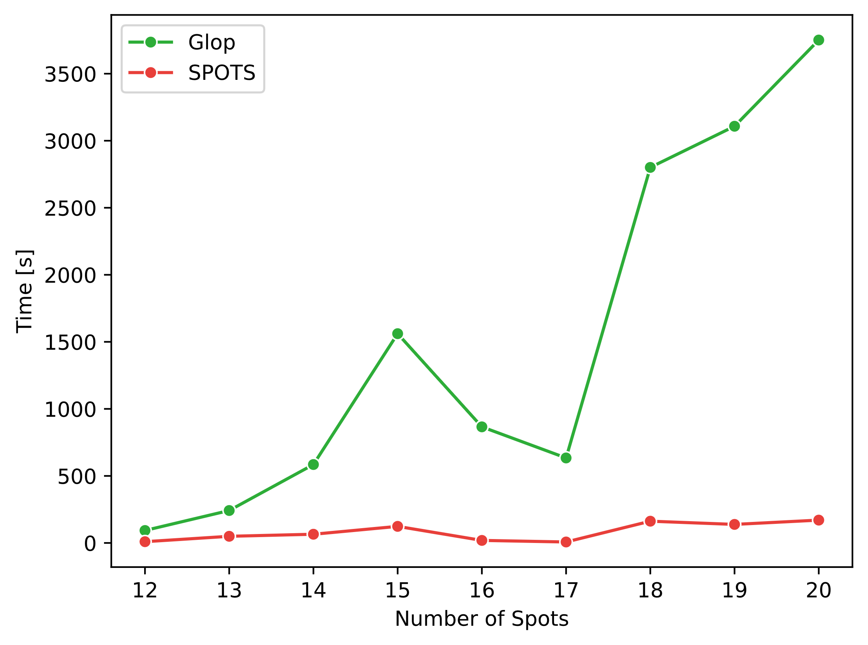
Our sequential solver SPOTS
Approximately 18 times faster than Glop + memory advantageous df-pn.

Slide 25
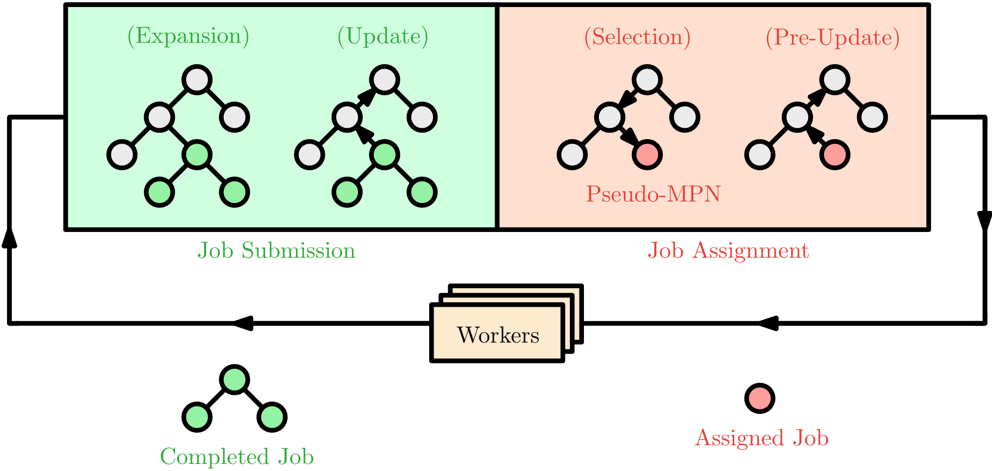
Parallel Proof-number search
Adapting PNS for large computational cluster with distributed memory.
Master-workers scheme:

Slide 26
1st improvement — share results
Share Grundy numbers with other workers to prevent search overhead:
Small number – no additional communication overhead.
Highly reusable – a land may occur in many positions.

Slide 27
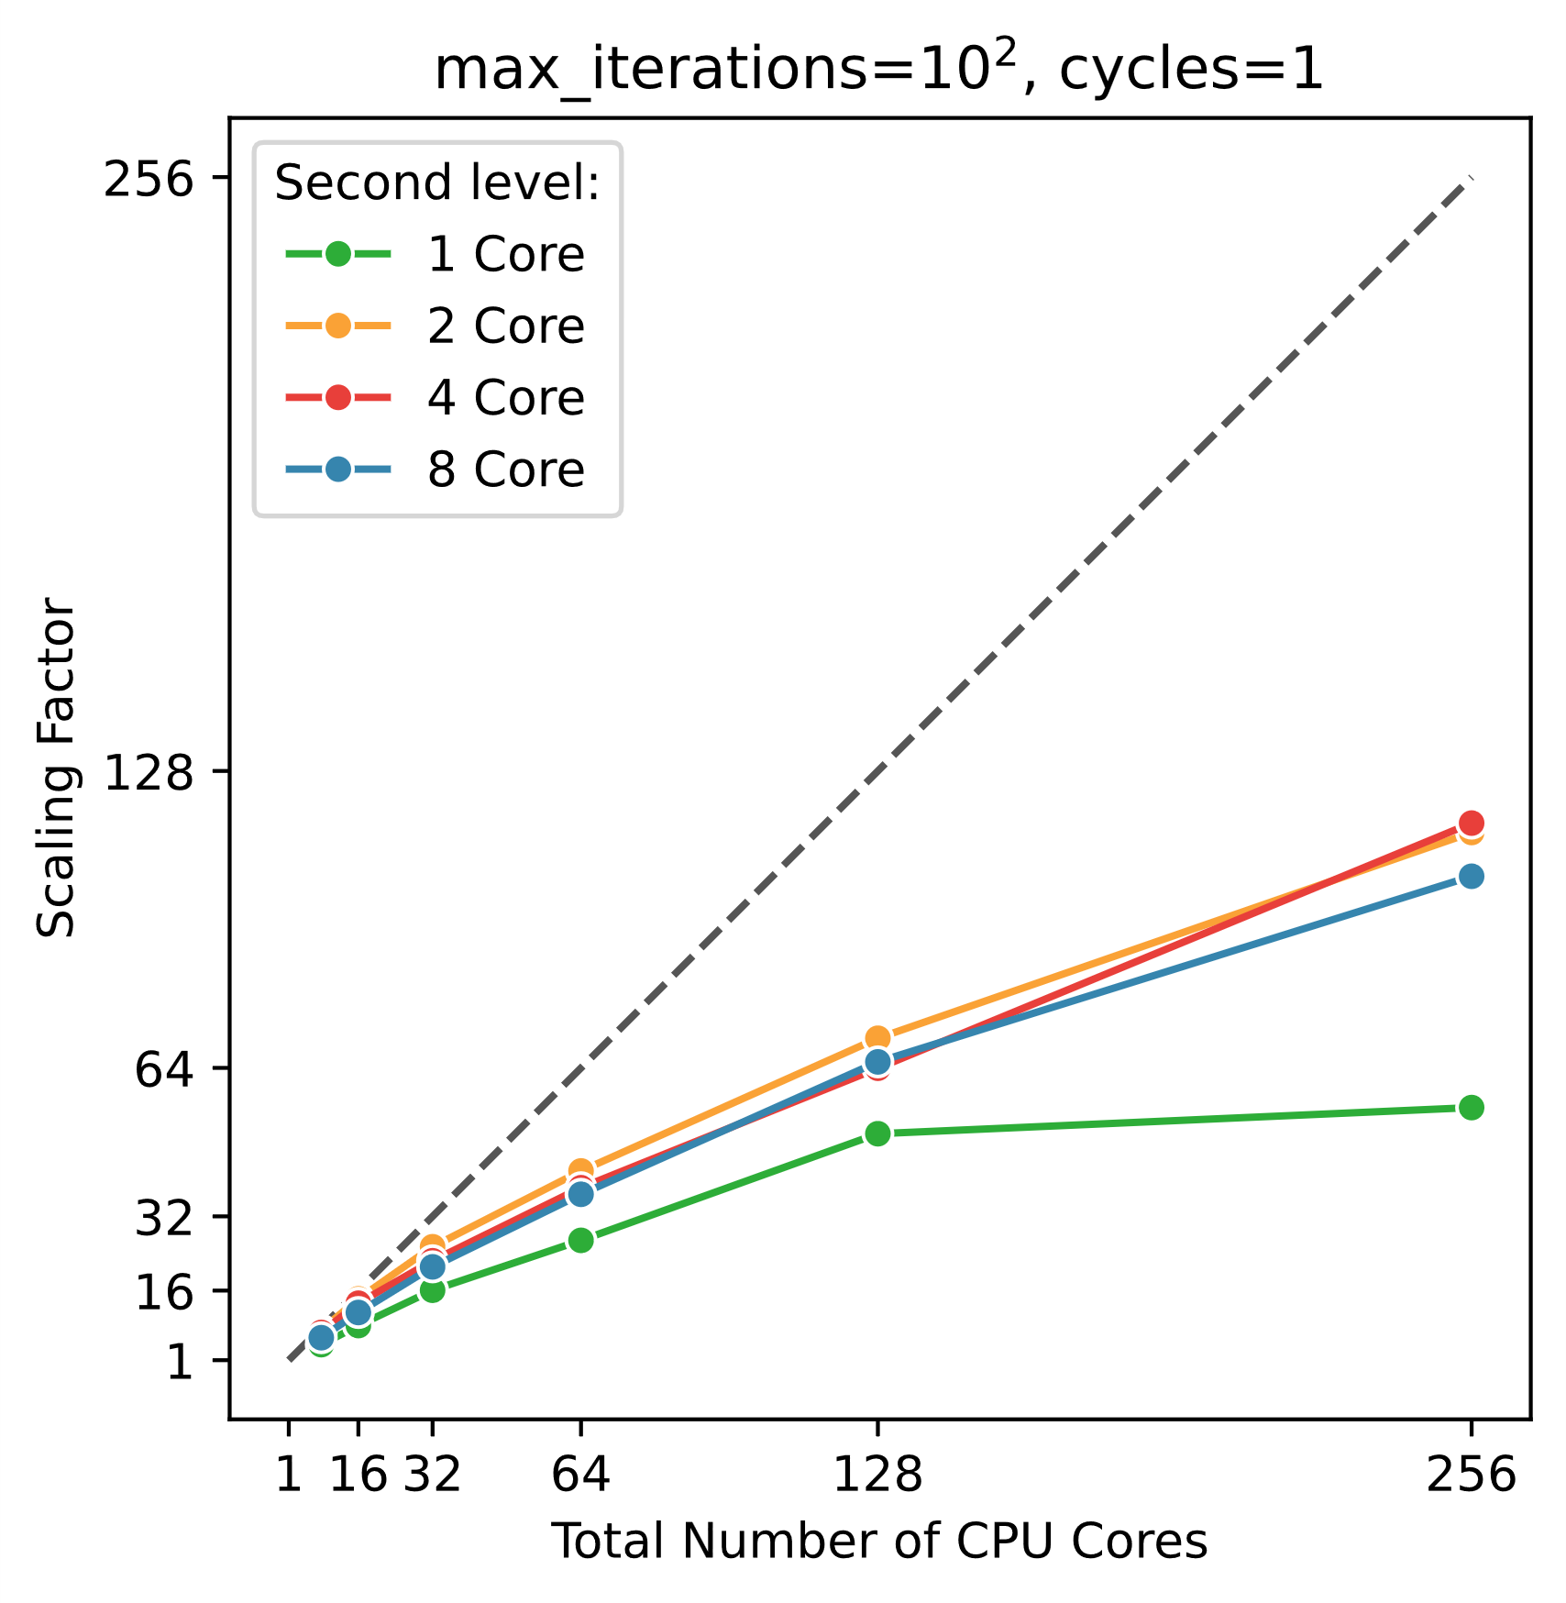
2nd improvement — P²PNS
Parallelize the workers themselves rather than adding more of them:
Reduced communication overhead, more relevant work, local memory utilization.

Slide 28
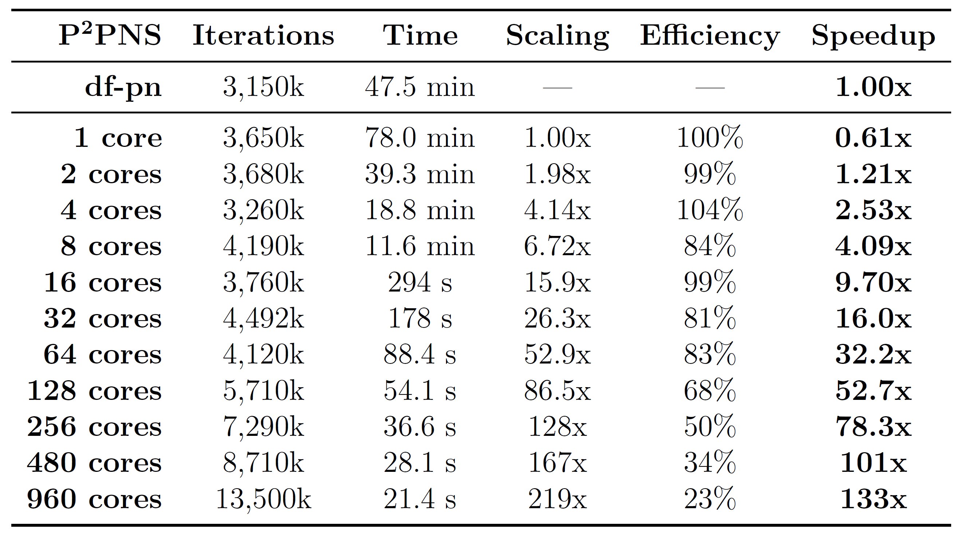
Scaling efficiency of P²PNS
Reaching roughly 100x speedup (480 cores) compared to the sequential df-pn.
Much better scaling efficiency than other parallel PNS:
Current PPN² search [6]
35% on 32 CPU cores
Our P²PNS
34% on 480 CPU cores
→ Addresses the scaling problem of PNS posed by Kishimoto et al. [7].

Slide 29
Resulting solver
SPOTS roughly 2800x faster (480 cores) than Glop.
→ 1 day of SPOTS ≈ 8 years of Glop

Slide 30
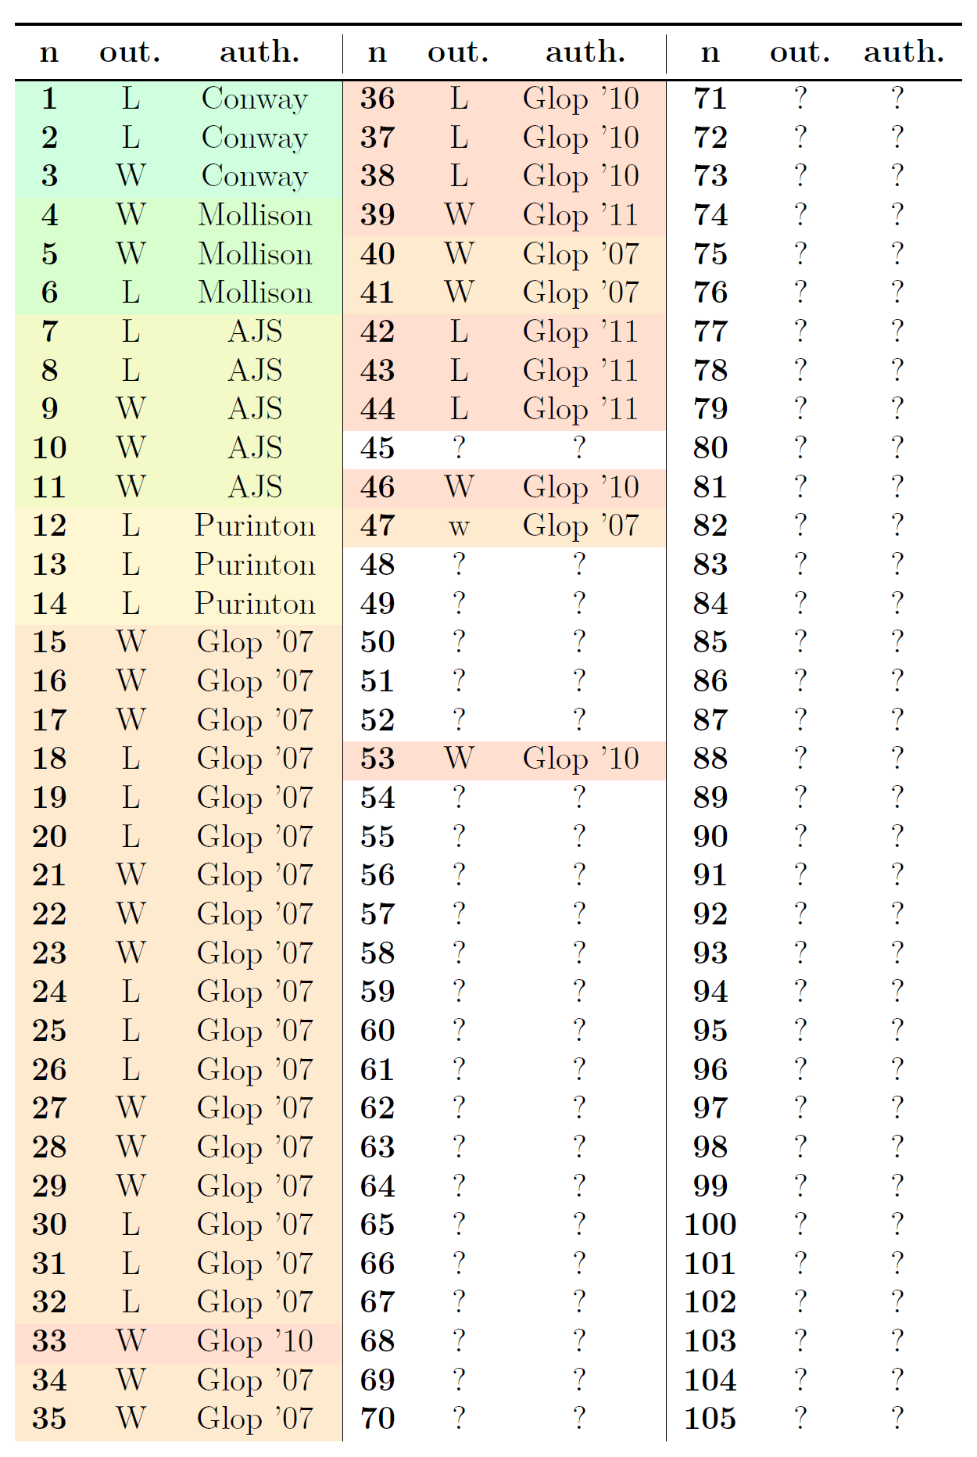
Resulting solver
SPOTS roughly 2800x faster (480 cores) than Glop.
→ 1 day of SPOTS ≈ 8 years of Glop
Outcome of 47 n-spot positions known until now.

Slide 31
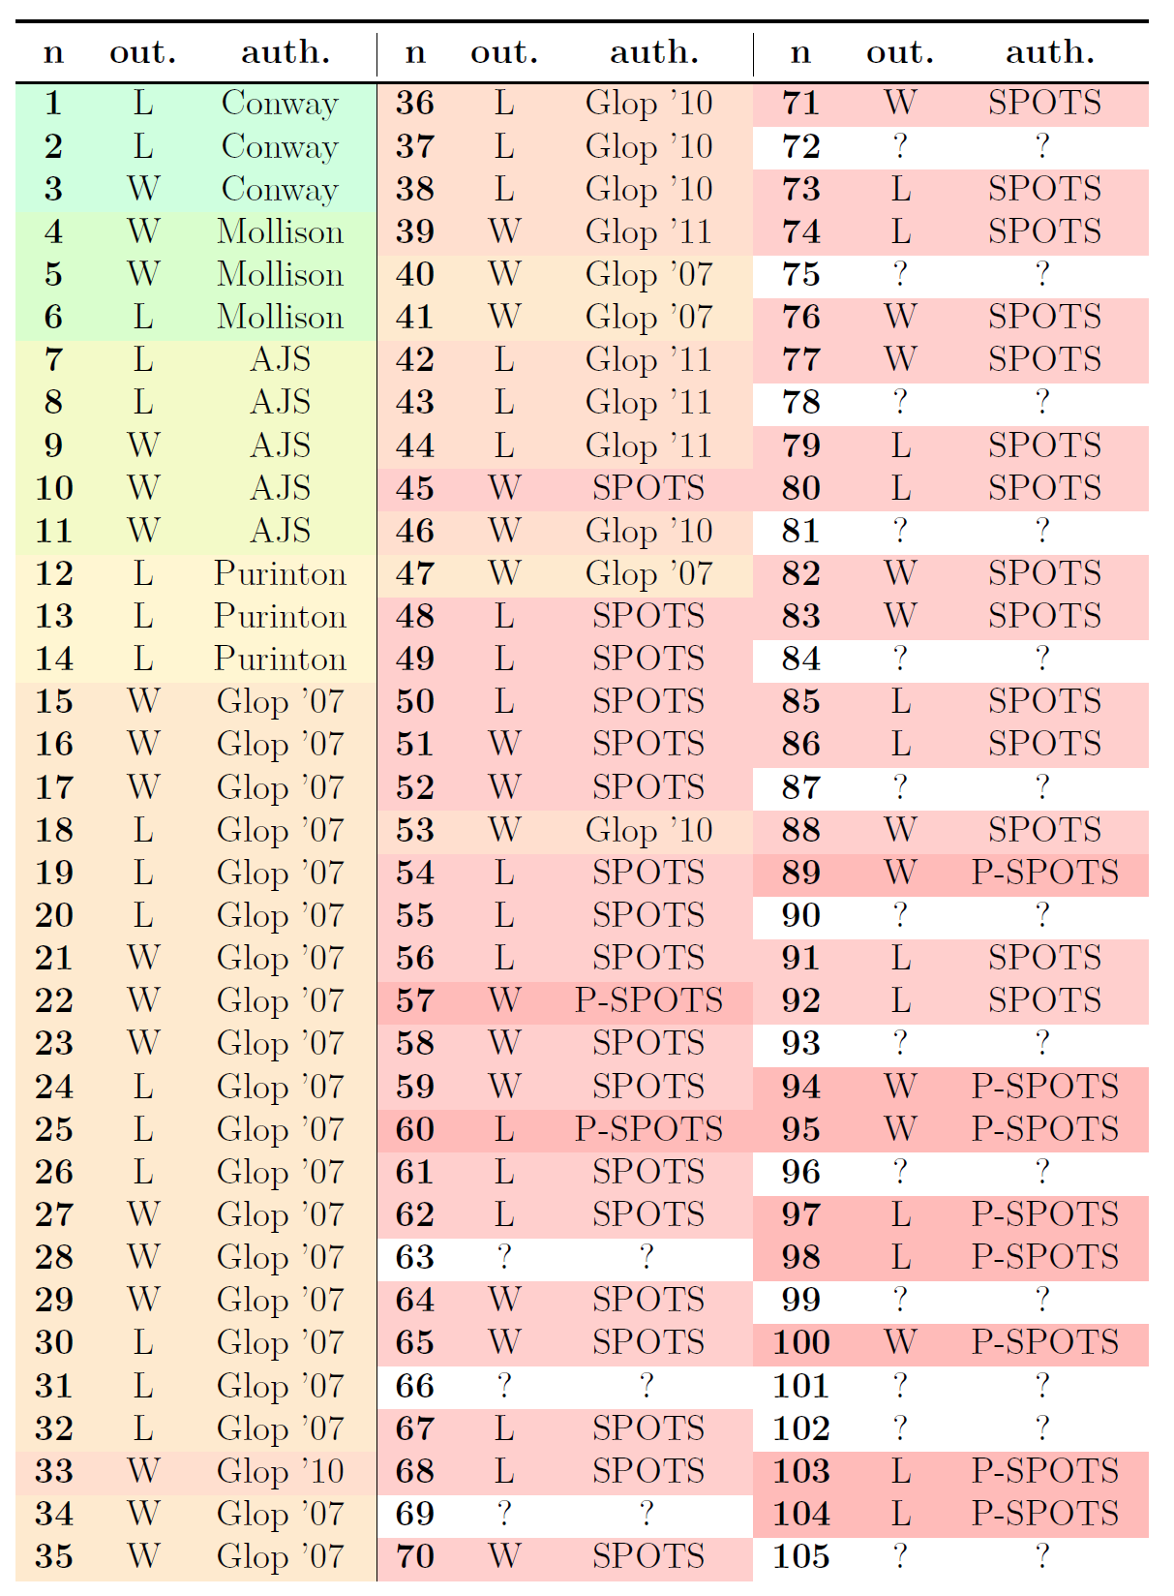
Resulting solver
SPOTS roughly 2800x faster (480 cores) than Glop.
→ 1 day of SPOTS ≈ 8 years of Glop
Outcome of 47 n-spot positions known until now.
→ We compute 42 new outcomes!
The largest proof is 1000x larger than the largest so far (took 24 days to compute ≈ 280,000 CPU hours).
The Sprouts conjecture remains open.

Slide 32
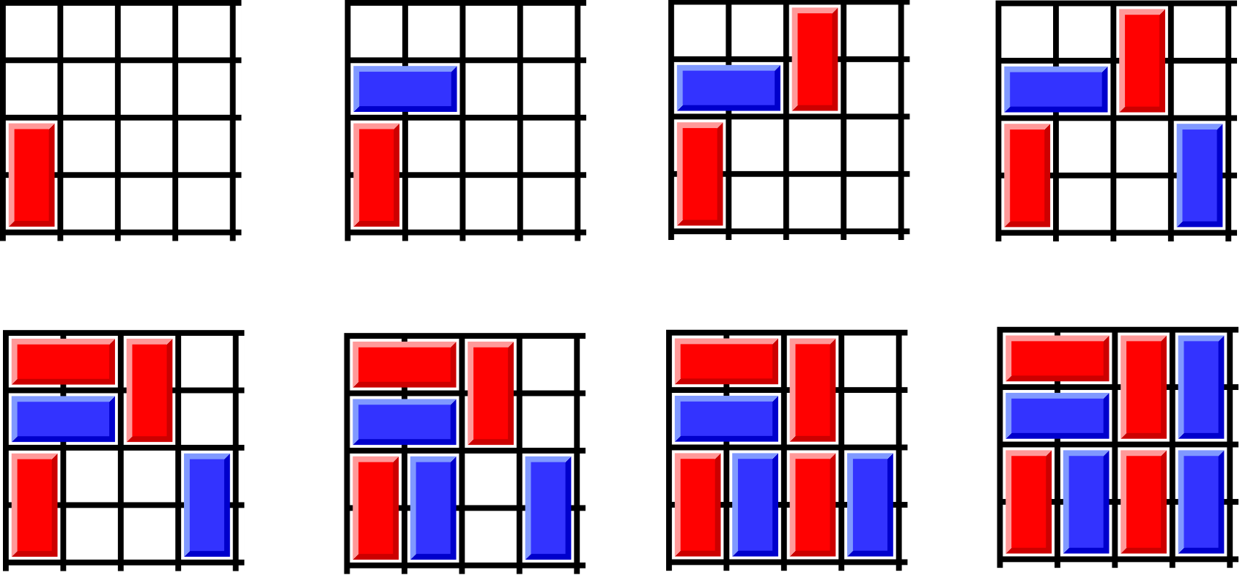
Cram rules
Impartial game under normal play condition.
https://en.wikipedia.org/wiki/Cram_(game)

Slide 33
Solved Cram grids
Outcome of (Even, Even) and (Even, Odd) is trivial.
Computed Grundy numbers:
 | 4 | 5 | 6 | 7 | 8 | 9 | 10 | 11 | 12
4 | 0 | 2 | 0 | 3 | 0 | 1 | 0 | 1 | 0
5 | - | 0 | 2 | 1 | 1 | 1 | 2 | 0 | ?
6 | - | - | 0 | 5 | 0 | 1 | 0 | ? | 0
7 | - | - | - | 1 | 3 | 1 | ? | ? | ?
8 | - | - | - | - | 0 | ? | 0 | ? | 0
9 | - | - | - | - | - | ? | ? | ? | ?

Slide 34
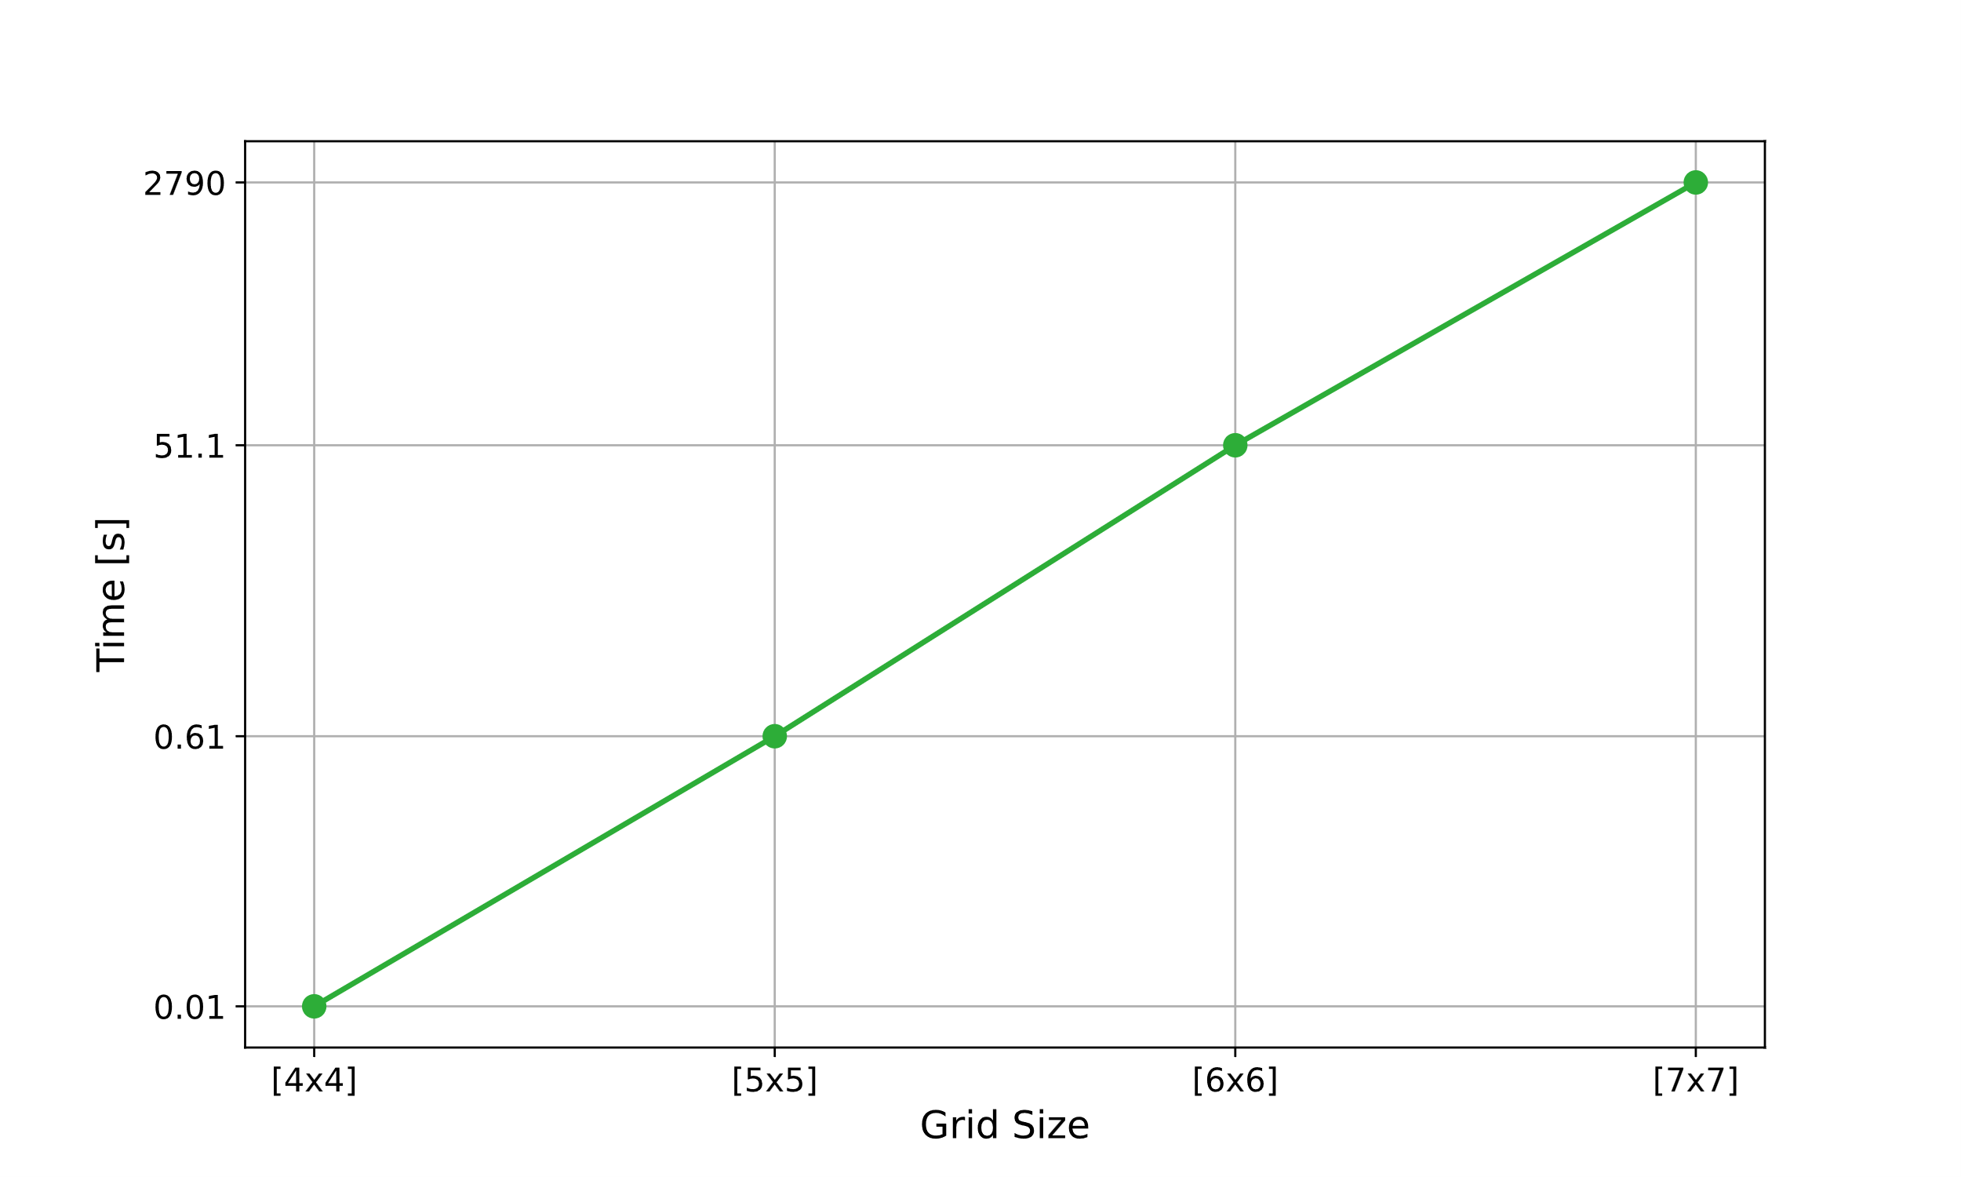
Complexity of squared Cram
Sequential df-pn for square grids.
The complexity seems to grow by a factor of 60 ([8, 8] ≈ 4 days, [9, 9] ≈ 4 months).

Slide 35
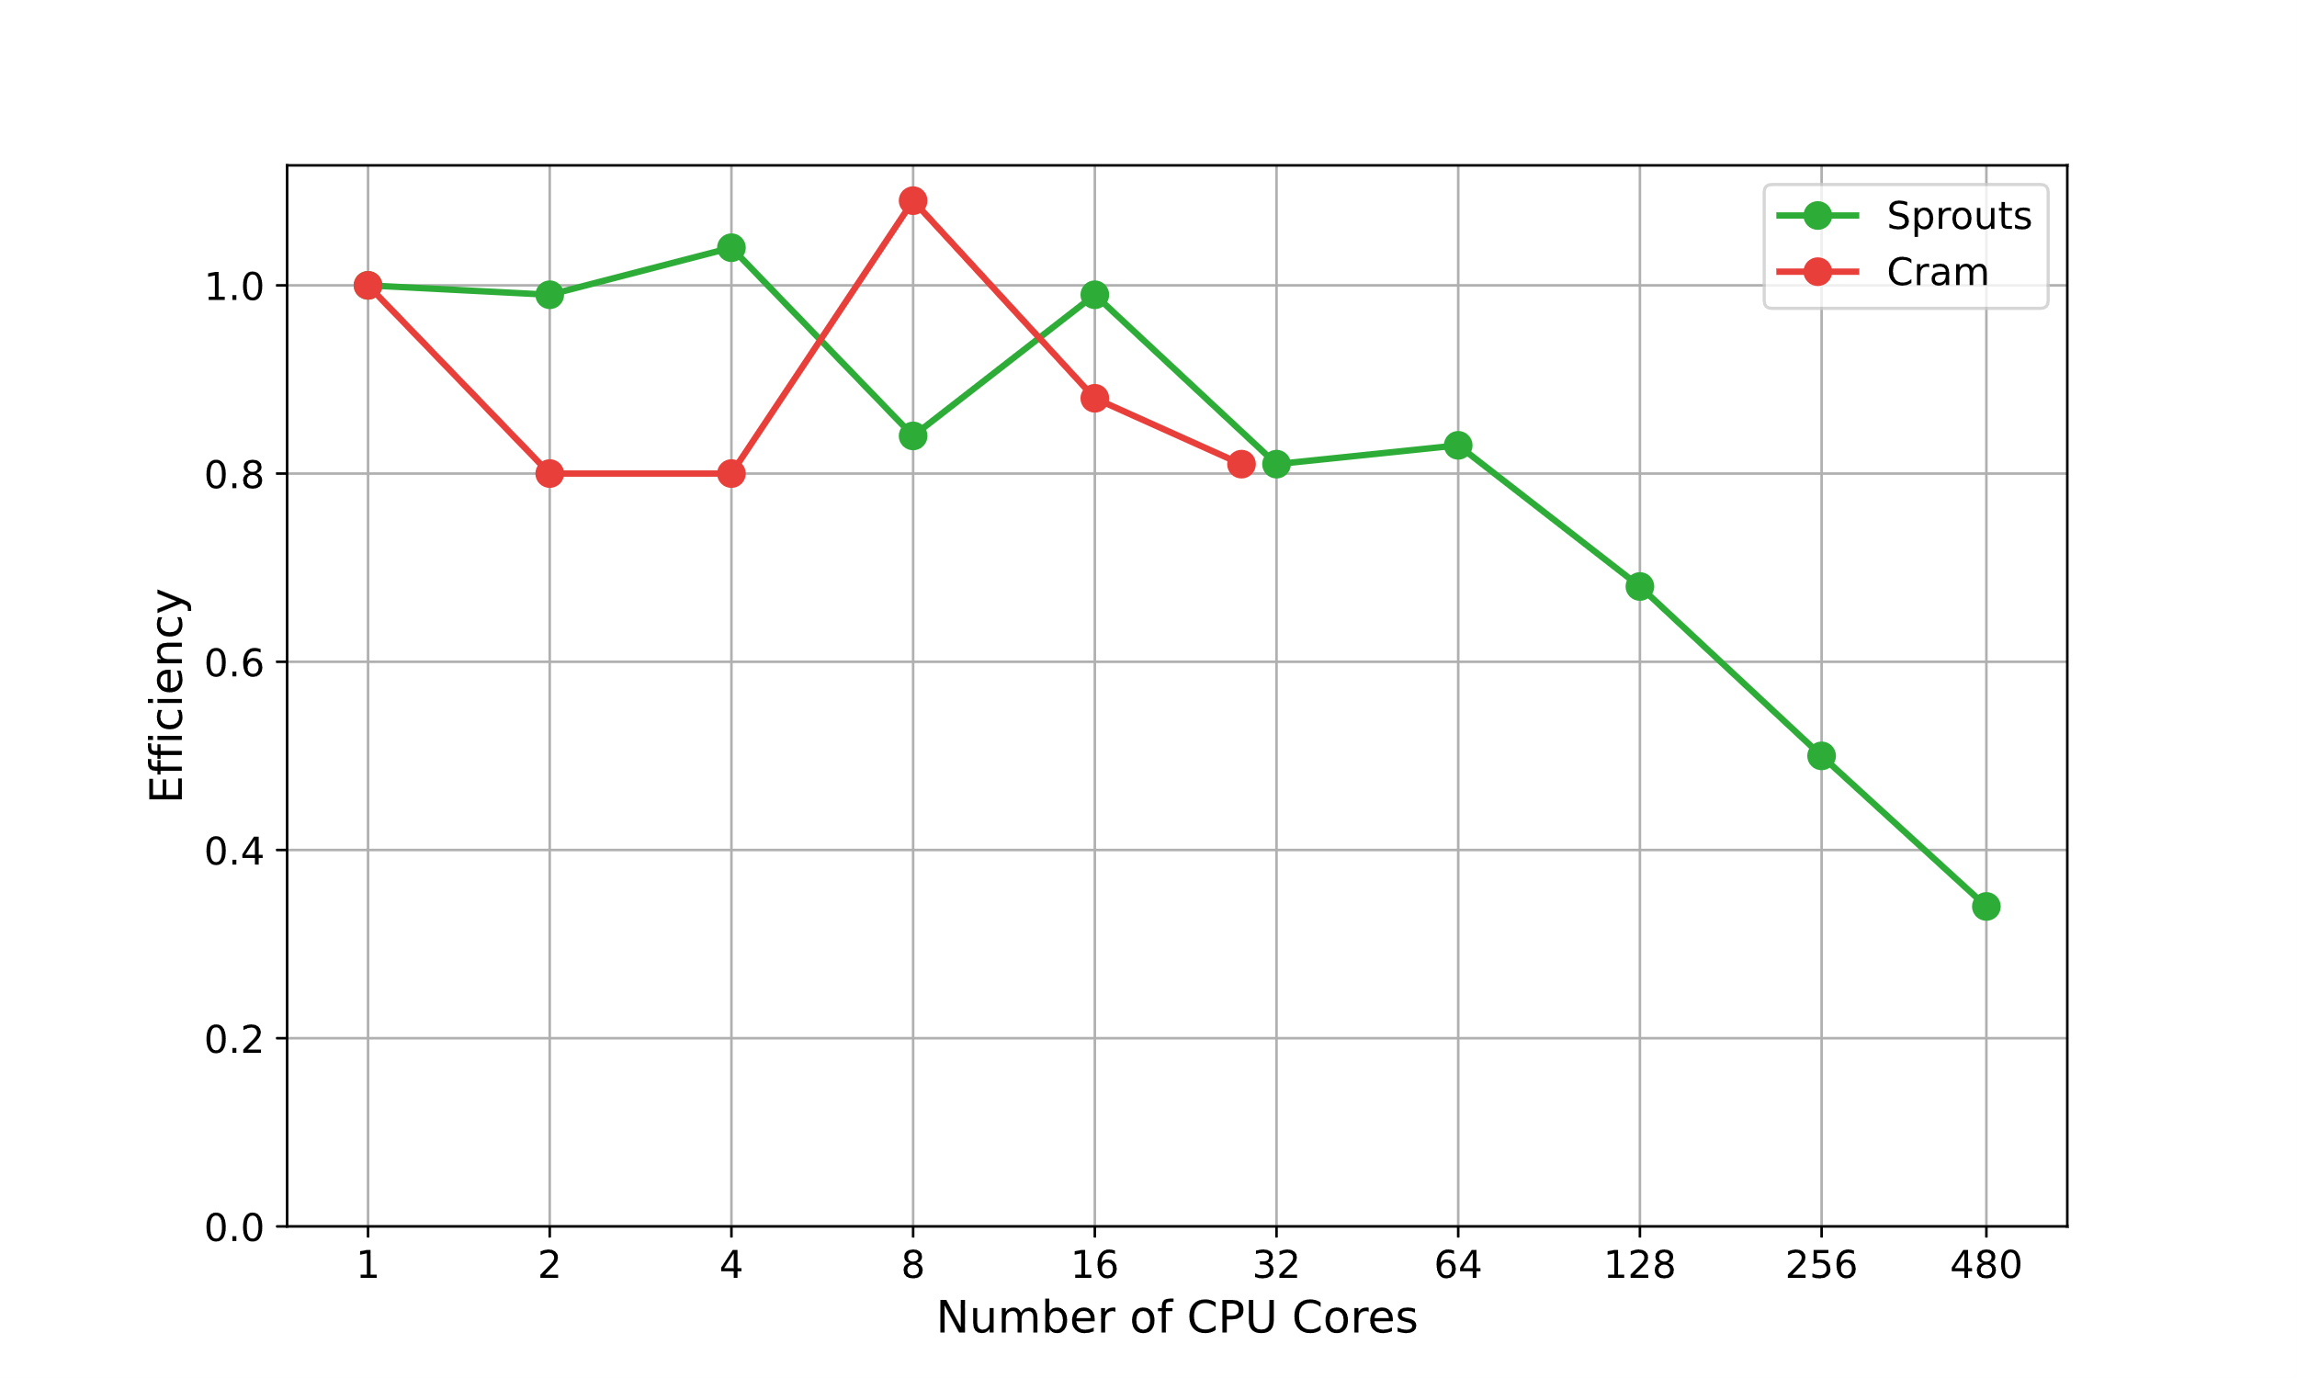
Scaling efficiency of P²PNS
Similar efficiency, the overhead of PN² is by a factor of 4 instead of 2.
Expected time of [9, 9] ≈ 2.5 days (480 CPU cores)

Slide 36
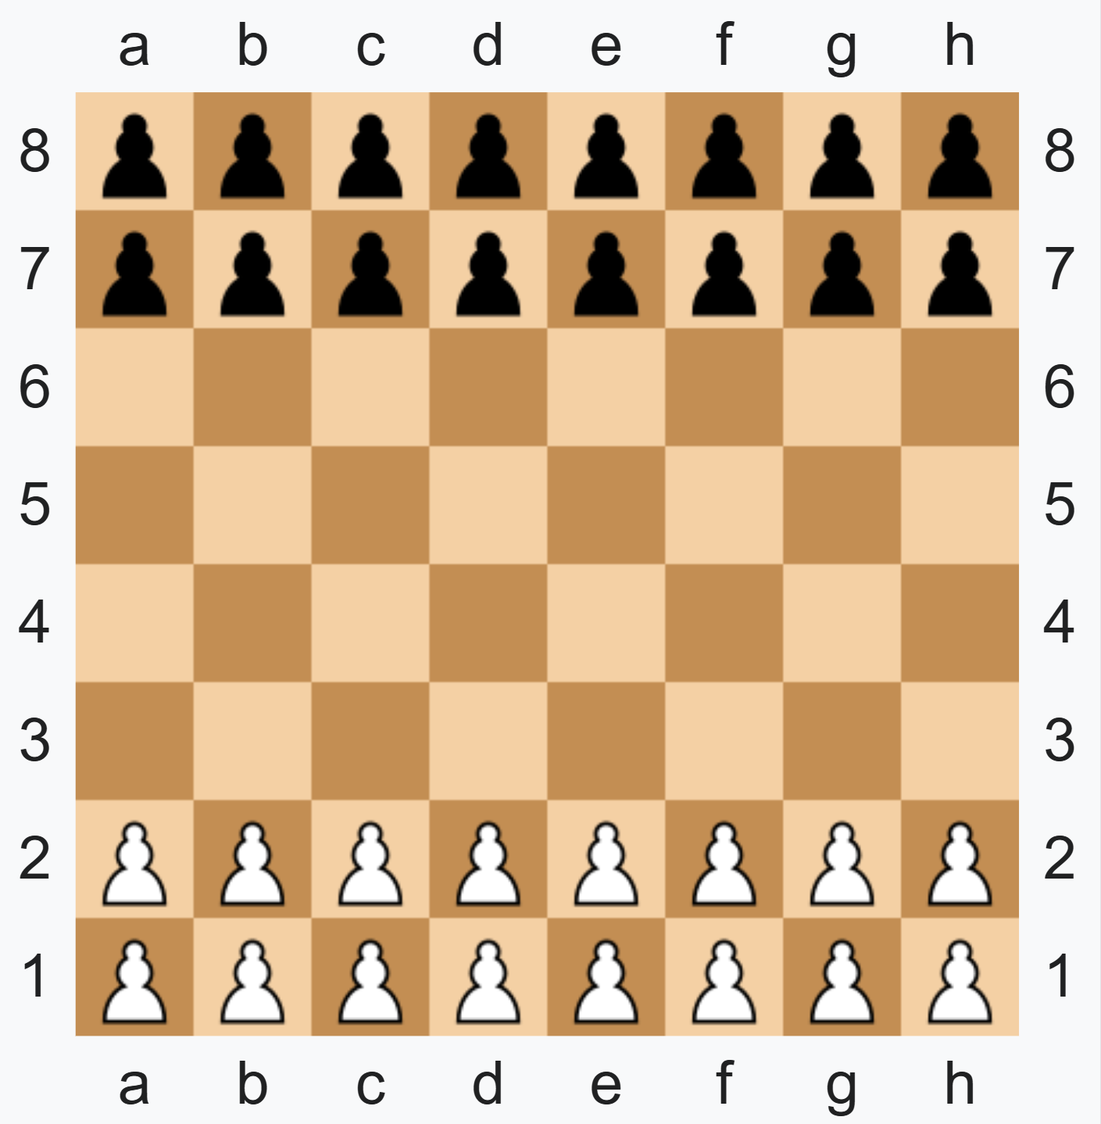
Breakthrough
Partizan game with no draw.
Solved boards:
6x5: second player wins.
5x5: second player wins.
3x7: second player wins.
We can apply our solver with few adjustments (no Grundy numbers).
Thank you for your attention.

Slide 37
References
[1] D. Applegate, G. Jacobson, and D. Sleator. Computer Analysis of Sprouts. Carnegie Mellon University Computer Science technical report CMU-CS-91-144. 1991.
[2] J. Lemoine and S. Viennot. “Computer Analysis of Sprouts with Nimbers”. In: Games of no chance 4. Vol. 63. Math. Sci. Res. Inst. Publ. Cambridge Univ. Press, New York, 2015, pp. 161–181.
[3] J. Lemoine. “Méthodes Algorithmiques pour la Résolution des Jeux Combinatoires”. In French. Ph.D. thesis. Université des Sciences et Technologie de Lille - Lille I, 2011.
[4] L. V. Allis. “Searching for Solutions in Games and Artificial Intelligence”. Ph.D. thesis. Rijksuniversiteit Limburg, 1994.
[5] A. Nagai. “A New Depth-First-Search Algorithm for AND/OR trees and its Applications”. M.Sc. thesis. The University of Tokyo, 1999.
[6] A. Saffidine, N. Jouandeau, and T. Cazenave. “Solving Breakthrough with Race Patterns and Job-Level Proof Number Search”. In: Advances in Computer Games. Ed. by H. J. van den Herik and A. Plaat. Berlin, Heidelberg: Springer Berlin Heidelberg, 2012, pp. 196–207.
[7] A. Kishimoto, M. H. M. Winands, M. Müller, and J. T. Saito. “Game-Tree Search Using Proof Numbers: The First Twenty Years”. In: ICGA Journal 35.3 (2012), pp. 131–156.

Slide 38
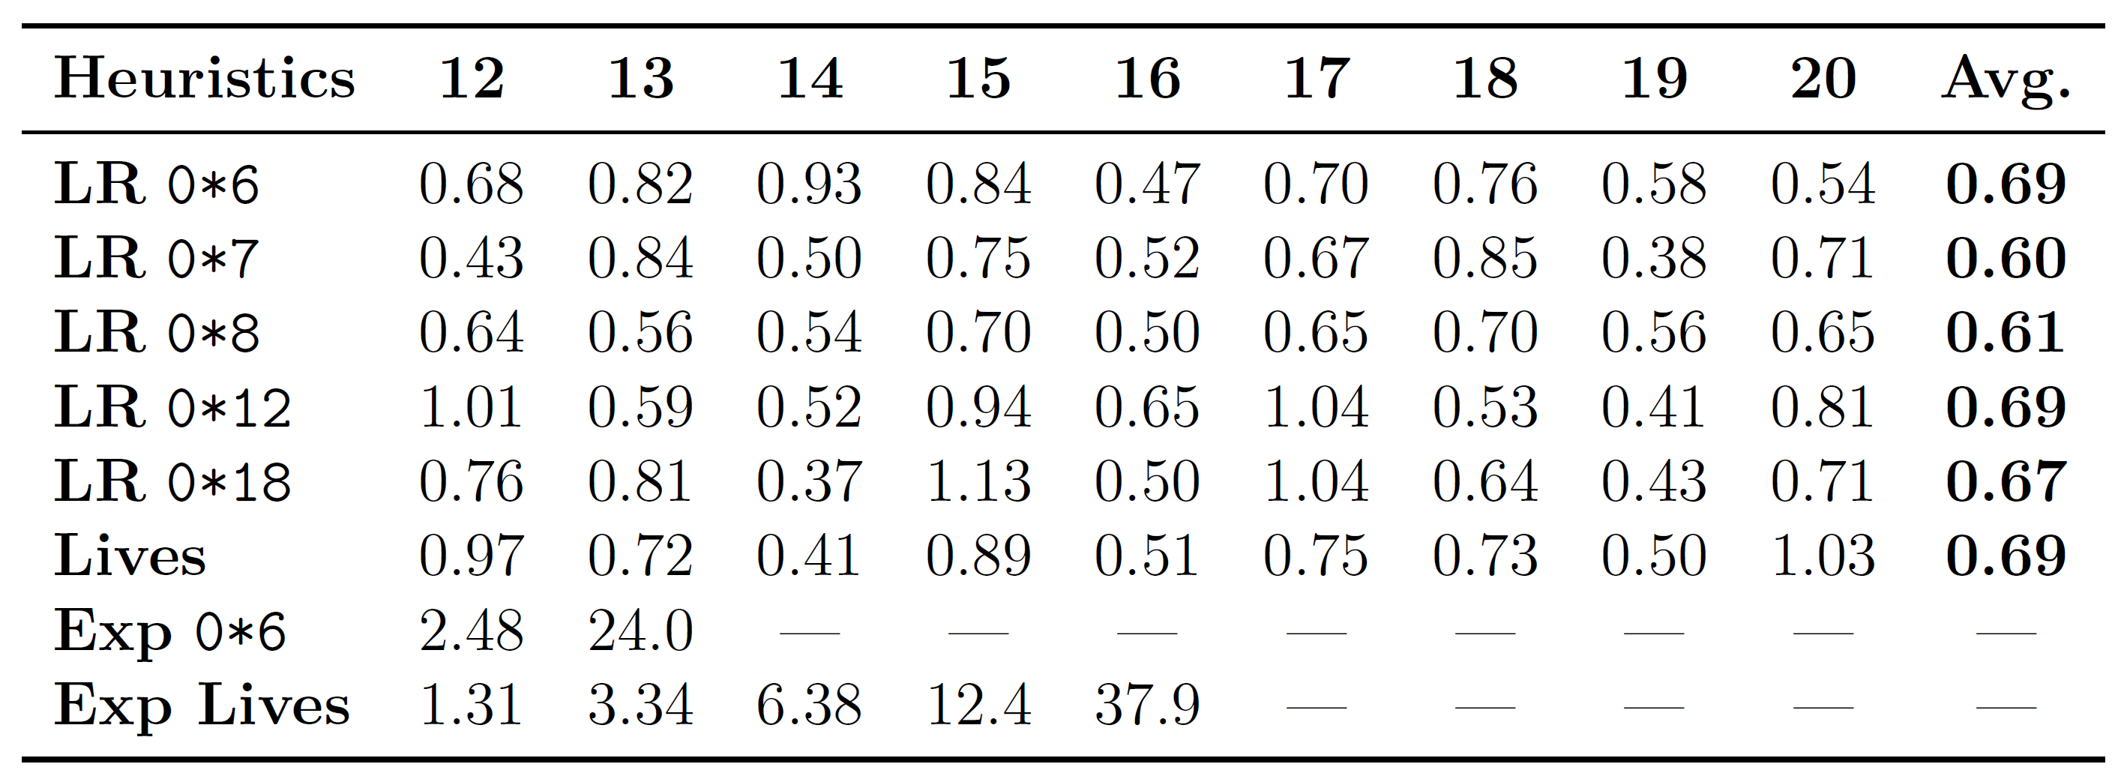
Learning initialization rules

Slide 39
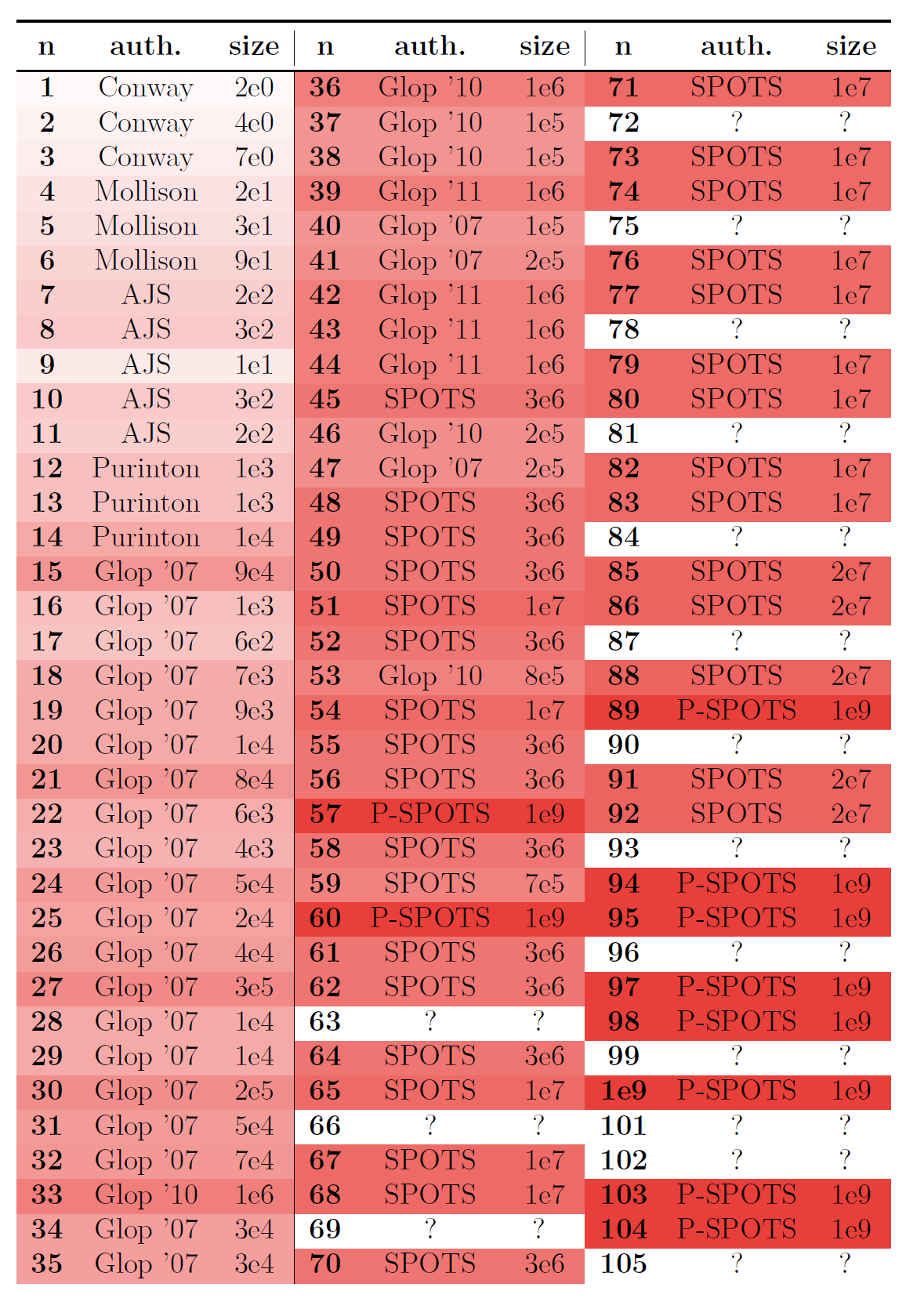
Solutions complexities

