Slide 1
Scheduling Problems and Algorithms in Traffic and Transport
MAPSP 2011
Nymburk, 24.06.11
Ralf Borndörfer
Zuse-Institute Berlin
Joint work with Ivan Dovica, Martin Grötschel, Olga Heismann, Andreas Löbel,
Markus Reuther, Elmar Swarat, Thomas Schlechte, Steffen Weider

Slide 2
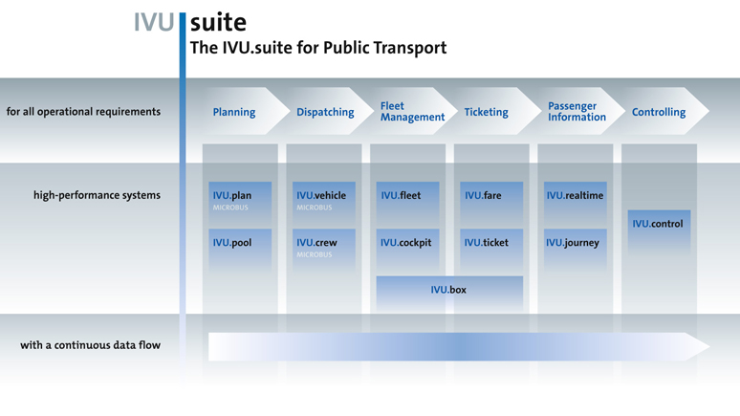
Optimization in Public Transit
Line
Planning
Vehicle
Scheduling
Depot
Scheduling
Fare
Planning
Integrated
Scheduling
Trip
Scheduling
Duty
Scheduling
Duty
Rostering

Slide 3
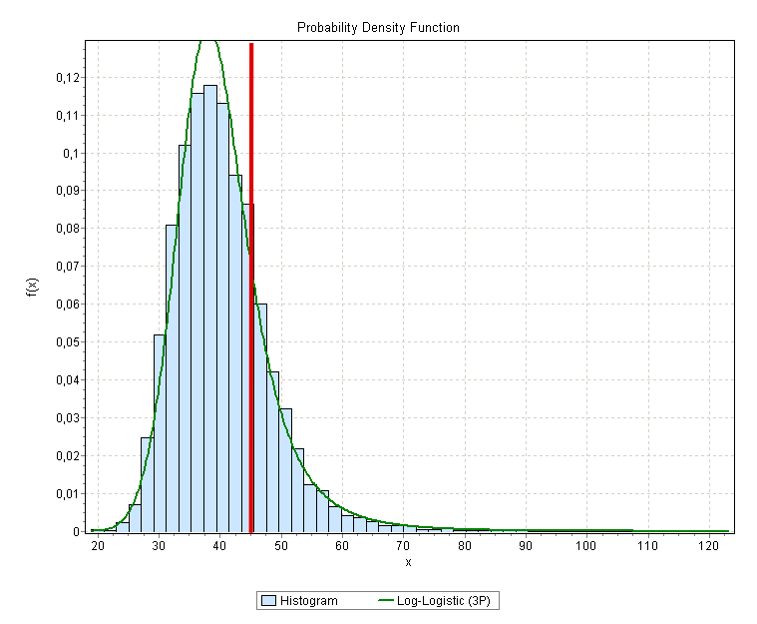
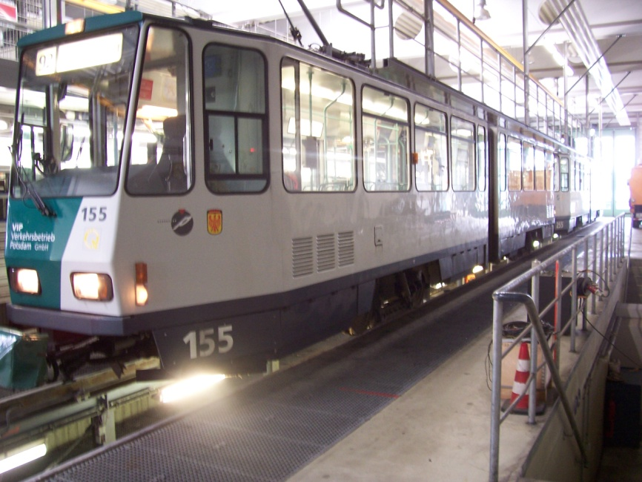
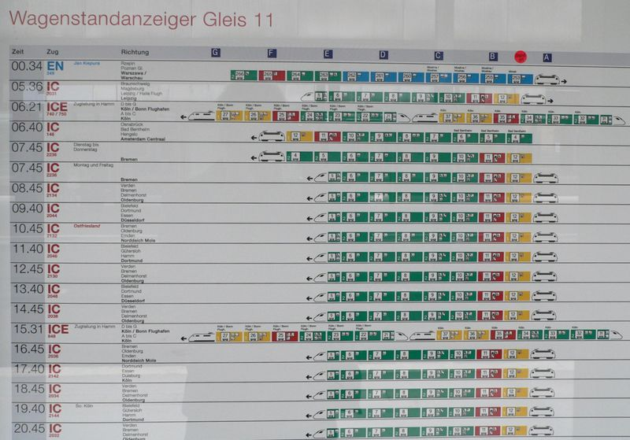
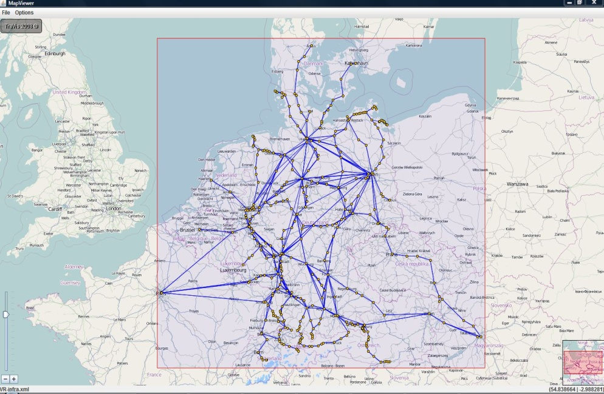
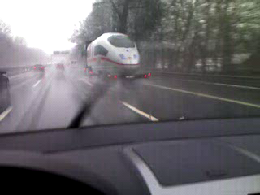
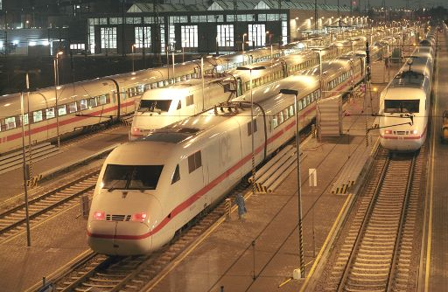
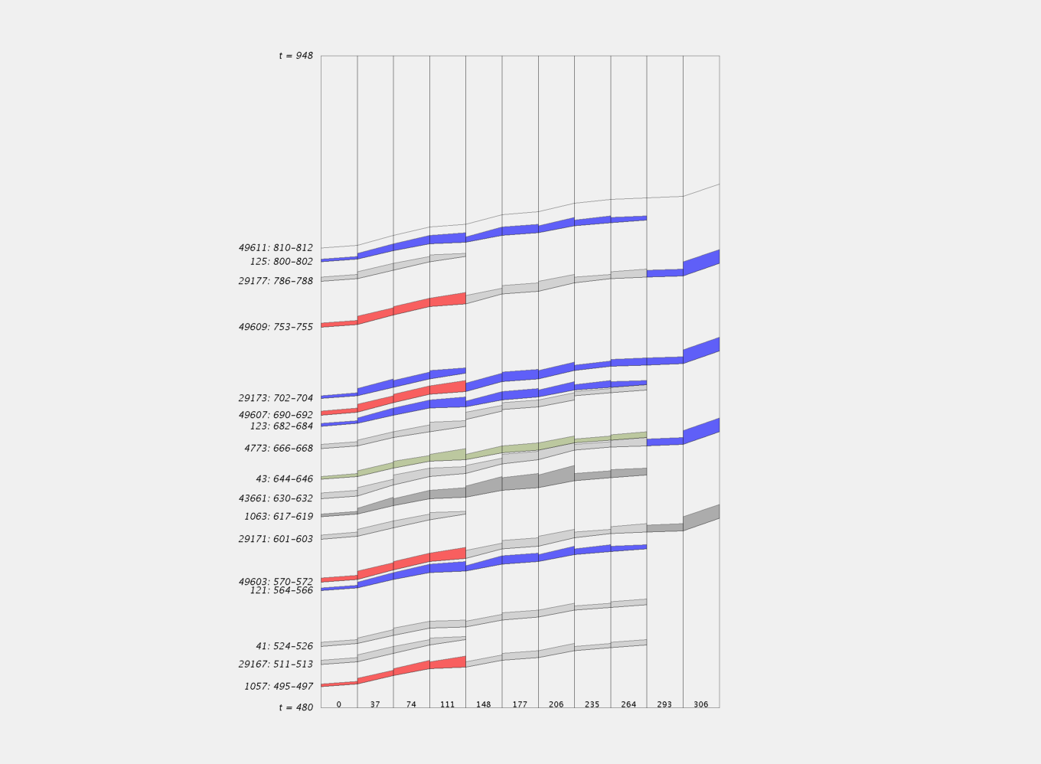
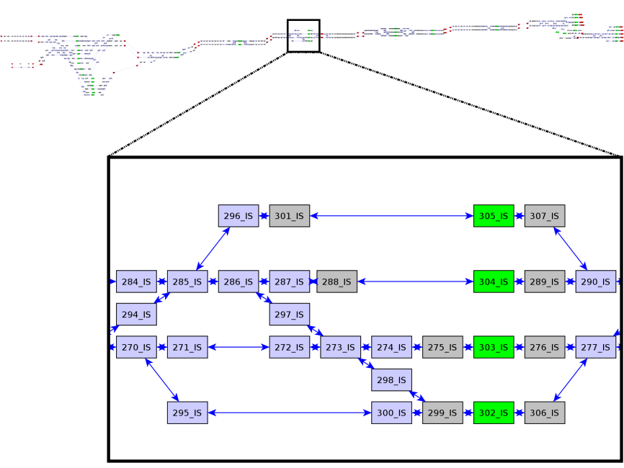
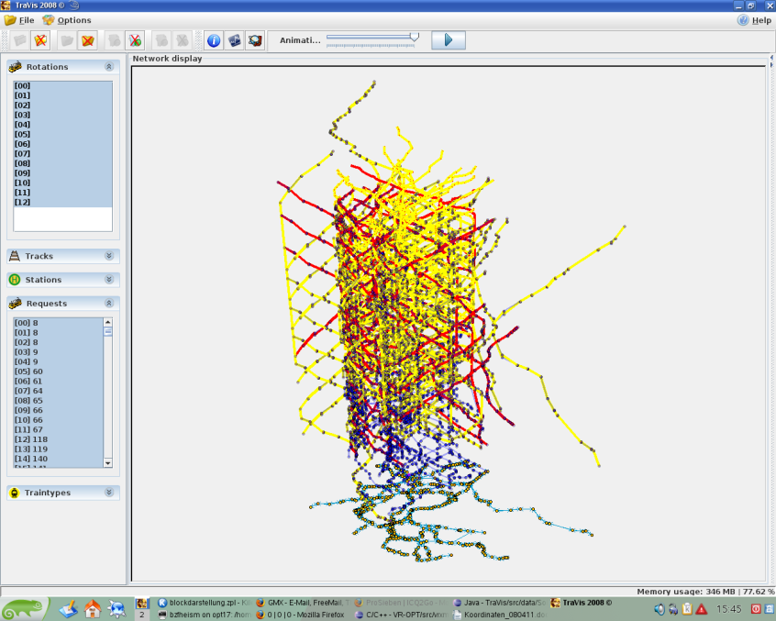






Railway Challenges
We want to avoid this!
Simplon Tunnel
  Basic Rolling Stock Rostering Problem = Multicommodity Flow Problem
  Can be solved efficiently for networks with 10⁹ arcs
  Constraints complicating rolling stock rostering
  Discretization: Space/Time ("Multiscale Problems")
  Robustness: Delay Propagation
  Path Constraints: Maintenance, Parking
  Configuration Constraints: Track Usage, Train Composition, Uniformity
Trip 1
Trip 2
Trip 4
Trip 5
Trip 3
Trip 6
Trip 7
Photo courtesy of DB Mobility Logistics AG
Visualization based on JavaView
Notes:
Railways = Source of Challenging Combinatorial Optimization Problems. Research needed.

Slide 4
Integrated
Routing and
Scheduling

Slide 5
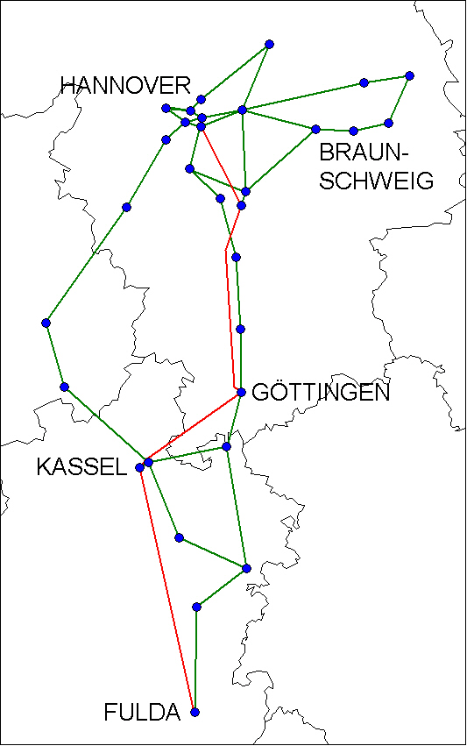
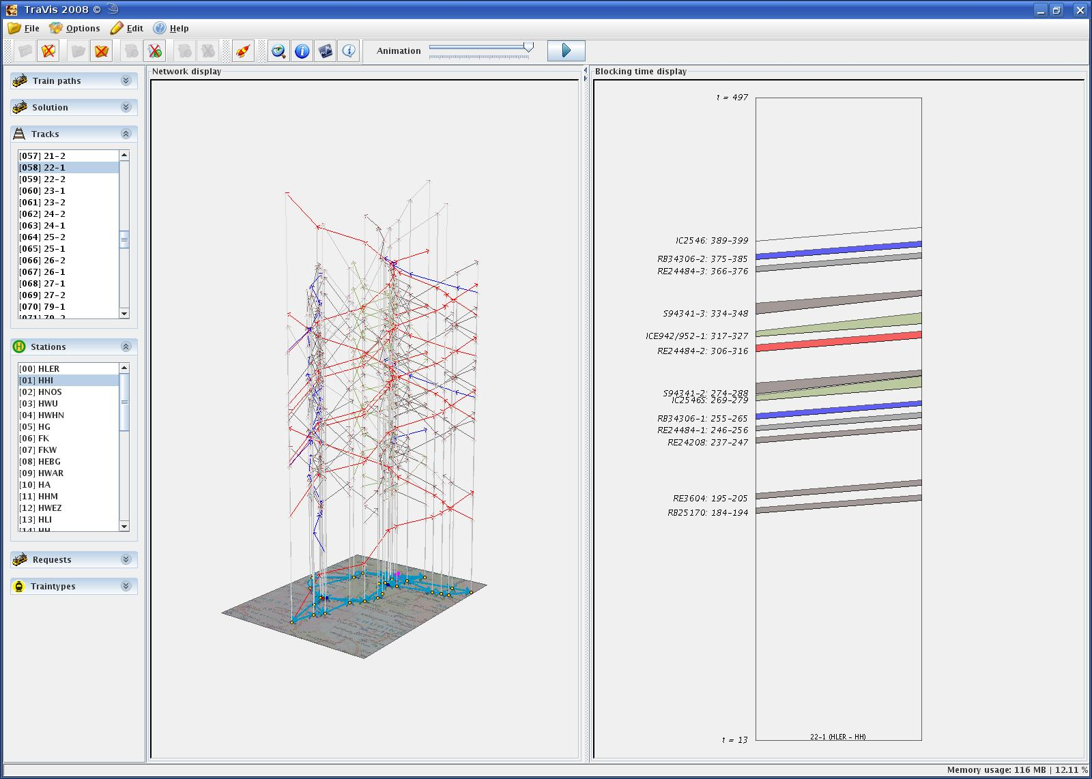
Integrated Routing and Scheduling
Routing
Scheduling

Slide 6
Timetable

Slide 7
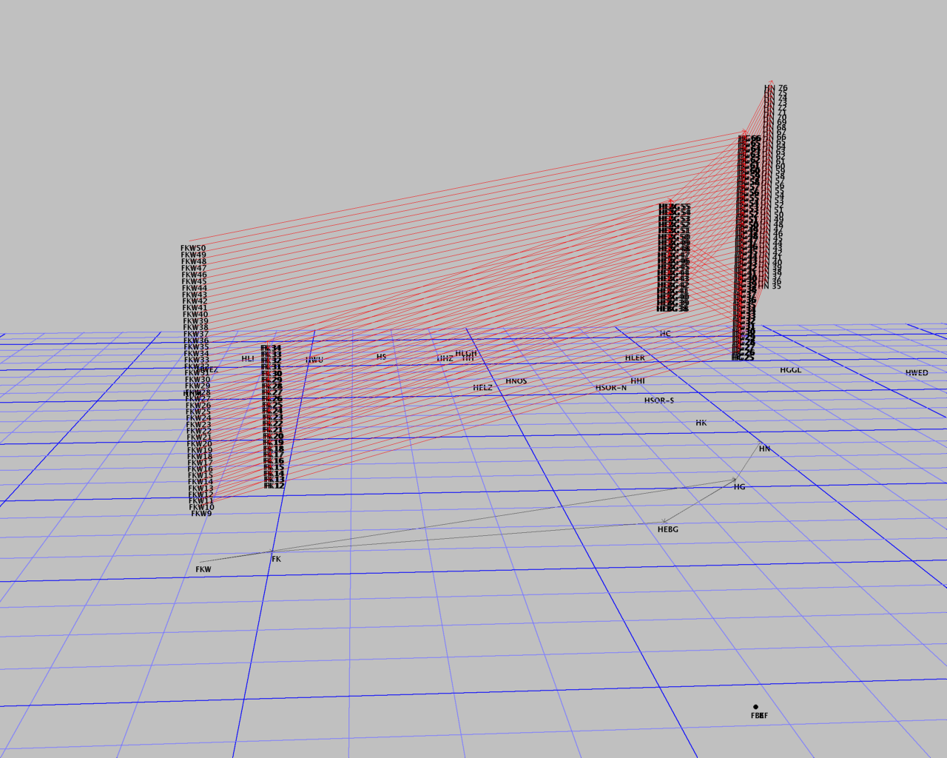
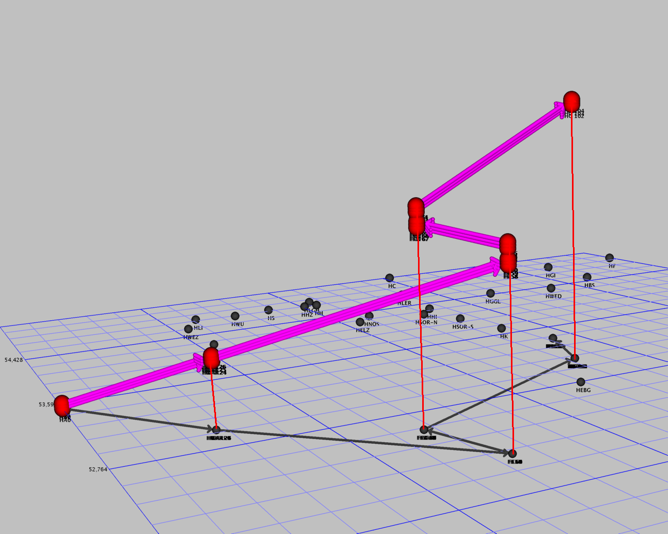
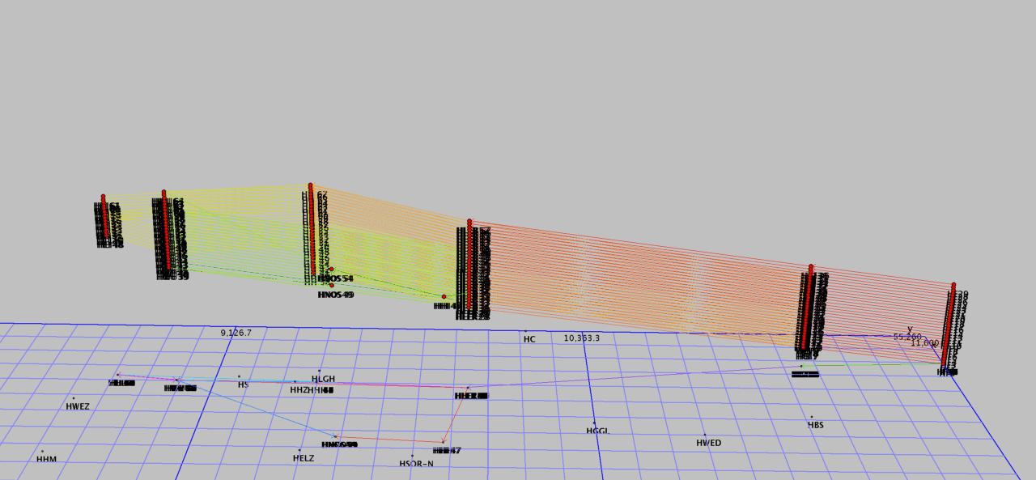
Train Routes are Flexible in Space and Time

Slide 8
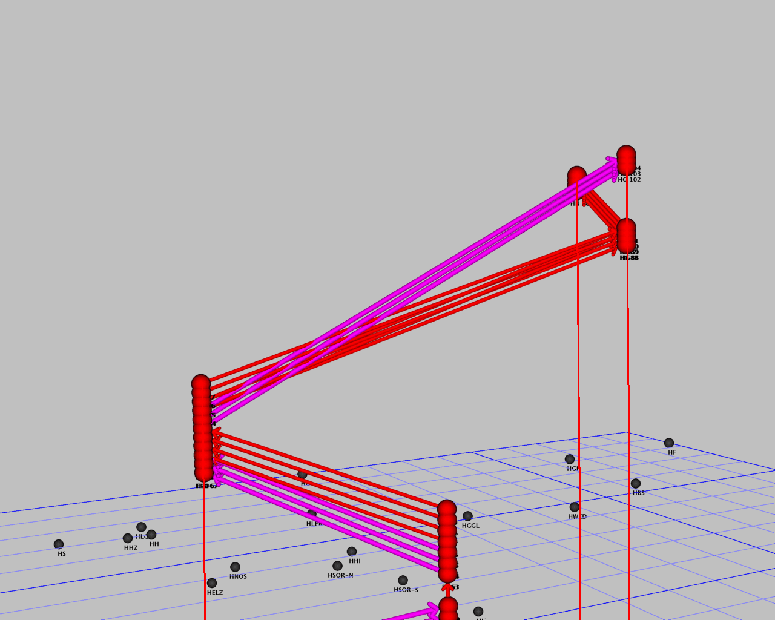
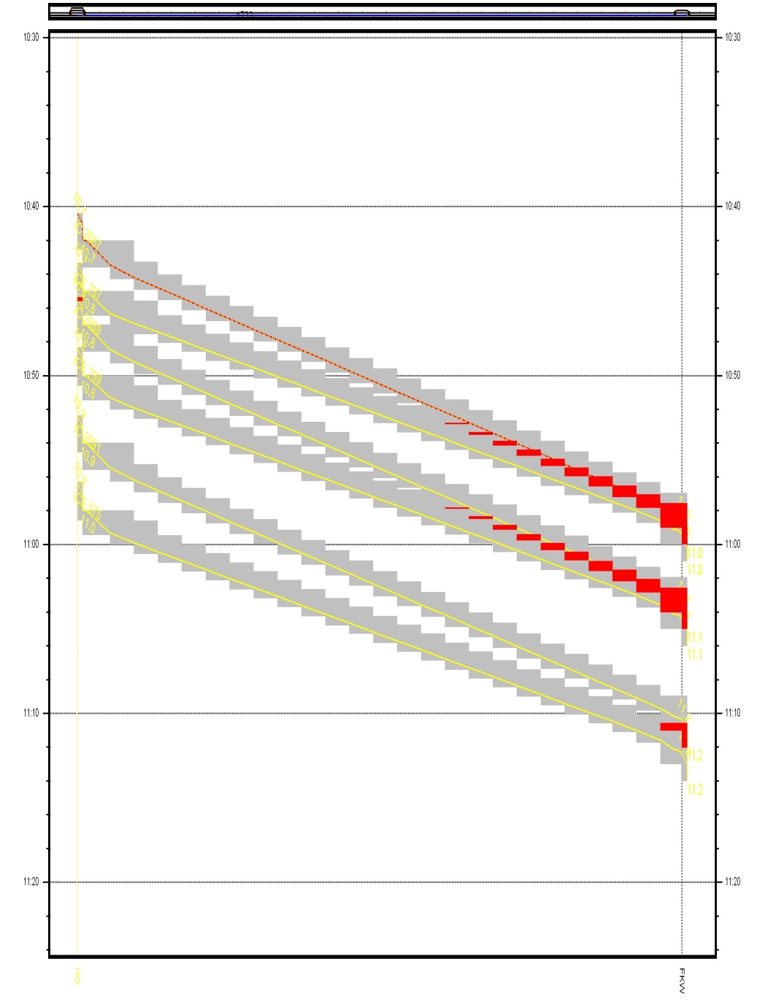
Conflict

Slide 9
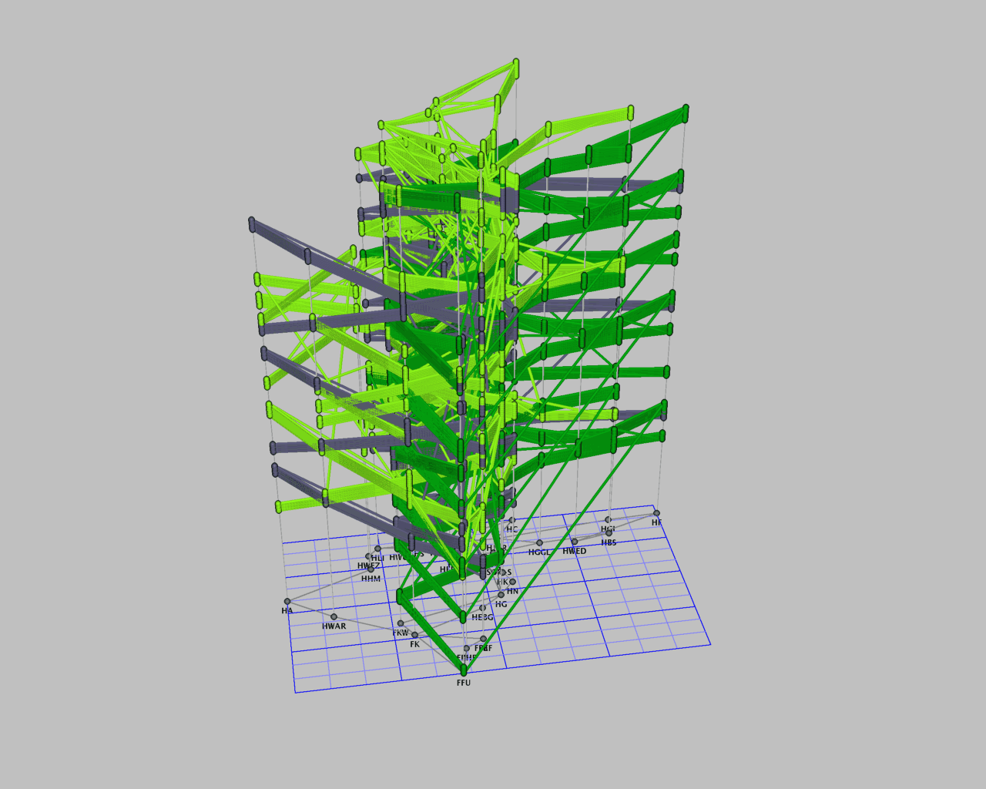
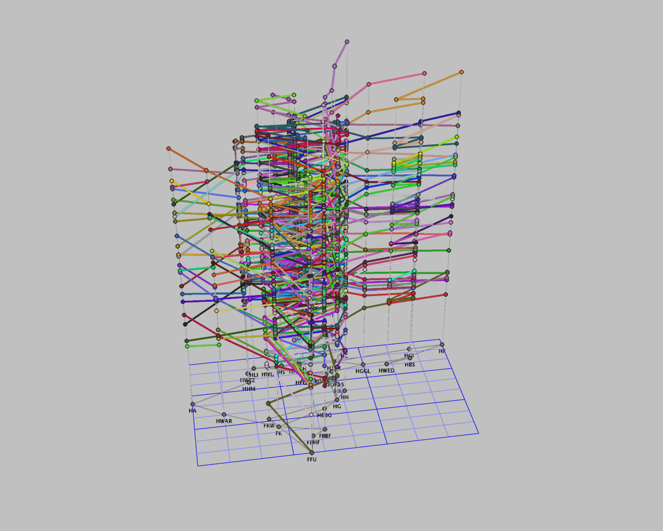
Track Allocation Graph

Slide 10
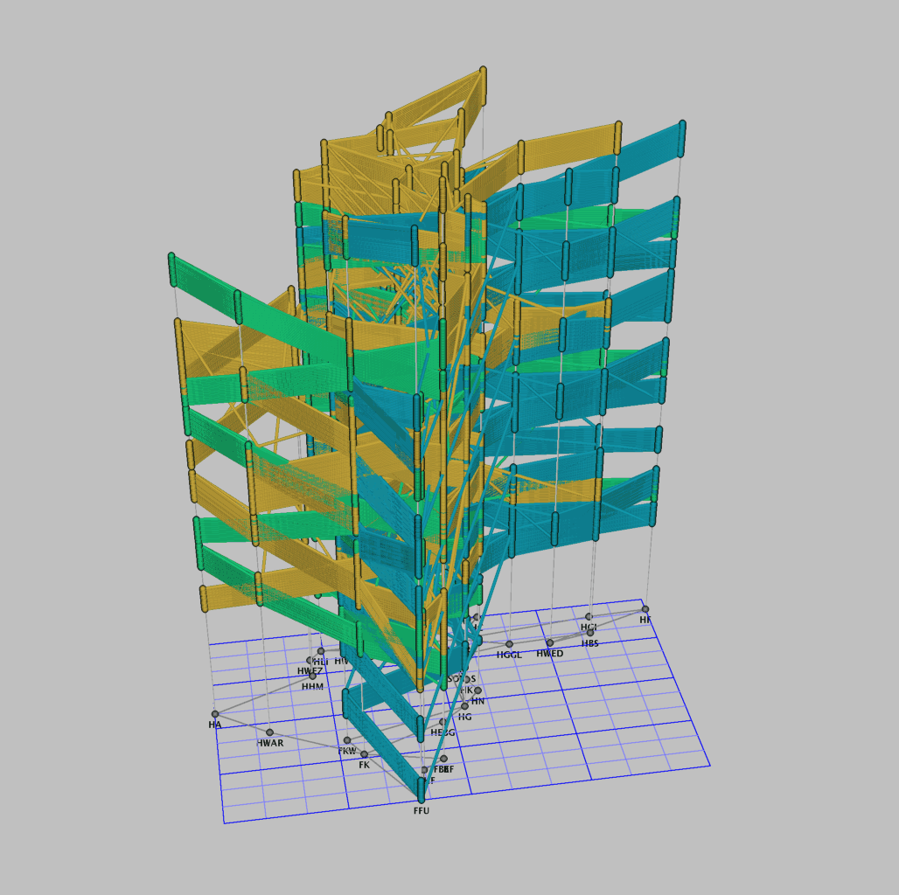
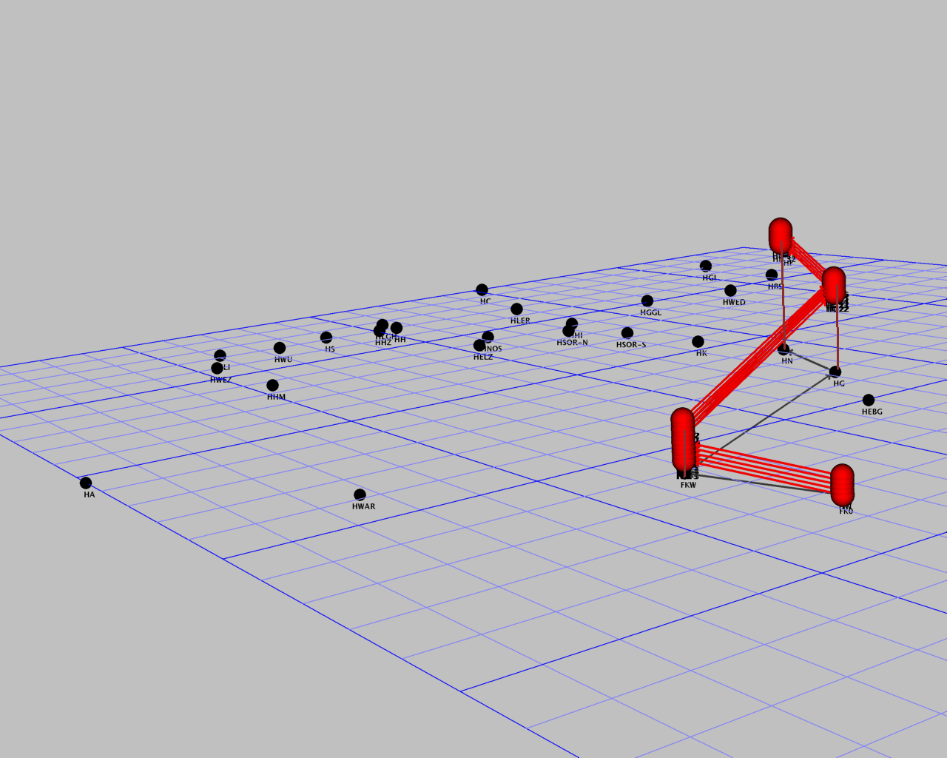
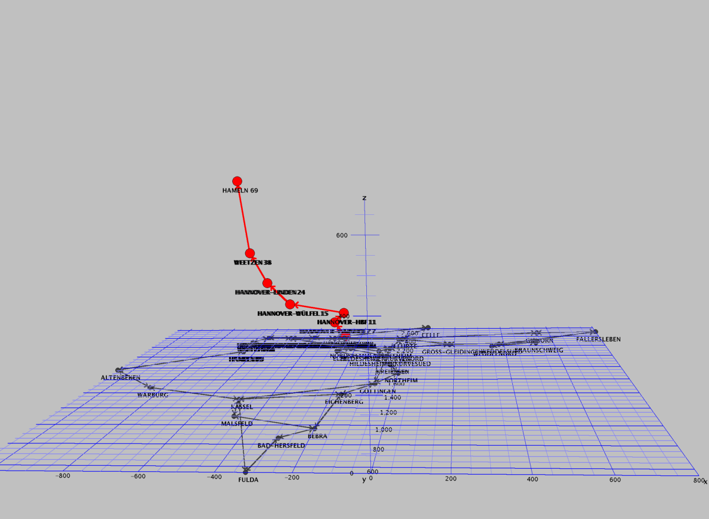
Track Allocation/Train Timetabling Problem
Combinatorial Optimization Problem
  Path Packing Problem
…

Slide 11
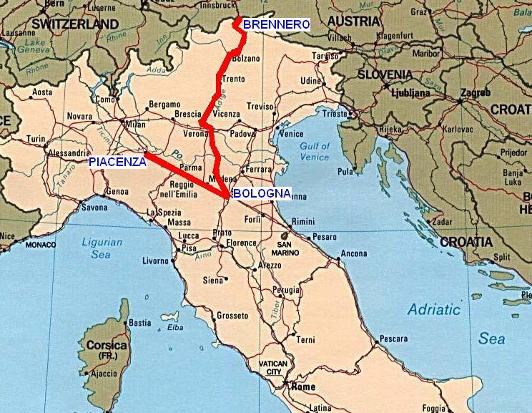
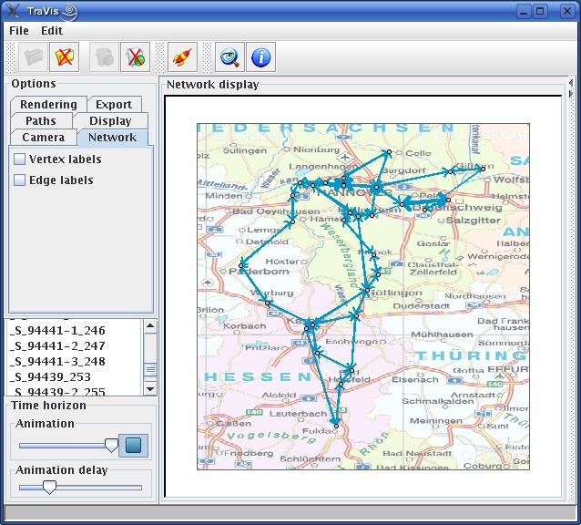
Literature
  Charnes and Miller (1956), Szpigel (1973), Jovanovic and Harker (1991),
  Cai and Goh (1994), Schrijver and Steenbeck (1994), Carey and Lockwood (1995)
  Nachtigall and Voget (1996), Odijk (1996) Higgings, Kozan and Ferreira (1997)
  Brannlund, Lindberg, Nou, Nilsson (1998), Lindner (2000), Oliveira and Smith (2000)
  Caprara, Fischetti and Toth (2002), Peeters (2003)
  Kroon and Peeters (2003), Mistry and Kwan (2004)
  Barber, Salido, Ingolotti, Abril, Lova, Tormas (2004)
  Semet and Schoenauer (2005),
  Caprara, Monaci, Toth and Guida (2005)
  Kroon, Dekker and Vromans (2005),
  Vansteenwegen and Van Oudheusden (2006), Liebchen (2006)
  Cacchiani, Caprara, T. (2006), Cachhiani (2007)
  Caprara, Kroon, Monaci, Peeters, Toth (2006)
  Borndoerfer, Schlechte (2005, 2007), Caimi G., Fuchsberger M., Laumanns M., Schüpbach K. (2007)
  Fischer, Helmberg, Janßen, Krostitz (2008)
  Lusby, Larsen, Ehrgott, Ryan (2009)
  Caimi (2009), Klabes (2010)
  ...

Slide 12
Path/Arc Packing Model

Slide 13
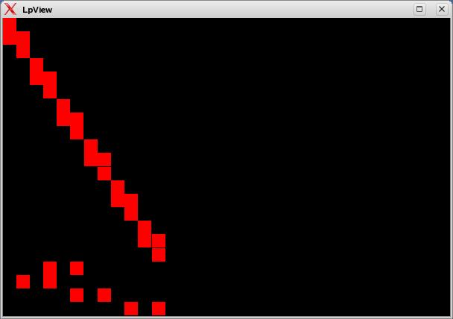
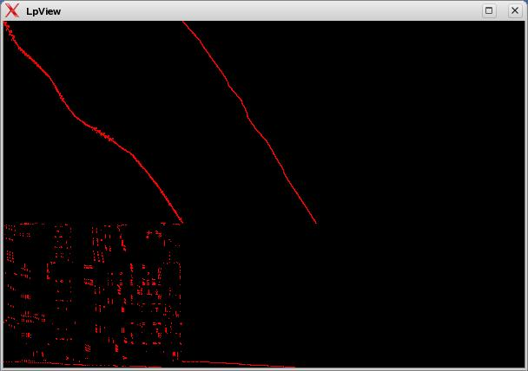
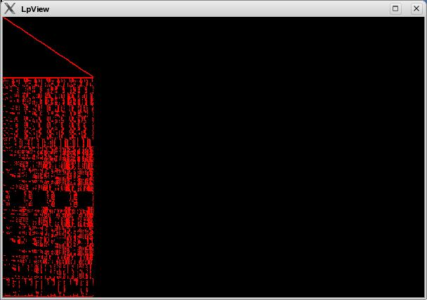
Path Packing Model

Slide 14
Configuration Model

Slide 15
Configuration Model

Slide 16
Packing- and Configuration Model

Slide 17
Track Allocation Models
Theorem (B., Schlechte [2007]):
= v_{LP}(PCP) = v_{LP}(ACP)
= v_{LP} (APP) = v_{LP}(PPP)
≤ v_{LP}(APP').
All LP-relaxations can be solved in polynomial time.
= v_{IP}(PCP) = v_{IP}(ACP)
= v_{IP} (APP) = v_{IP}(PPP)
= v_{IP}(APP').
APP'
APP
PPP
ACP
PCP

Slide 18
Packing- and Configuration Model

Slide 19
Configuration Model

Slide 20
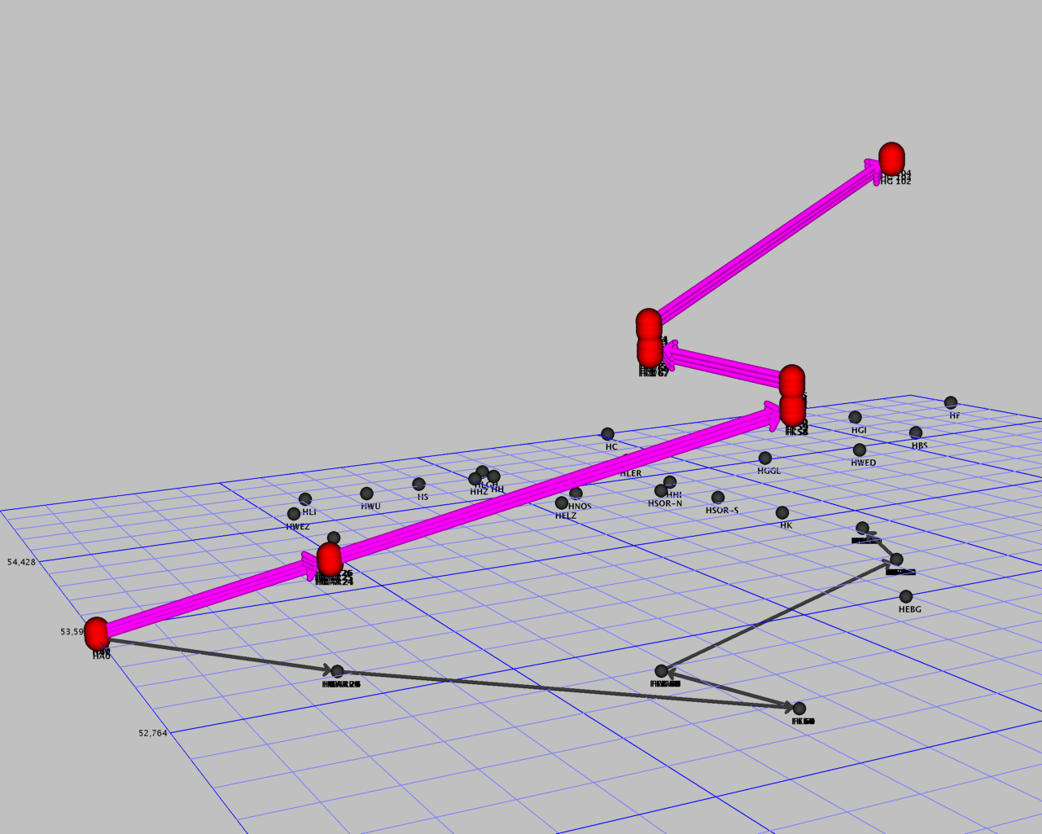
Configuration Model
Proposition:
Route pricing = acyclic shortest
path problem with arc weights
c_{a} = −c_{a}+λ_{a}.

Slide 21
Configuration Model
Proposition:
Config pricing = acyclic shortest
path problem with arc weights
c_{a} = −λ_{a}.

Slide 22
Configuration Model

Slide 23
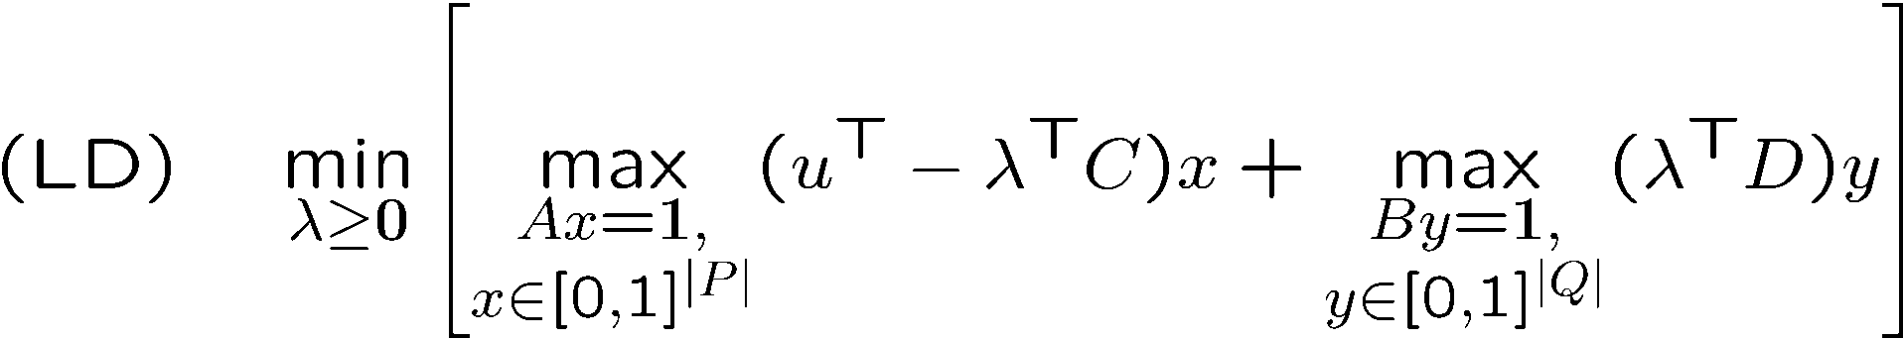
Lagrange Funktion des PCP
(PCP)
(LD)

Slide 24
Bundle Method
(Kiwiel [1990], Helmberg [2000])
  Problem
  Algorithm
    Subgradient
    Cutting Plane Model
    Update
  Quadratic Subproblem
  Primal Approximation
  Inexact Bundle Method
f
λ
Notes:
We will now take a closer look, at the determination of the next trial point

Slide 25
Bundle Method
(Kiwiel [1990], Helmberg [2000])
  Problem
  Algorithm
    Subgradient
    Cutting Plane Model
    Update
  Quadratic Subproblem
  Primal Approximation
  Inexact Bundle Method
f
λ₁
λ
Notes:
We will now take a closer look, at the determination of the next trial point

Slide 26
Bundle Method
(Kiwiel [1990], Helmberg [2000])
  Problem
  Algorithm
    Subgradient
    Cutting Plane Model
    Update
  Quadratic Subproblem
  Primal Approximation
  Inexact Bundle Method
f
λ₂
λ₁
λ
Notes:
We will now take a closer look, at the determination of the next trial point

Slide 27
Bundle Method
(Kiwiel [1990], Helmberg [2000])
  Problem
  Algorithm
    Subgradient
    Cutting Plane Model
    Update
  Quadratic Subproblem
  Primal Approximation
  Inexact Bundle Method
f
λ₂
λ₃
λ₁
λ
Notes:
We will now take a closer look, at the determination of the next trial point

Slide 28
Bundle Method
(Kiwiel [1990], Helmberg [2000])
  Problem
  Algorithm
    Subgradient
    Cutting Plane Model
    Update
  Quadratic Subproblem
  Primal Approximation
  Inexact Bundle Method
λ₂
λ₃
λ₁
Notes:
We will now take a closer look, at the determination of the next trial point

Slide 29
Rapid Branching
Perturbation Branching
  Sequence of perturbed IP objectives c_{j}^{i+1} := c_{j}^{i} – α(x_{j}^{i})², ∀j, i=1,2,…
  Fixing candidates in iteration i B^{i} := { j : x_{j}^{i} ≥ 1 – ε }
  Potential function in iteration i v^{i} := c^{T}x^{i} – w|B^{i} |
  Go on while not integer and potential decreases, else
    Perturb for k_{max} additional iterations, if still not successful
      Fix a single variable and reset objective every k_{s} iterations
  Set of fixed variables (many) B* := B^{argmin vi}
Binary Search Branching
  Set of fixed variables (many) B* := {j₁, ... , j_{m}}, c_{j1} ≤ ... ≤ c_{jm}
  Sets Q_{j}^{k} at pertubation branch j Q_{j}^{k} := { x : x_{j1}=...=x_{jk}=1 },
  k=0,...,m
  Branch on Q_{j}^{m}
    Repeat perturbation branching to plunge
    Backtrack to Q_{j}^{⎣m/2⎦} and set m := ⎣m/2⎦ to prune
Q_{j-1}^{⎣p/q⎦}
Q_{j}¹
Q_{j}²
Q_{j}⁴
Q_{j}^{⎣m/4⎦}
Q_{j}^{⎣m/2⎦}
Q_{j}^{m}
29

Slide 30
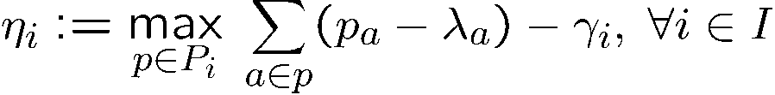
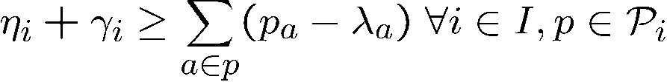
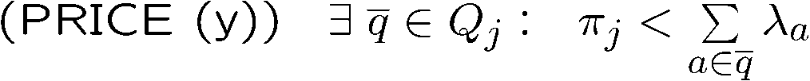
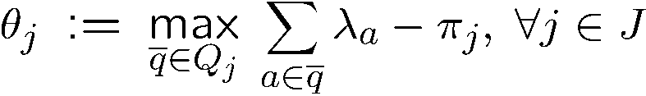
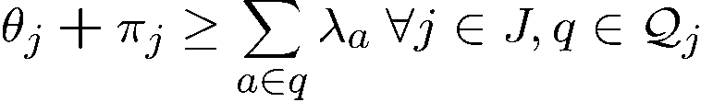
A Simple LP-Bound
Lemma (BS [2007]):

Slide 31
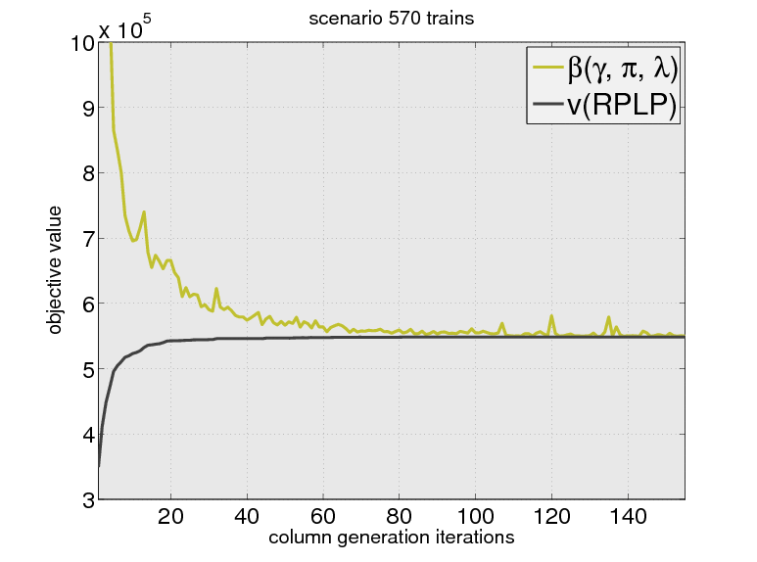
Solving the LP-Relaxation

Slide 32
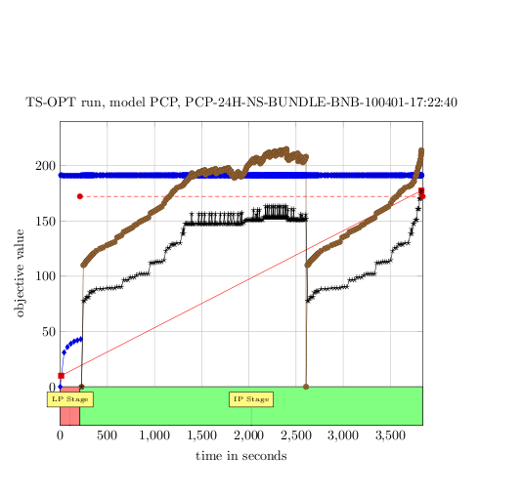
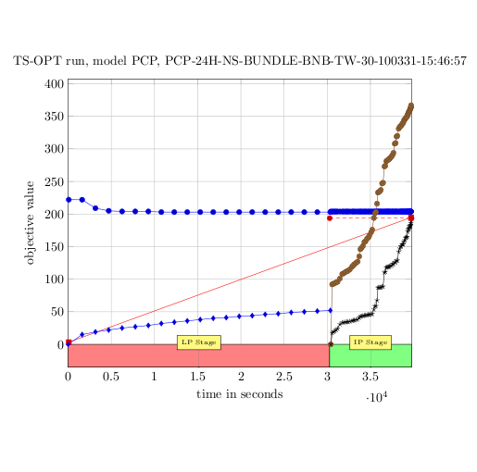
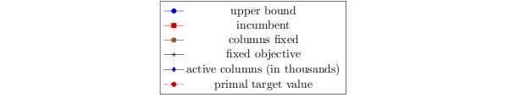
Solving the IP
  HaKaFu, req32, 1140 requests, 30 mins time windows
Mathematische Optimierung

Slide 33
Track Allocation and Train Timetabling
Article | Stations | Tracks | Trains | Modell/Approach
Szpigel [1973] | 6 | 5 | 10 | Packing/Enumeration
Brännlund et al. [1998] | 17 | 16 | 26 | Packing/ Lagrange, BAB
Caprara et al. [2002] | 74 (17) | 73 (16) | 54 (221) | Packing/ Lagrange, BAB
B. & Schlechte [2007] | 37 | 120 | 570 | Config/PAB
Caprara et al. [2007] | 102 (16) | 103 (17) | 16 (221) | Packing/PAB
Fischer et al. [2008] | 656 (104) | 1210 (193) | 117 (251) | Packing/Bundle, IP Rounding
Lusby et al. [2008] | ??? | 524 | 66 (31) | Packing/BAP
B. & Schlechte [2010] | 37 | 120 | >1.000 | Config/Rapid Branching
  BAB: Branch-and-Bound
  PAB: Price-and-Branch
  BAP: Branch-and-Price
Mathematische Optimierung

Slide 34
Discretization and Scheduling

Slide 35
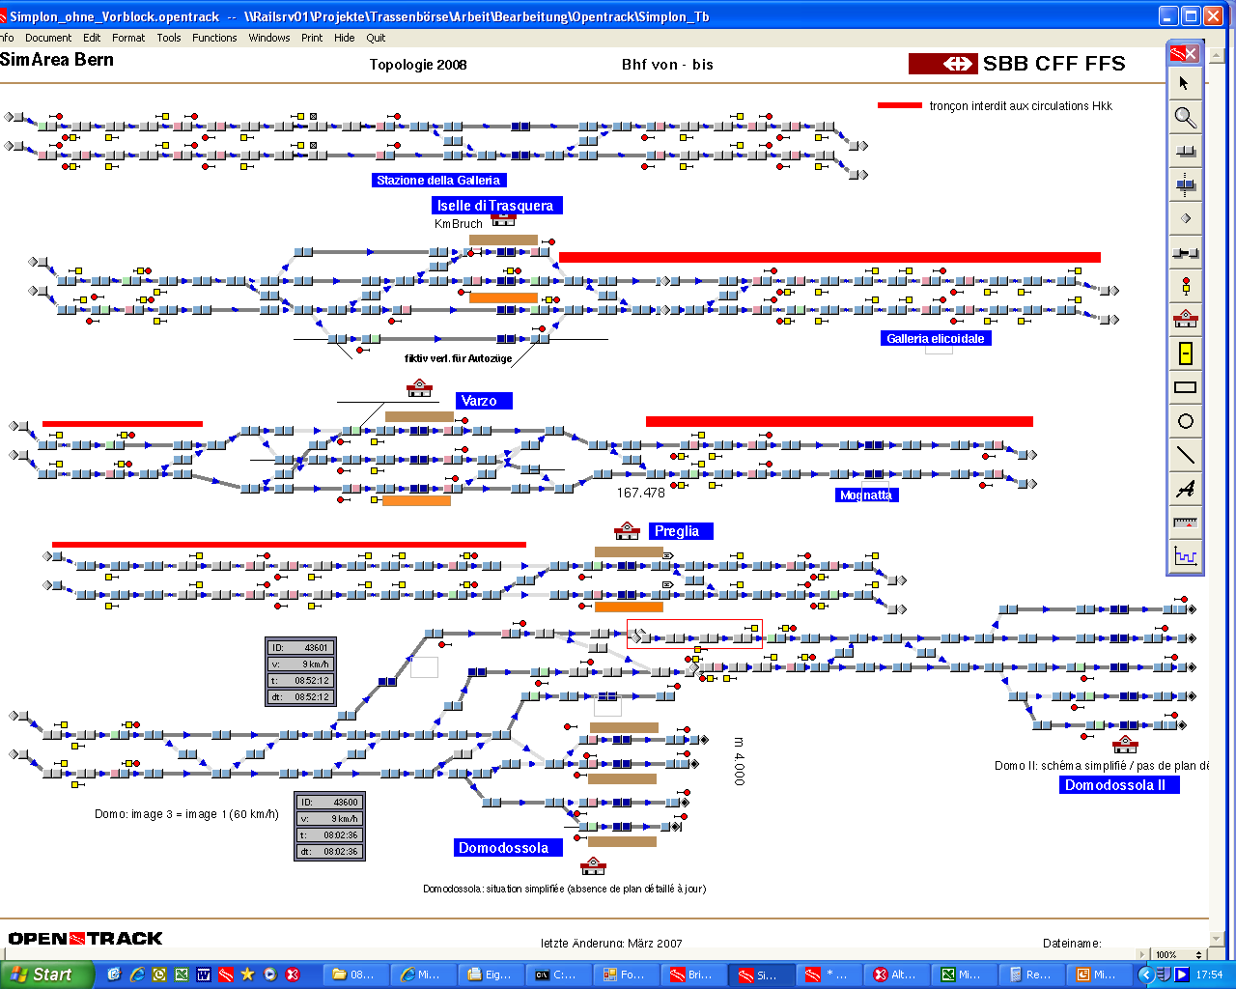
Railway Infrastructure Modeling
  Detailed railway infrastucture data given by simulation programs (Open Track)
  Signals
  Switches
  Tracks (with max. speed, acceleration, gradient)
  Stations and Platforms
Mathematische Optimierung

Slide 36
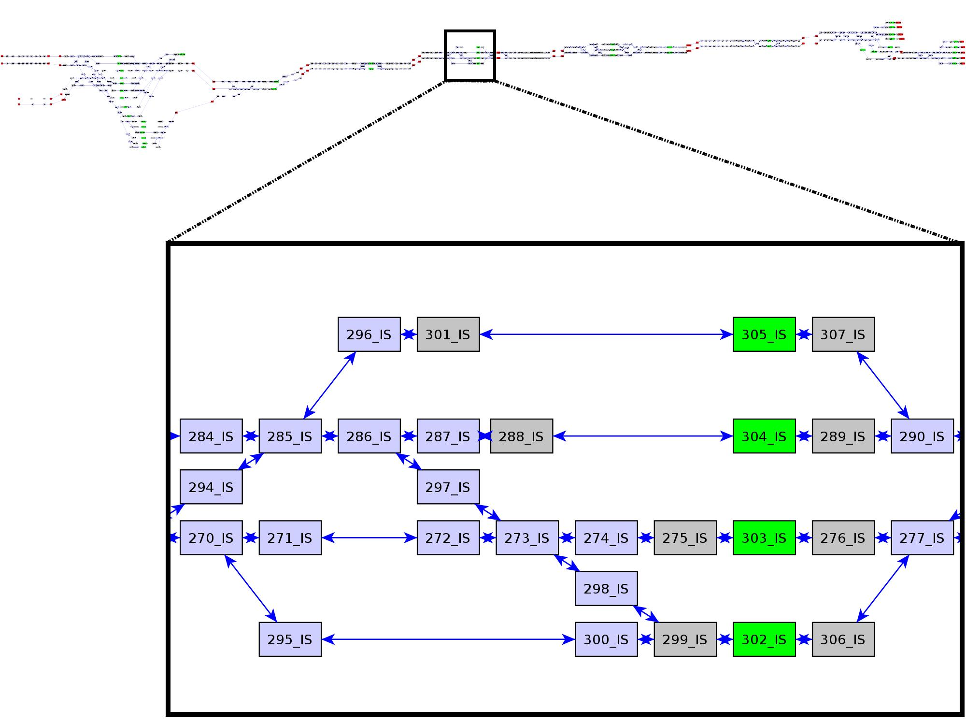
Microscopic Model
  Simplon micrograph: 1154 nodes and 1831 arcs, 223 signals etc.
Mathematische Optimierung
Notes:
36

Slide 37
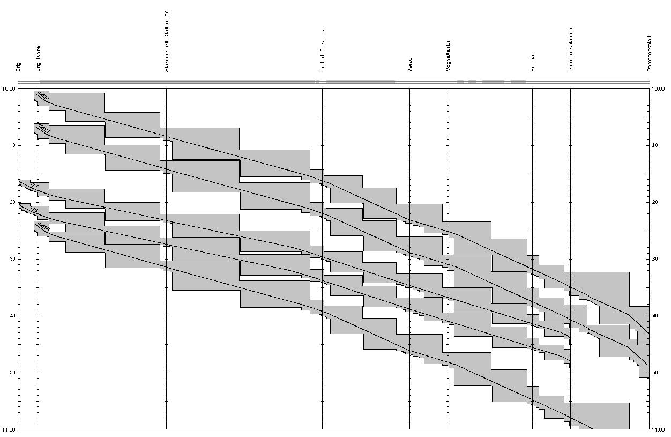
Headways
  Simulation tools provide exact running and blocking times
  Basis for calculation of minimal headway times
Mathematische Optimierung

Slide 38
Macroscopic Network Generation
  Simulation of all possible routes with appropiate train types
DOFM
BR
BRTU
SGAA
IS_A
IS
VAR
MOGN
PRE
DOBI_A
DO
BRRB
38
Chosen TrainTypes
R
GV SIM
EC
GV Auto Brig-Iselle
GV ROLA
GV MTO
Mathematische Optimierung

Slide 39
Interaction of Train Routes
  Generation of artifical nodes – „pseudo“ stations
  No interactions between train routes
IS
  Macro network definition is based on set of train routes
Mathematische Optimierung

Slide 40
Interaction of Train Routes
  Generation of artifical nodes – „pseudo“ stations
  Diverging of train routes
IS_P
IS
  The same holds for converging routes
Mathematische Optimierung

Slide 41
Interaction of Train Routes
  Generation of artifical nodes – pseudo stations
  crossing of train routes
IS_P1
IS
IS_P2
  Two pseudo stations were generated
Mathematische Optimierung

Slide 42
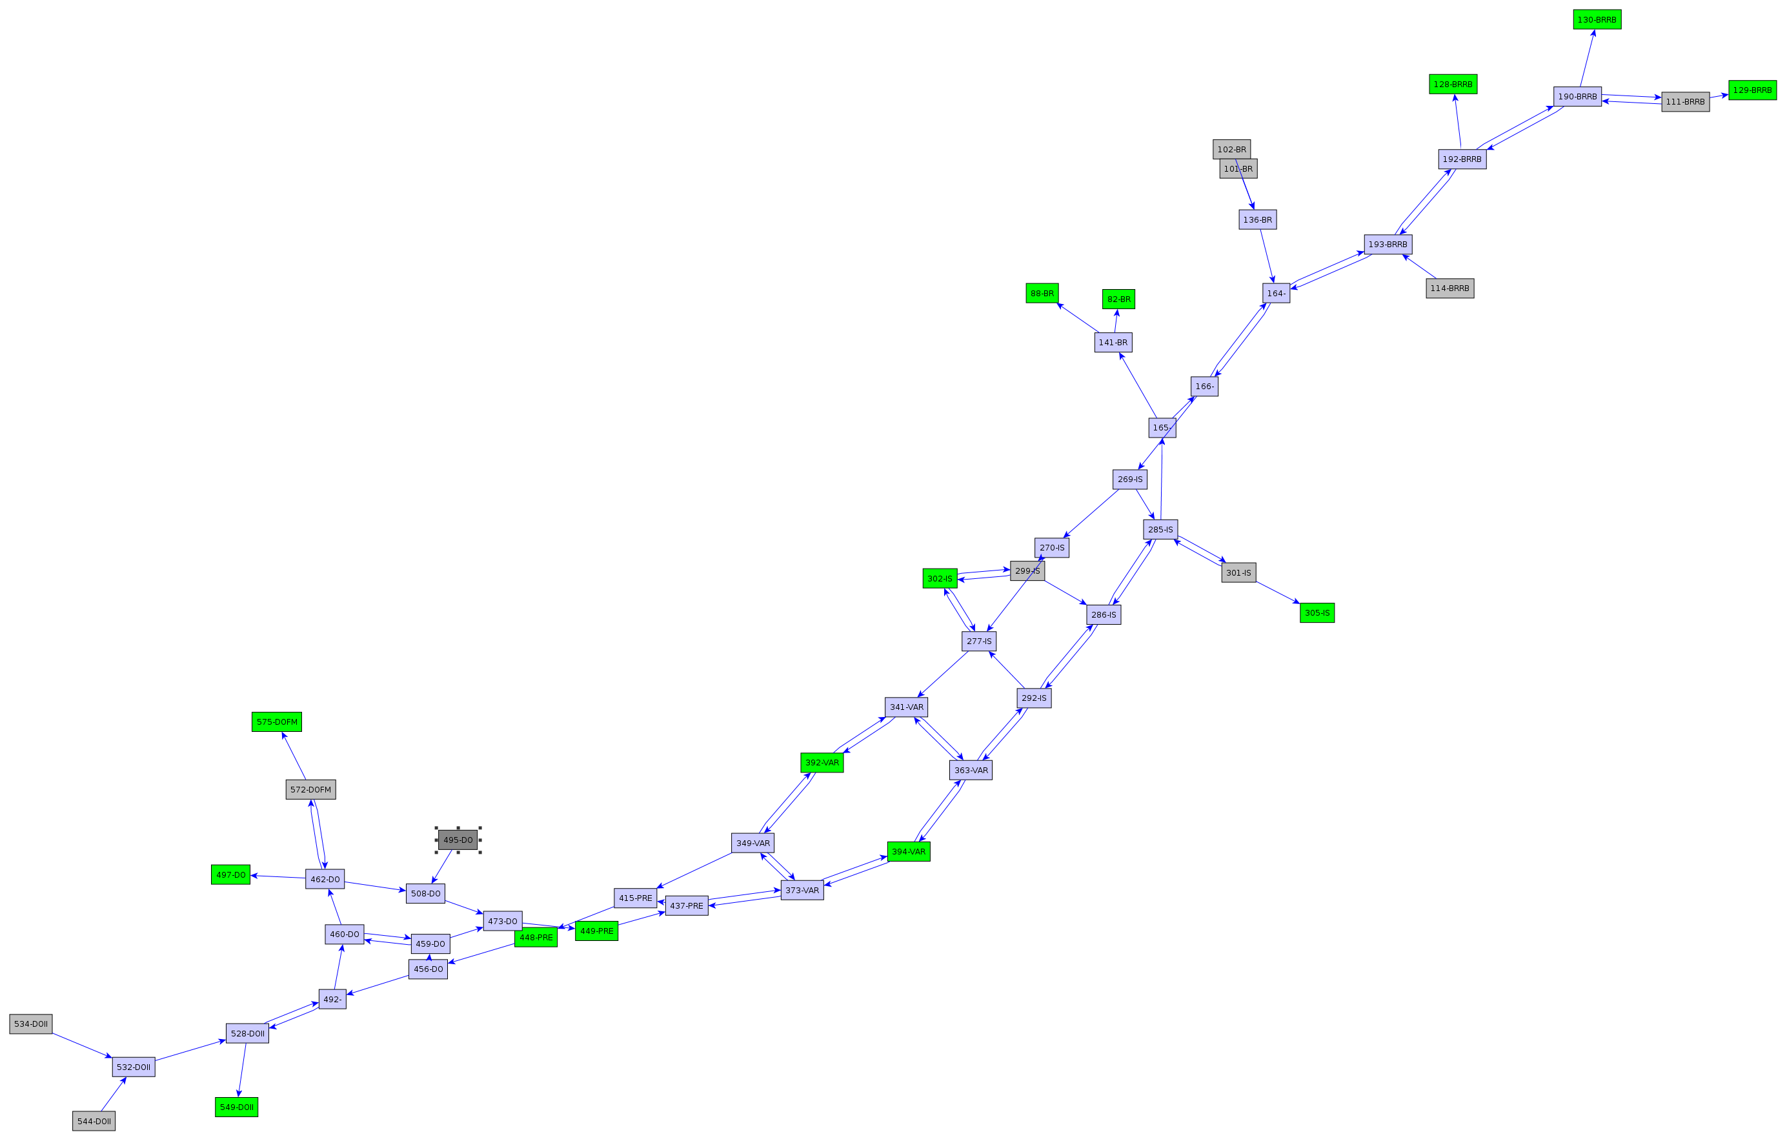
Reduced Macrograph
(53 nodes and 87 track arcs for 28 train routes)
Mathematische Optimierung
Notes:
42

Slide 43
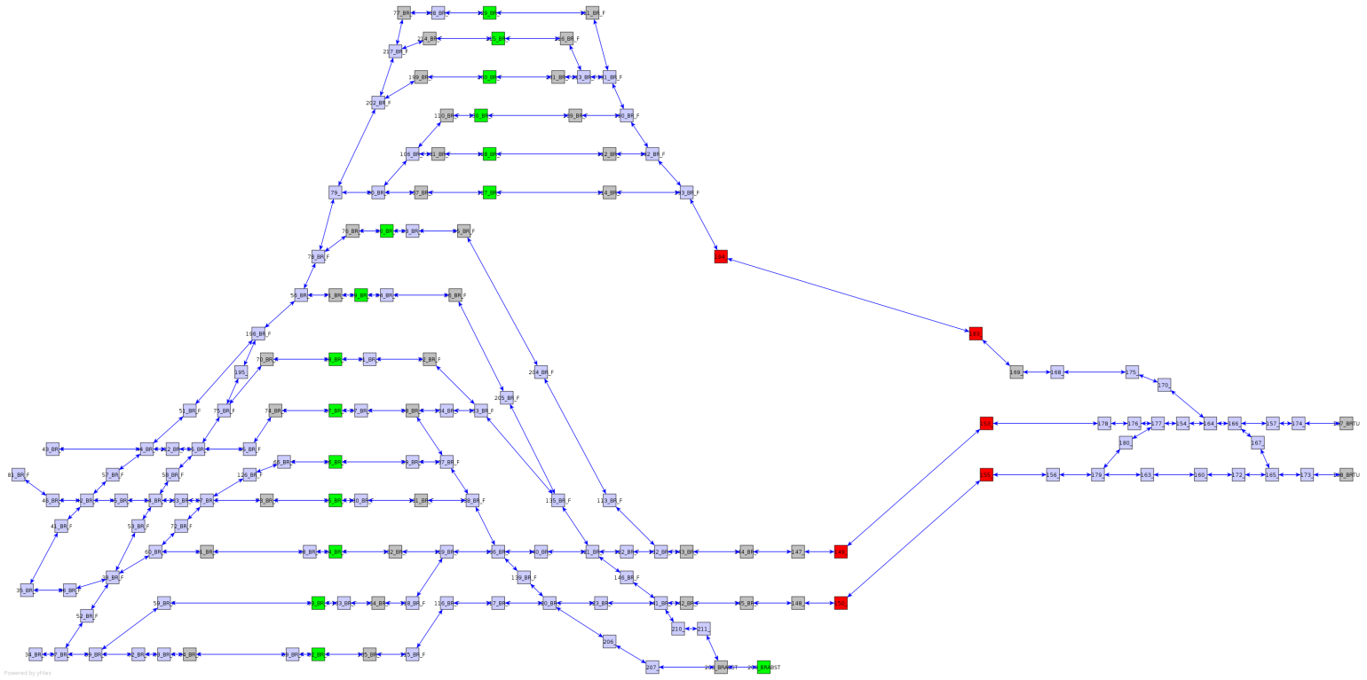
Station Aggregation
  Frequently many macroscopic station nodes are in the area of big stations
  Further aggregation is needed
EC | 2
R | 4
GV Auto | 2
GV Rola | 2
GV SIM | 4
GV MTO | 6
k =
k
k
Mathematische Optimierung
Notes:
43

Slide 44
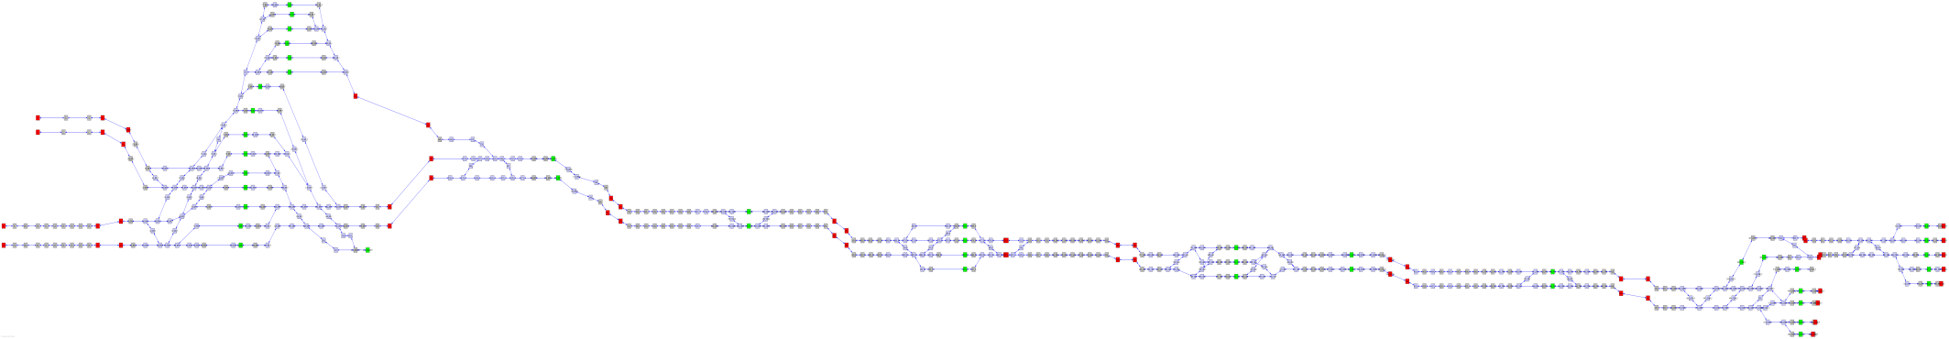
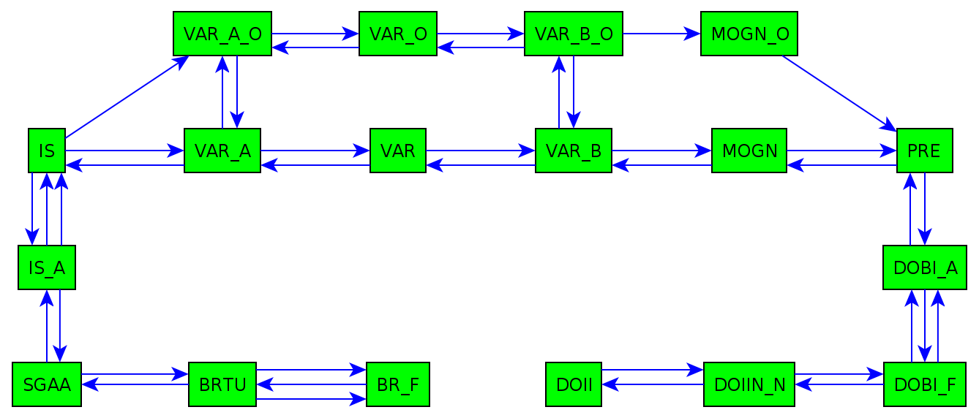
Micro-Macro Transformation
  Planned times in macro network are possible in micro network
  Valid headways lead to valid block occupations (no conflicts)
  ⇒ feasible macro timetable can be transformed to feasible micro timetable
Mathematische Optimierung

Slide 45

Micro-Macro-Transformation: Simplon Case
Micro
12 stations
1154 OpenTrack nodes
1831 OpenTrack edges
223 signals
8 track junctions
100 switches
6 train types
28 “routes“
230 ”block segments“
Macro
18 macro nodes
40 tracks
6 Train types
Mathematische Optimierung

Slide 46
Time Discretization
  Cumulative Rounding Procedure
  Compute macroscopic running time with specific rounding procedure
  Consider again routes of trains (represented by standard trains)
  Example with
Station | Dep/Pass | Rounded | Buffer
A | 0 | 0 | 0
B | 11 | 12 (2) | 1
C | 20 | 24 (4) | 4
D | 29 | 30 (5) | 1
  Theorem: If micro-running time d ≥ Δ for all tracks of the current train route, the cumulative rounding error (buffer) is always in .
Mathematische Optimierung

Slide 47
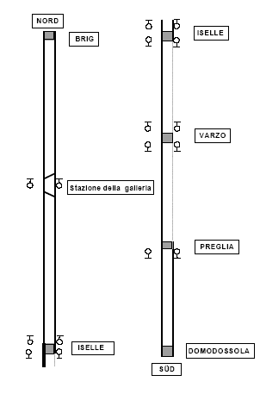
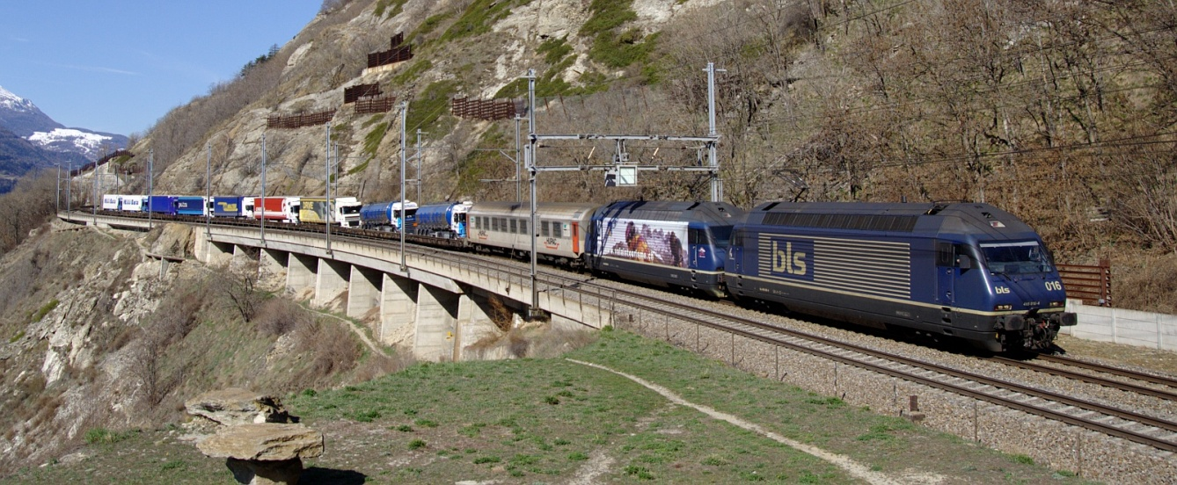
Complex Traffic at the Simplon
Source: Wikipedia
Slalom route
  ROLA trains traverse the tunnel on the “wrong“ side
Crossing of trains
  complex crossings of AUTO trains in Iselle
Conflicting routes
  complex routings in station area Domodossola and Brig
Mathematische Optimierung

Slide 48
Dense Traffic at the Simplon

Slide 49
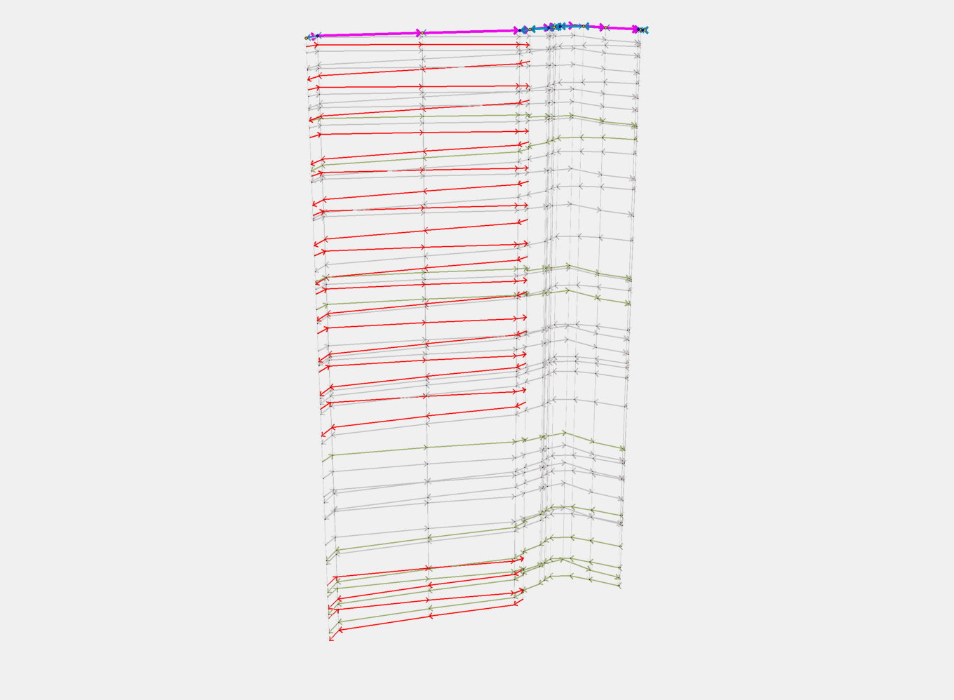
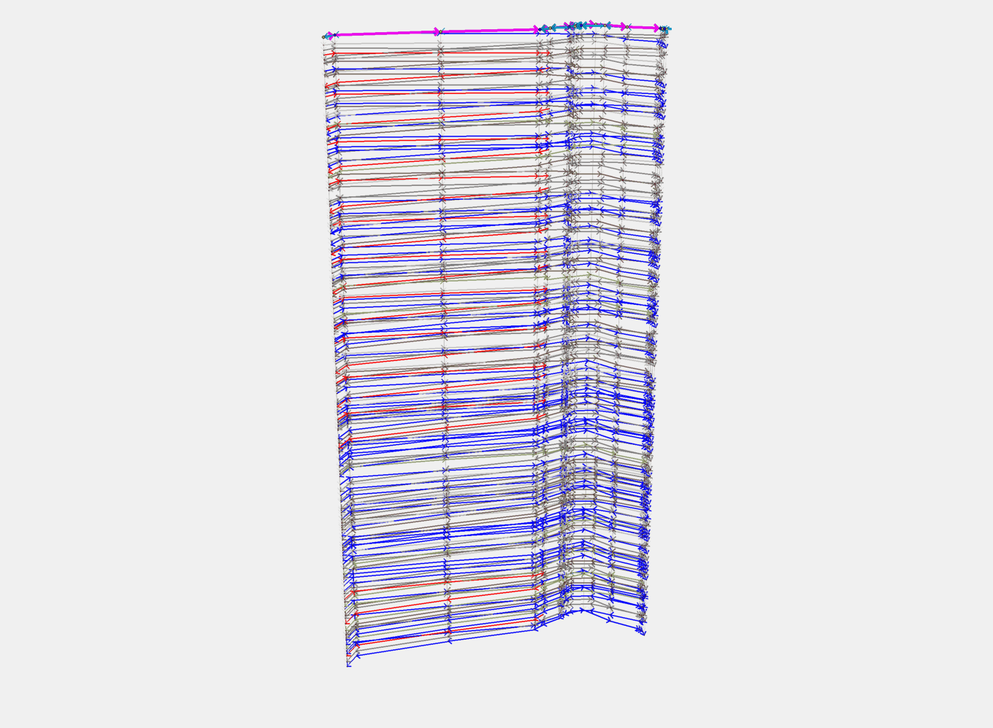
Saturation
Estimation of the maximum theoretical corridor capacity
  Network accuracy of 6s
  Consider complete routing through stations
  Saturate by additional cargo trains
  Conflict free train schedules in simulation software (1s accuracy)

Slide 50
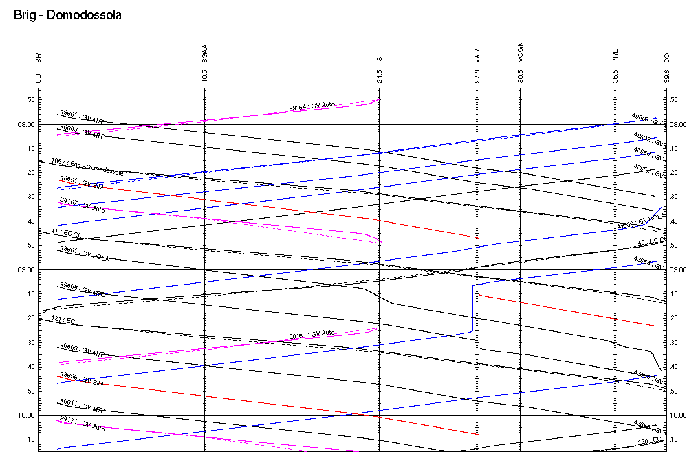
Manual Reference Plan
  Aggregation-Test (Micro->Macro->Micro)
  Microscopic feasible 4h (8:00-12:00) reference plan in Open Track
  Reproducing this plan by an Optimization run
  Reimport to Open Track

Slide 51

Theoretical Capacities
  180 trains for network small (without station routing and buffer times)
  196 trains for network big with precise routing through stations (without buffer times)
  175 trains for network big with precise routing through stations and buffer times

Slide 52
Retransformation to Microscopic Level (Network big)
  No delays, no early coming
  Feasible train routing and block occupation
  Timetable is valid in micro-simulation
52

Slide 53

Valid blocking time stairs
  Network big with buffer times
53

Slide 54
Time Discretization Analysis
  Network big with buffer times
Time discretization dt/s | 6 | 10 | 30 | 60
Number of trains | 196 | 187 | 166 | 146
Cols in IP | 504314 | 318303 | 114934 | 61966
Rows in IP | 222096 | 142723 | 53311 | 29523
Solution time in secs | 72774.55 | 12409.19 | 110.34 | 10.30
54

Slide 55
Hypergraph Scheduling

Slide 56

Trip Network

Slide 57

Cyclic Timetable for Standard Week
(Visualization based on JavaView)
57
Notes:
57

Slide 58

Rotation

Slide 59

Rotation

Slide 60

Rotation Schedule
(Blue: Timetable, Red: Deadheads)
(Visualization based on JavaView)

Slide 61
(Operational) Uniformity

Slide 62

Uniformity
(Blue: Uniform, …, Red: Irregular)
(Visualization based on JavaView)
62
Notes:
62

Slide 63

Uniformity
(Blue/Yellow: Uniform, …, Red: Irregular, Fat: Maintenance)
(Visualization based on JavaView)

Slide 64

Rotation Schedule

Slide 65

Uniformity

Slide 66

Uniformity

Slide 67

Modelling Uniformity Using Hyperarcs

Slide 68

Hyperassignment

Slide 69
Hyperassignment Problem
Definition: Let D=(V,A) be a directed hypergraph w. arc costs c_{a}
  H⊆A hyperassigment :⇔ δ⁺(v)∩H = δ⁻(v)∩H = 1
  Hyperassignment Problem :⇔ argmin c(H), H hyperassignment
Literature
  Cambini, Gallo, Scutellà (1992): Minimum cost flows on hypergraphs; solves only the LP relaxation
  Jeroslow, Martin, Rarding, Wang (1992): Gainfree Leontief substitution flow problems; does not hold for the hyperassignment problem
Theorem: The HAP is NP-hard (even for simple cases).

Slide 70

Further Complexity Results
Theorem: The LP/IP gap of HAP can be arbitrarity large.

Slide 71

Further Complexity Results
Theorem: The LP/IP gap of HAP can be arbitrarity large.

Slide 72

Further Complexity Results
Theorem: The LP/IP gap of HAP can be arbitrarity large.

Slide 73
Further Complexity Results
Theorem: The LP/IP gap of HAP can be arbitrarity large.
Proposition: The determinants of basis matrices of HAP can be arbitrarily large, even if all hyperarcs have head and tail size 2.
Proposition: HAP is APX-complete for hyperarc head and tail size 2 in general and for hyperarc head and tail cardinality 3 in the revelant cases.

Slide 74

Computational Results
(CPLEX 12.1.0)

Slide 75
Partitioned Hypergraph and Configurations
ICE
4711
(Mo)
ICE
4711
(Tu)
ICE
4711
(Mo)
ICE
4711
(Su)
ICE
4711
(Tu)
ICE
4711
(Mo)
ICE
4711
(Su)
ICE
4711
(Tu)
ICE
4711
(Su)

Slide 76
Extended Configuration Formulation
Theorem: There is an extended formulation of HAP with O(V⁸) variables that implies all clique constraints.

Slide 77
Stochastic
Scheduling

Slide 78

Delays
Cost of delays
  72 €/minute average cost of gate delay over 15 minutes, cf. EUROCONTROL [2004]
  840 – 1200 millions € annual costs caused by gate delays in Europe
Benefits of robust planning
  Cost savings
  Reputation
  Less operational changes
The Tail Assignment Problem – assign legs to aircraft in order to fulfill operational constraints such as preassignments, maintenance rules, airport curfews, and minimum connection times between legs, cf. Grönkvist [2005]
We consider the tail assignment problem in a research project based on real-world data from a European carrier using the NetLine system

Slide 79


Delay Propagation

Slide 80


Delay Propagation Along Rotations
EDP (bad)
EDP (good)

Slide 81
Delay Propagation
Goal: Decrease impact of delays
  Primary delays: genuine disruptions, unavoidable
  Propagated delays: consequences of aircraft routing, can be minimized
Rule-oriented planning
  Ad-hoc formulas for buffers
  These rules are costly and it is uncertain how efficient they are
  Calibrating these rules is a balancing act: supporting operational stability, while staying cost efficient
Goal-oriented planning
  Minimize occurrence of delay propagation on average

Slide 82
Stochastic Model
(similar to Rosenberger et. al. [2002])
Delay distribution
  Delays are not homogeneously spread in the network
  Stochastic model must captures properties of individual airports and legs
Structure of the stochastic model
  Gate phase, representing time spent on the ground
  Flight phase, representing time spent en-route
Phase durations are modelled by probability distribution
  G_{j} is random variable for delay of gate phase of leg j
  F_{j} is random variable for duration of flight phase of leg j

Slide 83

Robust Tail Assignment Problem
Mathematical model:
  Minimize non-robustness
  Cover all legs
  Fulfill side constraints
  One rotation for each aircraft
  Integrality
  Set partitioning problem with side constraints
  Problem has to be resolved daily for period of a few days
  Solved by Netline/Ops Tail xOPT (state-of-the-art column generation solver by Lufthansa Systems)
Notes:
R_k contains all preassignments….
side constraints: maintenance….
Rotations for individual aircraft….
D_r is difference between normal and our tail ASS

Slide 84
Column Generation
Compute
prices
Compute
rotations
Solve Tail Assignment Problem (IP)
Solve Tail
Assignment
Problem (LP)
Start
No
All fixed?
Yes
Stop
No
Conflict?
Backtrack?
Yes
No
Yes
Fix
rotations
Stop?
Notes:
Tail is solved by col gen.
This is standard

Slide 85
Column Generation
Compute
prices
Compute
robust
rotations
Solve Tail Assignment Problem (IP)
Solve Tail
Assignment
Problem (LP)
Start
No
All fixed?
Yes
Stop
No
Conflict?
Backtrack?
Yes
No
Yes
Fix
rotations
Stop?

Slide 86
Pricing Robust Rotations
  Robustness measure: total probability of delay propagation (PDP)
  Resource constraint shortest path problem
  where is random variable of delay propagated to leg i in rotation r and are dual variables corresponding to cover, aircraft, and side constraints
To solve this problem one must compute along rotations
Notes:
I have to say that we compute convolution numerically, otherwise Different approaches does not make sense on this slide!

Slide 87




Computing PD_{i} Along a Rotation
Delay distribution H_{j} of leg j
  H_{j} = G_{j} + F_{j}
Delay propagation from leg j to leg k via buffer b_{jk}
  PD_{k} = max( H_{j} - b_{jk} , 0)
Delay distribution H_{k} of next leg k
  H_{k} = PD_{k} + G_{k} + F_{k}
and so on…
convolution
convolution
convolution

Slide 88


Convolution
Convolution
  H = F + G and f, g and h are their probability density functions
Numerical convolution based on discretization
where are stepwise constant approximations of functions f, g
Alternative approaches
  Analytical convolution, cf. Fuhr [2007]

Slide 89
Path Search
Flight 1
Flight 2
Flight 4
Flight 5
Flight 3
Flight 6
Flight 7

Slide 90

Path Search
Flight 1
Flight 2
Flight 4
Flight 5
Flight 3
Flight 6
Flight 7

Slide 91
Path Search
Flight 1
Flight 2
Flight 4
Flight 5
Flight 3
Flight 6
Flight 7

Slide 92
Path Search
Flight 1
Flight 2
Flight 4
Flight 5
Flight 3
Flight 6
Flight 7

Slide 93

Path Search
Flight 1
Flight 2
Flight 4
Flight 5
Flight 3
Flight 6
Flight 7

Slide 94

Path Search
Flight 1
Flight 2
Flight 4
Flight 5
Flight 3
Flight 6
Flight 7

Slide 95
Path Search
Flight 1
Flight 2
Flight 4
Flight 5
Flight 3
Flight 6
Flight 7

Slide 96
Accuracy vs. Speed
Instance SC1: reference solution
  100 legs, 16 aircraft, no preassignments, no maintenace
  Optimizer produces the same solution for each step size
  CPU time differs only in computation of the convolutions
  PDP values differ because of approximation error
  * Comparison with average of 100 000 iterations
 | step size [min] | CPU [s] | PDP | error [%]
SC1 | 0.1 | 15.4 | 25.0586 | 0.11
SC1 | 0.5 | 1.0 | 25.0672 | 0.15
SC1 | 1 | 0.5 | 25.0917 | 0.25
SC1 | 2 | 0.4 | 25.2227 | 0.77
SC1 | 3 | 0.4 | 25.4775 | 1.79
SC1 | 4 | 0.3 | 25.7667 | 2.94
Simulation* |  |  | 25.0303

Slide 97
Accuracy vs. Speed
Instance SC1: optimized solution
  Different discretization step sizes may produce different solutions
  CPU time and PDP are not straightforward to compare
  *Value is average of 10 000 iterations
 | step size [min] | PDP optimized | CPU [s] | PDP simulated*
SC1 | 0.1 | 19.7268 | 4450 | 19.7469
SC1 | 0.5 | 19.7362 | 231 | 19.7382
SC1 | 1 | 19.7450 | 70 | 19.7239
SC1 | 2 | 19.8693 | 45 | 19.7313
SC1 | 3 | 20.0651 | 29 | 19.7239
SC1 | 4 | 20.3353 | 31 | 19.7562

Slide 98
Test Instances
Analyzed data
  approx. 350000 flights / 300 – 650 flights per day
  28 months, 4 subfleets
  European airline with hub-and-spoke network
Test instances
  We optimize single day instances of one subfleet
  Data for 4 months, no maintenance rules and preassignments
 |  | min |  |  | max |  |  | avg
 | #days | Legs | aircraft | flight time [min] | legs | aircraft | flight time [min] | legs | aircraft | flight time [min]
January | 26 | 44 | 12 | 3840 | 105 | 17 | 8830 | 88 | 15 | 7447
February | 22 | 94 | 15 | 8295 | 118 | 17 | 10065 | 109 | 16 | 9339
March | 21 | 94 | 15 | 7900 | 121 | 17 | 10390 | 110 | 16,3 | 9483
April | 27 | 93 | 15 | 7080 | 118 | 18 | 9750 | 103 | 16 | 8648

Slide 99


Gate Phase
Probability of delay
  Depends on day time and departure airport
Distribution of delay
  Independent of daytime and departure airport
probability of departure delay during the day on various airports
distribution of the length of gate primary delays on various airports
Gate phase
  gate delay distribution G_{j} of flight j
where Ln() is probability density function of Log-normal distribution with Power-law distributed tail and , t(j) is departure time of flight j and a(j) is departure airport of flight j

Slide 100


Flight Phase
Distribution of deviation from scheduled duration
  Depends on scheduled leg duration
Flight phase
  flight delay distribution F_{j} of flight j
where Llg() is probability density function
of Log-logistic distribution and l_{j} is scheduled flight
duration of leg j
Histogram of the flight duration and its representation by random variable. left: scheduled flight duration 80 minutes, right: scheduled flight duration 45 minutes
Notes:
Tell that they try to fit scheduled flight duration to actual, therefore this agretation is ok.

Slide 101



Model Verification
Parameters of the model:
  for every airport and day hour
  for every flight length
  Parameters are estimated by automatic scripts in R and quality is proofed by Chi-Square test.
Model applied to South American airline data
Validation of various assumptions of the model
  Stability of parameters over time, …
Notes:
Explain pictures and say som other verifications you have done

Slide 102
Gain of the Method
 |  | ORC |  |  | PDP |  |  | Savings
 | #days | PDP | EAD [min] | CPU [s] | PDP | EAD [min] | CPU [s] | PDP | EAD [min]
January | 26 | 414,51 | 28488 | 28 | 395,46 | 28085 | 66 | 19,05 | 403
February | 22 | 540,48 | 31870 | 31 | 530,42 | 31652 | 89 | 10,06 | 218
March | 21 | 516,69 | 30363 | 31 | 507,91 | 30174 | 75 | 8,78 | 189
April | 27 | 465,48 | 34453 | 42 | 449,16 | 34159 | 71 | 16,51 | 294
Robust Tail Assignment
102
ORC
  Standard KPI method
  Bonus for ground buffer minutes
  Threshold value for maximal ground buffer time (15 minutes)
PDP
  Total probability of delay propagation
EAD – expected arrival delay
Notes:
Vysvetli savings a pokracuj QQplotom

Slide 103
Gain in Detail
ORC vs. PDP on a single disruption scenario
  ORC outperforms PDP only in 21% of cases
  PDP saves on average 29 minutes of arrival delay
  For more disrupted days, PDP saves on average 62 minutes of arrival delay
Estimation of monetary savings by the cost model developed based on EUROCONTROL [2004]
Lufthansa Systems estimates annual saving of the method in the tail assignment to 300,000 € for short haul carrier with 30 aircraft
Application in other planning stages may increase the benefit

Slide 104
Planning in Public Transport
(Product, Project, Planned)
Cost Recovery
Fares
Construction Costs
Network Topology
Velocities
Lines
Service Level
Frequencies
Connections
Timetable
Sensitivity
Rotations
Relief Points
Duties
Duty Mix
Rostering
Fairness
Crew Assignment
Disruptions
Operations Control
IS-OPT
VS-OPT2
B15
multidepartmental
Departments
multidepotwise
Depots
multiple line groups
Line Groups
multiple lines
Lines
multiple rotations
Rotations
APD
DS-OPT
VS-OPT
BS-OPT
AN-OPT/B5
B1
B3
B1

Slide 105

Visit ISMP 2012!

Slide 106

Thank your for your attention
PD Dr. habil. Ralf Borndörfer
Zuse-Institute Berlin
Takustr. 7
14195 Berlin-Dahlem
Fon (+49 30) 84185-243
Fax (+49 30) 84185-269
borndoerfer@zib.de
www.zib.de/borndoerfer

