Slide 1
Fast Algorithms for Submodular Optimization
Yossi Azar Tel Aviv University
Joint work with Iftah Gamzu and Ran Roth

Slide 2
Preliminaries:
Submodularity

Slide 3
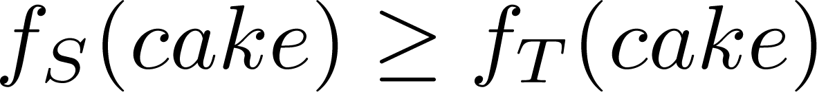
Submodular functions
Marginal value:
T =
,
,
S =
,

Slide 4
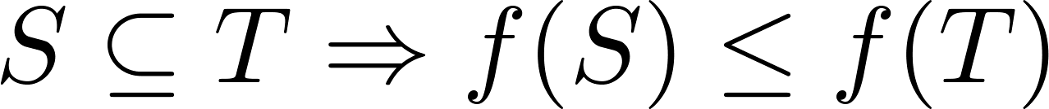
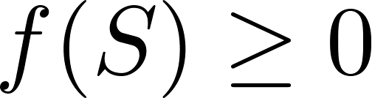
Set function properties
Monotone
Non-negative
Submodular
  a

Slide 5
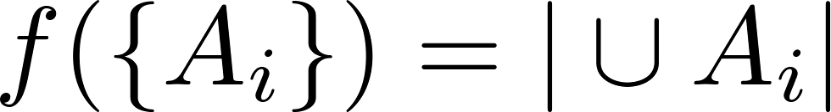
Examples
A₂
T
x
A₁
f_{S}(x)=0 ≥ f_{T}(x)=-1
S
A₃
Coverage Function
Graph Cut
Problem: General submodular function requires exponential description
We assume a query oracle model

Slide 6
Part I:
Submodular
Ranking

Slide 7
The ranking problem
Input:
  m items [m] = {1,…,m}
  n monotone set function f^{i}: 2^{[m]} → R₊
Goal:
  order items to minimize average (sum) cover time of functions
S ⊆ T ➔ f(S) ≤ f(T)
A permutation π:[m]→[m]
π(1) item in 1st place
π(2) item in 2nd place…
A minimal index k s.t.
f ({ π(1),…,π(k) }) ≥ 1
➔ goal is to min ∑_{i} k_{i}
Notes:
The threshold of 1 is arbitrary (one can normalize)

Slide 8








Motivation: web search ranking
…
f¹
f²
f³
…
amount of relevant info of search item 2 to user f³
the goal is to minimize the average effort of users

Slide 9

Motivation continued
Info overlap?
  f({1}) = 0.9
  f({2}) = 0.7
  f({1,2}) may be 0.94
  rather than 1.6
Info overlap captured by submodualrity
f
S ⊆ T ➔ f(S U {j}) – f(S) ≥ f(T U {j}) – f(T)
f({2}) – f(∅) ≥ f({1,2}) – f({1})
Notes:
In some cases there is info overlap so additive functions are not what we really need

Slide 10
The functions
Monotone set function f: 2^{[m]} → R₊ and…
Additive setting:
  item j has associated value v_{j}
Submodular setting:
  decreasing marginal values
  access using value oracle
f(S) =∑_{j∈S} v_{j}
S ⊆ T ➔ f(S U {j}) – f(S) ≥ f(T U {j}) – f(T)
Notes:
When adding an item to a smaller set than its marginal contribution is greater
Additive is subclass of submodualr

Slide 11
Additive case example
item
function
1 2 3 4
f¹
f²
f³
f⁴
The associated values of f²
for order = (1,2,3,4) the cost is 3+2+2+3 = 10
for order = (4,2,1,3)
the cost is 2+2+3+2 = 9
goal: order items to minimize sum of functions cover times
Notes:
This case reduces to the question of how to permute columns in a matrix so that the cover time of the rows (prefix sum of value in that row up to that index) is minimal
Note that the submodular case doesn’t have such neat combinatorial representation

Slide 12
Previous work
Only on special cases of additive setting:
  Multiple intents ranking:
    “restricted assignment”: entries row i are {0,w_{i}}
    logarithmic-approx [A+GamzuYin ‘09]
    constant-approx [BansalGuptaKrishnaswamy ‘10]
items
functions

Slide 13
Previous work
Only on special cases of additive setting:
  Min-sum set cover:
    all entries are {0,1}
    4-approx [FeigeLovaszTetali ’04]
    best unless P=NP
  Min latency set cover:
    sum of row entries is 1
    2-approx (scheduling reduction)
    best assuming UGC [BansalKhot ’09]
items
functions

Slide 14
Our results
Additive setting:
  a constant-approx algorithm
  based on randomized LP-rounding
  extends techniques of [BGK ‘10]
Submodular setting:
  a logarithmic-approx algorithm
  an adaptive residual updates scheme
  best unless P=NP
  generalizes set cover & min-sum variant
Notes:
The adaptive residual updates scheme has similarities with multiplicative weights method
The restricted setting in which there is a single submodular function to cover already incorporates the set cover problem as a special instance

Slide 15
Warm up: greedy
Greedy algorithm:
  In each step: select an item with maximal contribution
  suppose set S already ordered
  contribution of item j to f^{i} is c = min { f^{i}(S U {j}) – f^{i}(S), 1 – f^{i}(S) }
  select item j with maximal ∑_{i} c
i
j
i
j
Notes:
We indicated that the submodular setting captures the set cover problem (and min-sum variant) so maybe a greedy algorithm would do the trick (when there is one function then it works… the main problem is when there are many functions).

Slide 16
Greedy is bad
Greedy algorithm:
  In each step: select an item with maximal contribution
items
1 2 3 … √n
greedy order = (1,3,…,√n,2) cost ≥ (n-√n)·√n = Ω(n^{3/2})
item contribution is (n-√n)·1/n
f¹
.
.
.
f^{n-√n}
.
.
.
f^{n}
functions
OPT order = (1,2,…,√n)
cost = (n-√n)·2 + (3 +…+ √n)
= O(n)

Slide 17
Residual updates scheme
Adaptive scheme:
  In each step: select an item with maximal contribution with respect to functions residual cover
  suppose set S already ordered
  contribution of item j to f^{i} is c = min { f^{i}(S U {j}) – f^{i}(S), 1 – f^{i}(S) }
  cover weight of f^{i} is w_{i} = 1 / (1 – f^{i}(S))
  select item j with maximal ∑_{i} c w_{i}
i
j
i
j
Notes:
We would like to take into account the residual cover of functions… we would like to give more influence to values corresponding to functions whose cover draw near their thresholds
One should think about the w_i’s has weights (at the beginning all of them is just 1)

Slide 18
Scheme continued
Adaptive scheme:
  In each step: select an item with maximal contribution with respect to functions residual cover
1 2 3 … √n
w₁ = n
.
.
.
w_{n-√n} = n
.
.
.
w_{n} = 1
f¹
.
.
.
f^{n-√n}
.
.
.
f^{n}
w₁ = 1
.
.
.
w_{n-√n} = 1
.
.
.
w_{n} = 1
select item j with maximal ∑_{i} c w_{i}
i
j
order = (1,2,…)
w* = 1 / (1 – (1 – 1/n)) = n
Notes:
Going back to the bad example for greedy…

Slide 19
Submodular contribution
Scheme guarantees:
  optimal O(ln(1/ε))-approx
  ε is smallest non-zero marginal value ε = min {f^{i}(S U {j}) – f^{i}(S) > 0}
Hardness:
  an Ω(ln(1/ε))-inapprox assuming P≠NP via reduction from set cover

Slide 20
Summery (part I)
Contributions:
  fast deterministic combinatorial log-approx
  log-hardness
  → computational separation of log order between linear and submodular settings

Slide 21
Part II:
Submodular
Packing

Slide 22
Maximize submodular function s.t. packing constraints
Input:
  n items [n] = {1,…,n}
  m constraints Ax ≤ b A∈[0,1]^{mxn}, b∈[1,∞)^{m}
  submodular function f: 2^{[n]} → R₊
Goal:
  find S that maximizes f(S) under Ax_{S} ≤ b
  x_{S}∈{0,1}^{n} is characteristic vector of S

Slide 23
The linear case
Input:
  n items [n] = {1,…,n}
  m constraints Ax ≤ b A∈[0,1]^{mxn}, b∈[1,∞)^{m}
  linear function f = cx, where c∈R₊
Goal: (integer packing LP)
  find S that maximizes cx_{S} under Ax_{S} ≤ b
  x_{S}∈{0,1}^{n} is characteristic vector of S
^{n}

Slide 24
Solving the linear case
LP approach:
  solve the LP (fractional) relaxation
  apply randomized rounding
Hybrid approach:
  solve the packing LP combinatorialy
  apply randomized rounding
Combinatorial approach:
  use primal-dual based algorithms

Slide 25
Approximating the linear case
Main parameter: width W = min b_{i}
Recall: m = # of constraints
All approaches achieve…
    m^{1/W}-approx
    when w=(ln m)/ε² then (1+ε)-approx
What can be done when f is submodular?

Slide 26
The submodular case
LP approach can be replaced by…
  interior point-continuous greedy approach [CalinescuChekuriPalVondrak ’10]
  achieves m^{1/W}-approx
  when w=(ln m)/ε² then nearly e/(e-1)-approx
  both best possible
Disadvantages:
  complicated, not fast… something like O(n⁶)
  not deterministic (randomized)
  fast & deterministic & combinatorial?

Slide 27
Our results
Recall max { f(S) : Ax_{S} ≤ b & f submodular }
Fast & deterministic & combinatorial algorithm that achieves…
  m^{1/W}-approx
  If w=(ln m)/ε² then nearly e/(e-1)-approx
  Based on multiplicative updates method

Slide 28
Multiplicative updates method
In each step:
Continue while total weight is small
(maintaining feasibility)
  suppose items set S already selected
  compute row weights
  compute item cost
  select item j with minimal
  where

Slide 29
Summery (part II)
Contributions:
  fast deterministic combinatorial algorithm
  m^{1/W}-approx
  if w=(ln m)/ε² then nearly e/(e-1)-approx
  → computational separation in some cases between linear and submodular settings

Slide 30
Part III:
Submodular
MAX-SAT

Slide 31
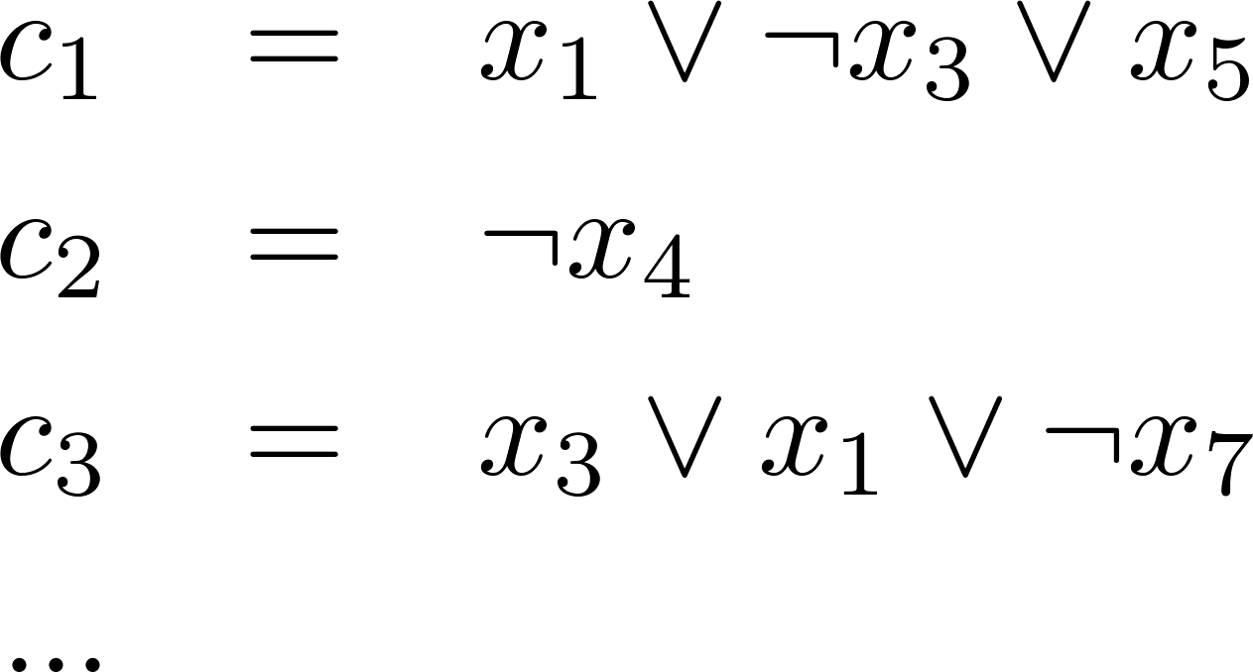
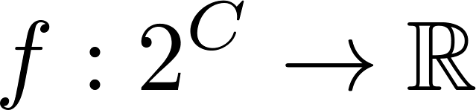
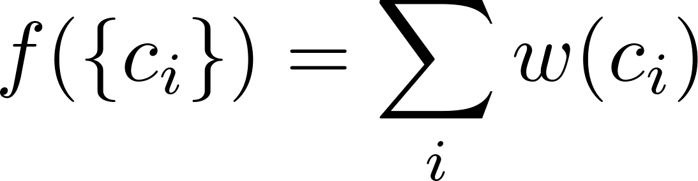
Max-SAT
L, set of literals
C, set of clauses
Weights
Goal: maximize sum of weights for satisfied clauses
Notes:
What happens if f is not monotone?

Slide 32
Submodular Max-SAT
L, set of literals
C, set of clauses
Weights
Goal: maximize sum of weights for legal subset of clauses
Notes:
What happens if f is not monotone?

Slide 33
Max-SAT Known Results
Hardness
  Unless P=NP, hard to approximate better then 0.875 [Håstad ’01]
Known approximations
  Combinatorial/Online Algorithms
    0.5 Random Assignment
    0.66 Johnson’s algorithm [Johnson ’74, CFZ’ 99]
    0.75 “Randomized Johnson” [Poloczek and Schnitger ‘11]
  Hybrid methods
    0.75 Linear Programming [Goemans Williamson ‘94]
    0.797 Hybrid approach [Avidor, Berkovitch ,Zwick ‘06]
Submodular Max-SAT?

Slide 34
Our Results
Algorithm:
  Online randomized linear time 2/3-approx algorithm
Hardness:
  2/3-inapprox for online case
  3/4-inapprox for offline case (information theoretic)
  Computational separation:
    submodular Max-SAT is harder to approximate than Max-SAT

Slide 35
Equivalence
Submodular Max-SAT
Maximize a submodular function subject to a binary partition matroid

Slide 36
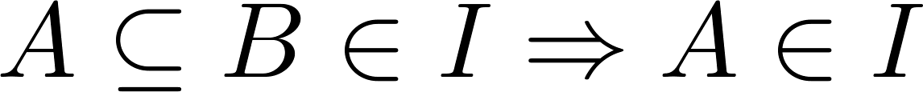
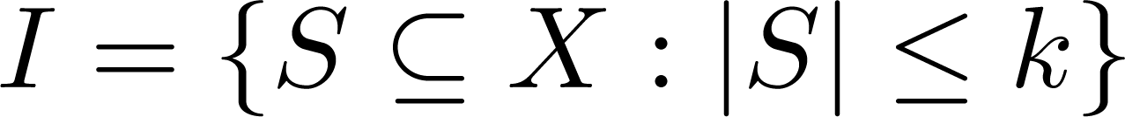
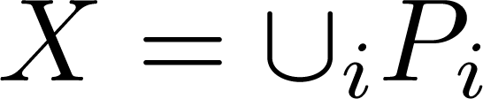
Matroid
  Items
  Family I of independent (i.e. valid) subsets
Matroid Constraint
Inheritance
Exchange
Types of matroids
  Uniform matroid
  Partition matroid
  Other (more complex) types: vector spaces, laminar, graph…

Slide 37
Binary Partition Matroid
a₁
a₂
a₃
…
a_{m}
b₁
b₂
b₃
…
b_{m}
A partition matroid where |P_{i}|=2 and k_{i}=1 for all i.

Slide 38
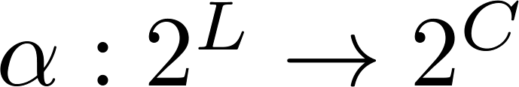
Equivalence
c₁
c₁
x₁
c₁
x₁
x₂
x₃
…
x_{m}
~x₁
~x₂
~x₃
…
~x_{m}
~x₁
c₂
x₂
c₃
~x₂
c₄
. . .
Claim: g is monotone submodular

Slide 39
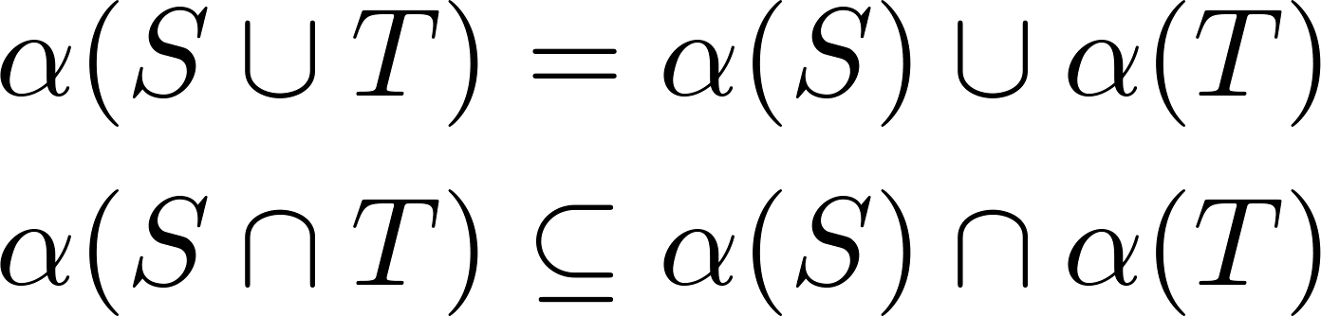
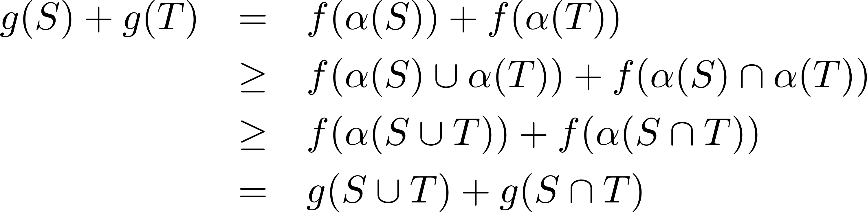
Equivalence
Observe
f submodularity
f monotonicity
Similarly prove that g is monotone

Slide 40
Equivalence Summary
2-way poly-time reduction between the problems
Reduction respects approx ratio
So now we need to solve the following problem
Maximize a submodular monotone function subject to binary partition matroid constraints.

Slide 41
Greedy Algorithm
[FisherNemhauserWolsey ’78]
Let M be any matroid on X
  Goal: maximize monotone submodular f s.t. M
Greedy algorithm:
  Grow a set S, starting from S=Φ
  At each stage
    Let a₁,…,a_{k} be elements that we can add without violating the constraint
    Add a_{i} maximizing the marginal value f_{s}(a_{i})
  Continue until elements cannot be added

Slide 42
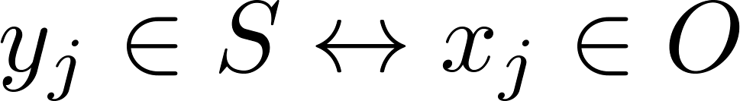
Greedy Analysis [FNW ’78]
Claim: Greedy gives a ½ approximation
Proof: O – optimal solution S={y₁,y₂,…,y_{n}} – greedy solution
Generate a 1-1 matching between O and S:
  Match elements in O∩S to themselves
  x_{j} can be added to S_{j-1} without violating the matroid
S
O
y_{n}
x_{n}
y_{n-1}
x_{n-1}
y_{n-2}
x_{n-2}
…
…
y₁
x₁

Slide 43
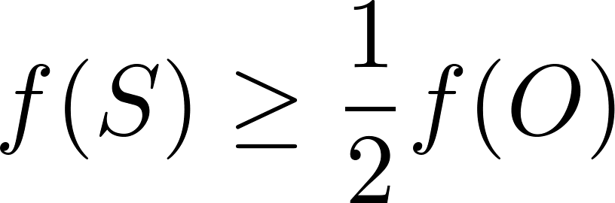
Greedy Analysis [FNW ’78]
greediness
submodularity
Summing:
submodularity
monotonicity
Question: Can greedy do better on our specific matroid?
Answer: No. Easy to construct an example where analysis is tight

Slide 44
Continous Greedy [CCPV ‘10]
A continuous version of greedy (interior point)
Sets become vectors in [0,1]^{n}
Achieves an approximation of 1-1/e ≈ 0.63
Disadvantages:
  Complicated, not linear, something like O(n⁶)
  Cannot be used in online
  Not deterministic (randomized)

Slide 45
Matroid/Submodular - Known results
Goal: Maximize a submodular monotone function
subject to matroid constraints
Any matroid:
  Greedy achieves ½ approximation [FNW ‘78]
  Continous greedy achieving 1-1/e [CCPV ‘10]
Uniform matroid:
  Greedy achieves 1-1/e approximation [FNW ’78]
  The result is tight under query oracle [NW ‘78]
  The result is tight if P≠NP [Feige ’98]
Partition matroid
  At least as hard as uniform
  Greedy achieves a tight ½ approximation
Can we improve the 1-1/e threshold for a binary partition matroid?
Can we improve the ½ approximation using combinatorial algorithm?
Notes:
FNW = Fisher, Nemhauser, Wolsey ‘78
CCPV = Calinescu, Chekuri, Pal, Vondrak
NW = Nemhauser, Wolsey ’78
Feige = Uri Feige

Slide 46
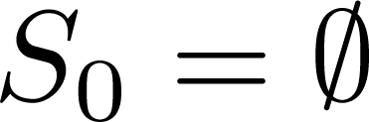




Algorithm: ProportionalSelect
Go over the partitions one by one
Start with
  Let P_{i}={a_{i}, b_{i}} be the current partition
    Select a_{i} with probability proportional to f_{S}(a_{i})
    Select b_{i} with probability proportional to f_{S}(b_{i})
    S_{i+1}=S_{i} U {selected element}
Return S=S_{m}
a₁
a₂
a₃
a₄
b₁
b₂
b₃
b₄
S

Slide 47
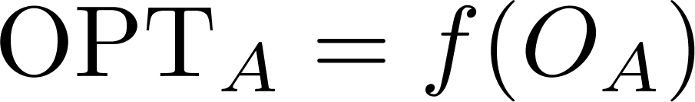
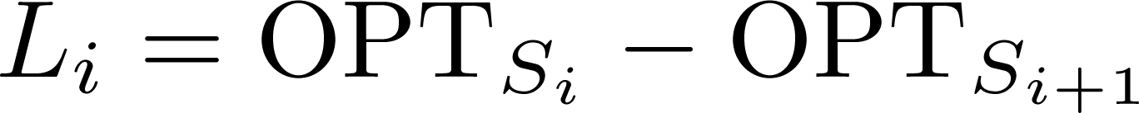
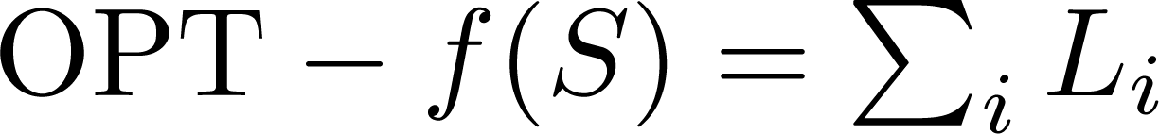
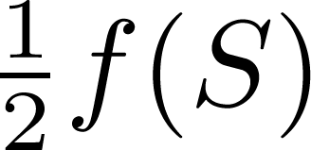
Sketch of Analysis
O_{A} the optimal solution containing A.
The loss at stage i:
Observation:
If we bound the sum of losses by
we get a 2/3 approximation.

Slide 48
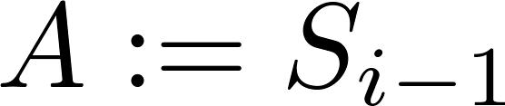
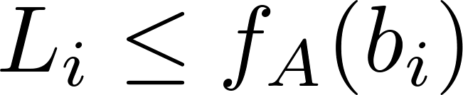
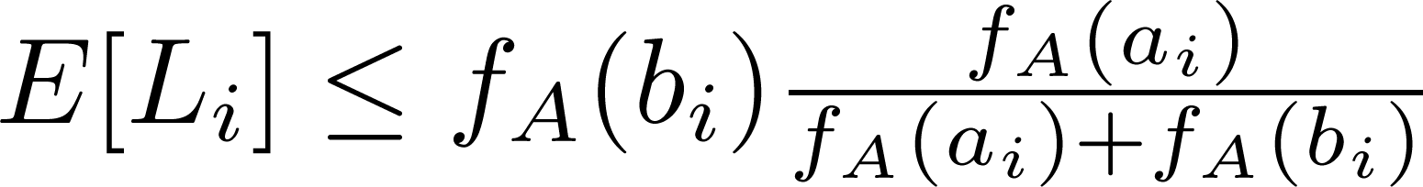
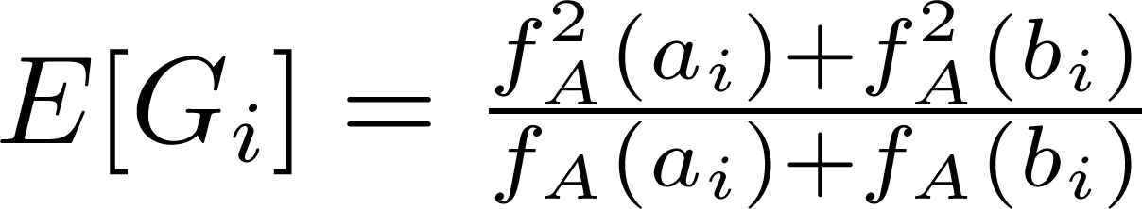
Sketch of Analysis
Stage i: we picked a_{i} instead of b_{i}
Lemma
Given the lemma
  On the other hand, the expected gain is
  Because xy ≤ ½(x² + y²) we have E[L_{i}] ≤ ½E[G_{i}]
The analysis is tight

Slide 49
Algorithm: Summary
ProportionalSelect
  Achieves a 2/3-approx, surpasses 1-1/e
  Linear time, single pass over the partitions

Slide 50
Online Max-SAT
Variables arrive in arbitrary order
A variable reports two subsets of clauses
  The clauses where it appears
  The clauses where its negation appears
Algorithm must make irrevocable choice about the variable’s truth value
Observation: ProportionalSelect works for online Max-SAT

Slide 51
Online Max-SAT Hardness
We show a hardness of 2/3
  2/3 is the best competitive ratio possible
  Holds for classical & submodular versions
By Yao’s principle
  Present a distribution of inputs
  Assume the algorithm is deterministic

Slide 52
Online Max-SAT Hardness
Consider the following example
x₁
x₁
x₁
x₁
x₁
x₁
x₁
x₁
~x₁
~x₁
~x₁
~x₁
~x₁
~x₁
~x₁
~x₁
OPT | ALG
T | T | x₁
T | F | x₂
T | Doesn’t matter | x₃
T | Doesn’t matter | x₄
15 | 12
OPT wins again!
Got lucky!
Wrong choice
x₂
x₂
x₂
x₂
~x₂
~x₂
~x₂
~x₂
Irrelevant
x₃
x₃
~x₃
~x₃
Irrelevant
x₄
~x₄

Slide 53

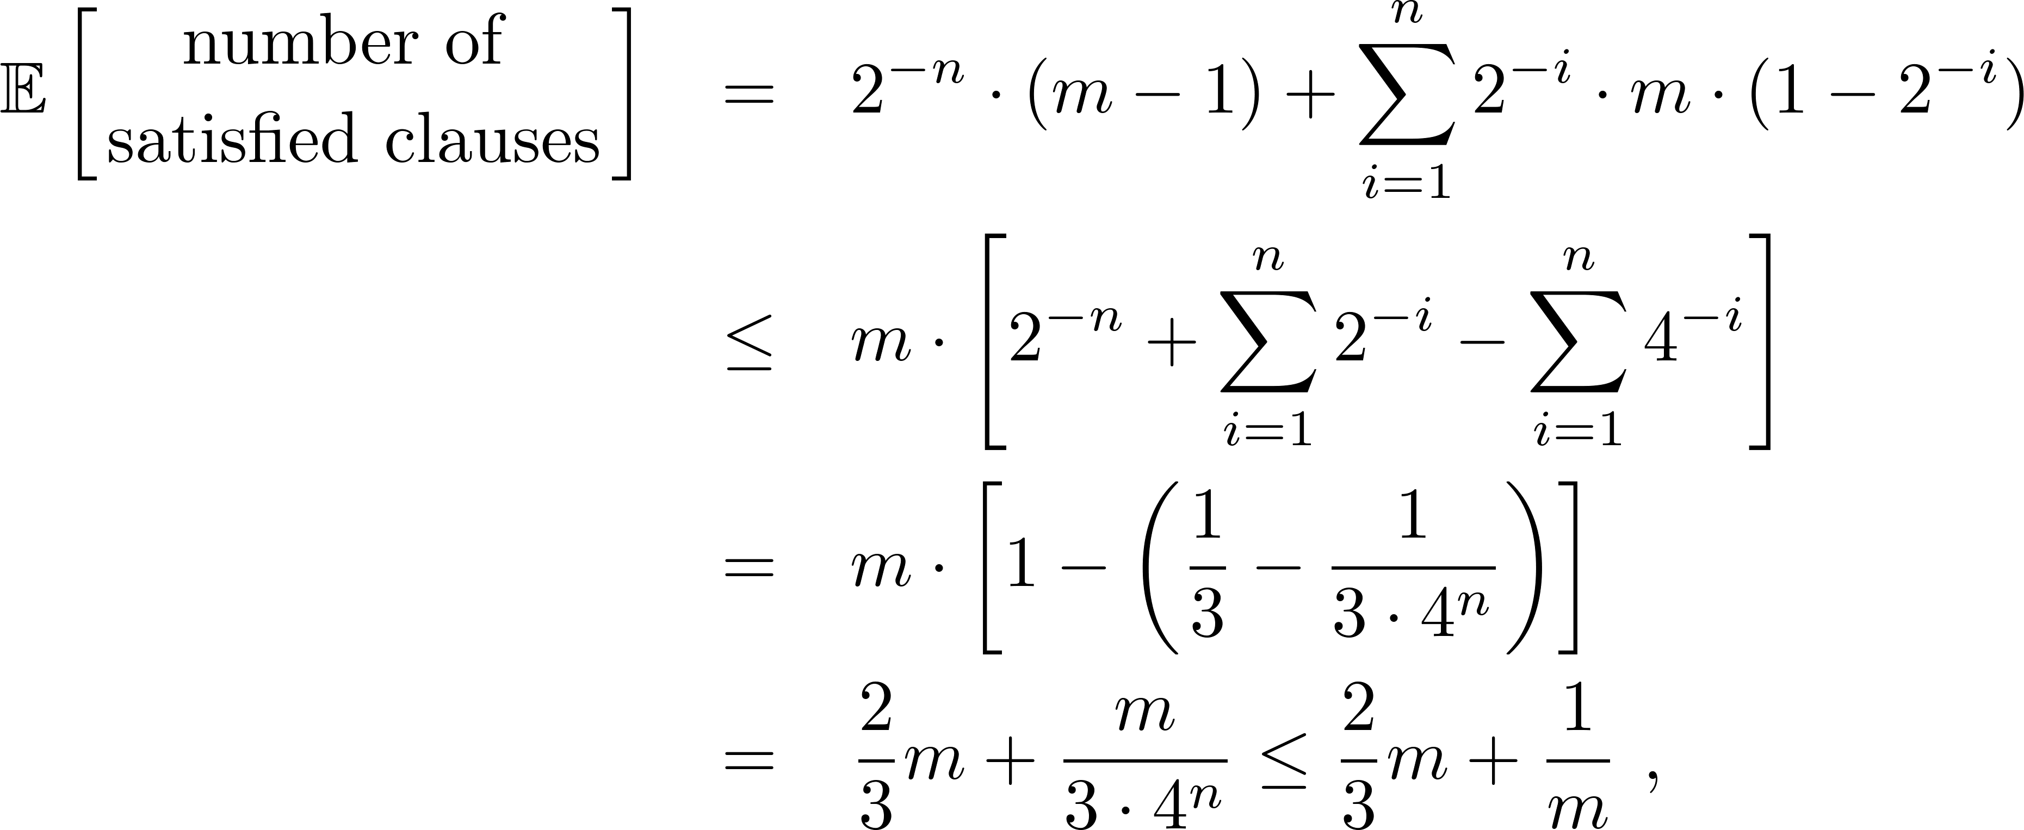
Online Max-SAT Hardness
Input distributions chooses randomly {T,F}
  At each stage a wrong choice ends the game
Algorithm sees everything symmetric at each stage
Given m clauses, choosing always right gives:

Slide 54
Online Max-SAT - Summary
ProportionalSelect gives a 2/3 approximation
Hardness proof of 2/3 for any algorithm
Tight both for classical and submodular
Other models
  Length of the clauses is known in advance [PS ’11]
  Clauses rather than variables arrive online [CGHS ’04]
Next: Hardness for the offline case
Notes:
CGHS = D. Coppersmith, D. Gamarnik, M. T. Hajiaghayi, and G. B. Sorkin. Random max sat, random max cut, and their phase transitions. Random Struct. Algorithms, 24(4):502–545, 2004.
PS = Poloczek Schnitger, SODA’11

Slide 55
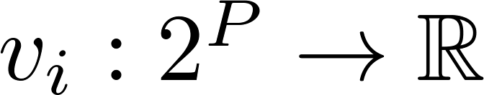
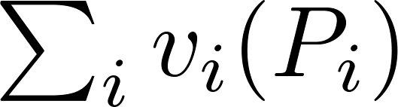
Offline Hardness - Reduction
Claim: any 3/4-approx algorithm must call the oracle of f exponential # of times
Proof: reduction to submodular welfare problem
  set P of products p₁,…,p_{m}
  k players with submodular valuation funcs
  partition the products between players: P₁,…,P_{n}
  to maximize social welfare:
Notice that k=2 is a special case of our problem
A 1-(1-1/k)^{k} – inapprox by [MSV ’08]

Slide 56


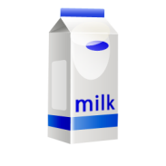
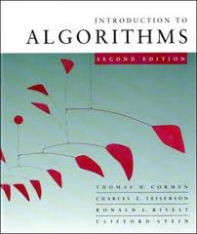
Offline Hardness - Reduction
A₁
1
1
1
1
A₂
2
2
2
2
…
f is monotone and submodular
only one player takes the item
Notes:
MSV = Mirrokni, Schapira, Vondrak

Slide 57
Summary (part III)
Submodular Max-SAT
  Fast combinatorial online algorithm achieving 2/3-approx
    Linear time, Simple to implement
  Tight for online Max-SAT
  Offline hard to approximate to within 3/4
    Submodular Max-SAT harder than Max-SAT

Slide 58
Concluding remarks:
Fast Combinatorial algorithms:
  submodular ranking (deterministic & optimal)
  submodular packing (deterministic & optimal)
  submodular MAX-SAT (online optimal)
Usually, submodularity requires…
  more complicated algorithms
  achieves worse ratio wrt. linear objective

